Slide 1
Defense Friendly DUI Update: 2024 Lister, Holt & Dennis’s Criminal Law Update October 2024
Ben sessions, Sessions & Fleischman
Ben@thesessionslawfirm.com
Notes:
OTO

Slide 2
@weinerraters
@bensessions
Notes:
OTO

Slide 3
Notes:
OTO

Slide 4
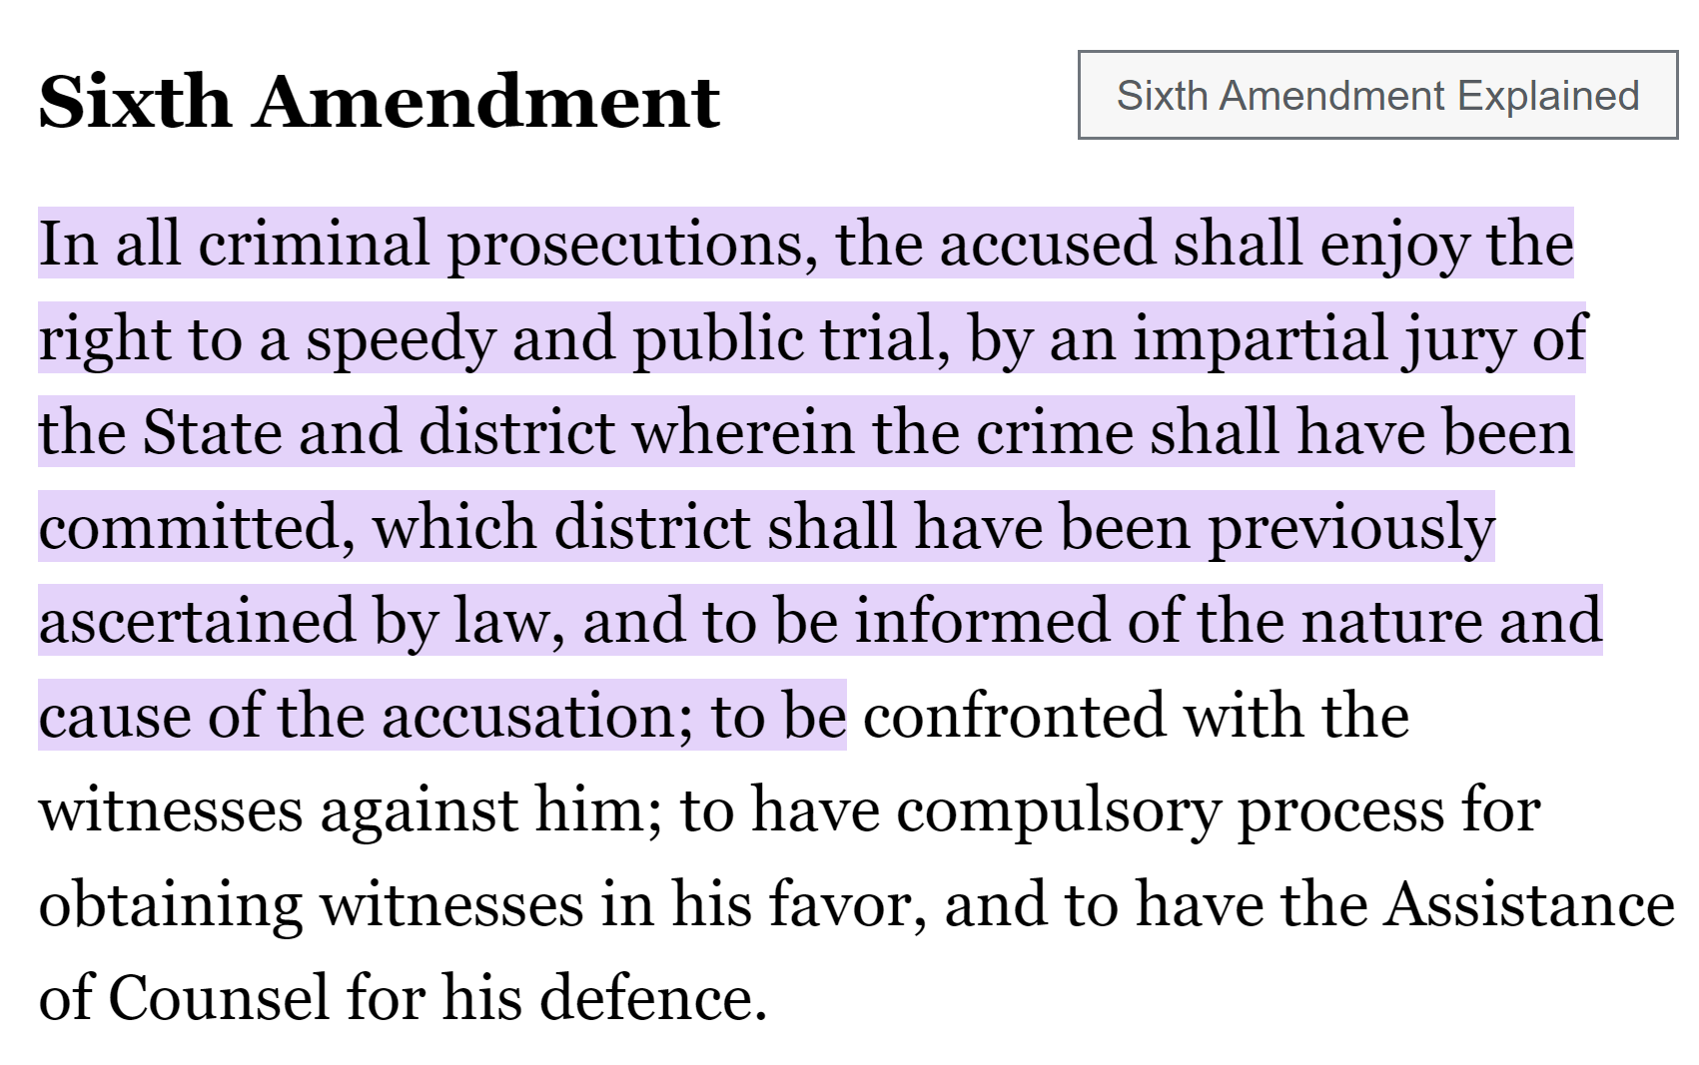

Slide 5
https://www.thesessionslawfirm.com/about-our-firm/resources/

Slide 7
OVERVIEW OF THE GOOD NEWS
Getting off on the right foot – particularization of motions
a/k/a get out of here with that junk
The greatest gift of this year - Jones
Don’t sleep on constitutional speedy motions – judges keep messing it up
My favorite issue
DAUBERT MOTIONS
SEARCH WARRANTS – don’t let them take shortcuts
My Pet project
Is the statute of limitations still a thing?

Slide 8
My Goals
To help you identify some of the good issues from recent cases
To help you understand how to apply those cases
Notes:
BEN

Slide 9
Is there anything more anxiety-ridden than hearing that whining about “but these motions aren’t particularized?
I hate that.
Notes:
BEN

Slide 10
Particularization wasn’t ever really a problem, but this is just a reminder…
Motion here adequately advised State “that Cochran was challenging the traffic stop and his arrest. [Cits.] Further, ‘[t]he motion in this case was sufficient to put the [S]tate on notice as to the type of search involved (without warrant vs. with warrant), which witness to bring to the hearing on the motion, and the legal issues to be resolved at that hearing.’ Lavelle v. State, 250 Ga. 224, 227(3), 297 S.E.2d 234 (1982).”
Cochran v. State, 371 Ga.App. 391, 900 S.E.2d 213 (March 28, 2024).

Slide 11
We love cases that increase the burden on the state at motions.
For years, I’ve loved Burrell. It helped me take advantage of missing links in the chain of proof at motions.
Burrell v. State, 261 Ga. App. 677, 583 S.E.2d 521 (2003).
Well, we have a new case that is every bit as helpful to us.
It’s great for DUI, drugs, all sorts of circumstance….
Notes:
BEN

Slide 12
The greatest gift of this year - Jones
“[T]he State failed to establish why it was reasonable for the officer to detain Jones while waiting for a second unit without performing any field sobriety tests when the evidence showed that (1) the officer was certified to perform two of the field sobriety tests he eventually performed; (2) he had a PBT in his patrol car which he eventually used on Jones; and (3) the deputy never disclosed to the officer the results of the HGN test. Moreover, although the officer testified that it was his routine practice to wait for backup before conducting a DUI investigation ‘for both parties’ safety, if anything,’ the trial court seemingly rejected this rationale as unreasonable given that the officer spent the time waiting outside his patrol car engaging in small talk with Jones. We, therefore, conclude that the trial court did not err in granting the motion to suppress on the ground that the detention was unreasonably prolonged.”
State v. Jones, 371 Ga.App. 445, 900 S.E.2d 749 (April 22, 2024).
Notes:
BEN

Slide 13
We don’t raise constitutional speedy trial motions enough.
Notes:
OTO

Slide 14
Basics of the Constitutional Speedy Analysis
The analysis has two stages. First, the court must determine whether the interval from the accused's arrest, indictment, or other formal accusation to the trial is sufficiently long to be considered “presumptively prejudicial.” If not, the speedy trial claim fails at the threshold. If, however, the delay has passed the point of presumptive prejudice, the court must proceed to the second step of the Barker-Doggett analysis, which requires the application of a delicate, context-sensitive, four-factor balancing test to determine whether the accused has been deprived of the right to a speedy trial.
Ruffin v. State, 284 Ga. 52, 55, 663 S.E.2d 189, 195 (2008) (citations omitted).
When does the law say is the “time frame” for a case’s age before it’s presumptively prejudicial?
Notes:
OTO

Slide 15
Constitutional Speedy Motions: Judges keep messing them up.
Analysis was required notwithstanding counsel’s failure to appear for hearing. Distinguishing Oni v. State, 268 Ga.App. 840, 602 S.E.2d 859 (July 30, 2004) (counsel waived statutory speedy trial demand by failing to appear for hearing, among other things). 2. “[A]lthough the trial court stated in its order denying the motion for speedy trial that ‘a portion’ of Padilla-Garcia’s incarceration was due to the COVID-19 pandemic, we are unaware of any authority holding that a mere reference to the suspension of jury trials because of the pandemic is sufficient by itself to satisfy the Barker-Doggett factors. Instead, we have noted that the suspension of jury trials because of the COVID-19 pandemic is only part of the analysis of the second Barker-Doggett factor concerning the reasons for the delay and that the suspension of jury trials because of the pandemic ‘is not weighed against either party.’ State v. Adams, 364 Ga.App. 864, 868(2)(b)(i), 876 S.E.2d 719 (2022)…
Padilla-Garcia v. State, 369 Ga.App. 244, 893 S.E.2d 152 (September 20, 2023).
Notes:
OTO

Slide 16
My Favorite Issue: Withdrawing Consent to Testing
You MUST timely withdraw consent to testing of the blood.
Do it by email to the crime lab.
File your motion to suppress raising withdrawal of consent as one of the grounds.
Notes:
OTO

Slide 17
My Favorite Issue: Withdrawing Consent to Testing
Why do I love this issue?
First, the testing is a “separate” search:
In State v. De la Paz, officers received a warrant to search a defendant’s blood for alcohol. But, without seeking an additional warrant, they then tested his blood for drugs. The Court of Appeals held that this was a separate search and that, without a warrant to authorize that search, the officers could not conduct the additional test. “Because th[e] warrant was limited to alcohol testing and did not contemplate or authorize testing for drugs, the subsequent testing for drugs was unauthorized.”
State v. De la Paz, No. A23A1769, at *11 (Ga. Ct. App. Mar. 8, 2024).
Notes:
OTO

Slide 18
My Favorite Issue: Withdrawing Consent to Testing
What’s the argument?
De la Paz’s holding controls here. The State may not argue that consent to draw the Defendant’s blood then authorized any potential later test, any more than a warrant could authorize any potential later test. And because the Court of Appeals has held that this later test is a separate search, the State requires either a warrant or consent to conduct it. See Williams v. State, 296 Ga. 817, 819, 771 S.E.2d 373, 375 (2015) (holding that the extraction of blood is a search).
Here, the defendant withdrew his consent before testing was conducted. “"[O]nce consent is legally obtained, it continues until it is either revoked or withdrawn” Winslow v. State, 315 Ga. 133, 136 (Ga. 2022).
Notes:
OTO

Slide 19
Daubert Motions
“[N]othing in the language of Rule 702 supports the trial court's conclusion that an investigating officer's testimony is somehow exempted from the statute's admissibility standard or comports with White's argument that the investigating officer rule is somehow a streamlined version of Daubert’s clear standards. Accordingly, we conclude that when an investigating officer is called to provide an expert opinion, the trial court must perform the same gatekeeping function under Rule 702 that it is required to do with all expert witnesses.”
Miller v. Golden Peanut Co., LLC, 317 Ga. 22, 29–30, 891 S.E.2d 776, 783 (2023)
Notes:
OTO

Slide 20
Daubert Motions
“[W]e conclude that the trial court abused its discretion by failing to fully exercise its gatekeeping function under Rule 702. See Knight, 299 Ga. at 289-90, 788 S.E.2d 421 (In determining whether expert testimony is reliable, the trial court must consider “whether the methodology by which the expert reaches his conclusions is sufficiently reliable.”); McClain v. Metabolife, Intl., Inc., 401 F.3d 1233, 1238 (II) (11th Cir. 2005) (“A trial court ... abuses its discretion by failing to act as a gatekeeper” to ensure the reliability of expert testimony.).
Specifically, the trial court did not consider either the reliability or helpfulness of Sergeant Fallin's testimony. Although Miller does not dispute Sergeant Fallin's qualifications as an accident-reconstruction expert, the trial court is still required to assess the remaining two prongs of the Daubert test: reliability and helpfulness.
Miller v. Golden Peanut Co., LLC, 317 Ga. 22, 30, 891 S.E.2d 776, 784 (2023)
Notes:
BEN

Slide 21
Daubert Motions
“[W]e conclude that the trial court abused its discretion by failing to fully exercise its gatekeeping function under Rule 702. See Knight, 299 Ga. at 289-90, 788 S.E.2d 421 (In determining whether expert testimony is reliable, the trial court must consider “whether the methodology by which the expert reaches his conclusions is sufficiently reliable.”); McClain v. Metabolife, Intl., Inc., 401 F.3d 1233, 1238 (II) (11th Cir. 2005) (“A trial court ... abuses its discretion by failing to act as a gatekeeper” to ensure the reliability of expert testimony.).
Specifically, the trial court did not consider either the reliability or helpfulness of Sergeant Fallin's testimony. Although Miller does not dispute Sergeant Fallin's qualifications as an accident-reconstruction expert, the trial court is still required to assess the remaining two prongs of the Daubert test: reliability and helpfulness.
Miller v. Golden Peanut Co., LLC, 317 Ga. 22, 30, 891 S.E.2d 776, 784 (2023)
Notes:
BEN

Slide 22
HGN Test
In Spencer v. State, 302 Ga. 133 (2017), the Court found error when the trial court allowed the officer to draw a correlation between .08 grams of alcohol and clues on the HGN. Ineffective assistance of counsel for failing to object. Reado-Seck v. State, 346 Ga. App. 381 (2018)
*Here comes Daubert.
*Since this is a judicially noticed scientific procedure, should we be responsible for limiting the test to only what the Hawkins case noticed?

Slide 23
HGN Test
Trial court summarily overruled the objection, without allowing counsel to even finish his sentence, let alone expound on it. The court thus made no ruling on the trooper/witness’s qualifications to perform the test or “the relevance and reliability of the proffered testimony based on the Daubert standard.” Nor did the State proffer any evidence supporting its admission under Daubert. Thus, the record is too “scant” to determine the admissibility of the evidence, “especially so given that no reported Georgia decision has ever considered the reliability of HGN- related evidence under the Daubert standard.”
Garrison v. State, S24G0007, Ga. , S.E.2d , 2024 WL 3802691 (August 13, 2024).

Slide 24
SEARCH WARRANTS

Slide 25
Search Warrants – The Basics
Defendant argues the evidence should be suppressed because the State failed to introduce the affidavit used to obtain the warrant at the suppression hearing. We agree with the defendant that the State is required to introduce the affidavit supporting the issuance of the search warrant in response to a motion to suppress challenging the sufficiency of the affidavit and validity of the warrant. “[W]hen a motion to suppress is made on one of the three statutory grounds, challenging the validity of a search and seizure with a warrant, the burden of showing that the search and seizure were lawful shall be on the state. This burden upon the State is satisfied by production of the warrant and its supporting affidavit, and by showing either by those documents or by other evidence that the warrant is not subject to the statutory challenge alleged.” (Emphasis supplied.) State v. Slaughter, 252 Ga. 435, 439, 315 S.E.2d 865 (1984).
Gates v. State, 229 Ga. App. 766, 767, 495 S.E.2d 113, 114–15 (1997)
Notes:
BEN

Slide 26
Search Warrants – Look at how far the State will go to avoid getting a search warrant.
After a serious injury accident, sheriff’s officer obtained an ex parte order from superior court pursuant to OCGA § 24-12-1, directing the hospital to furnish defendant’s medical records to the sheriff’s department without disclosing that fact to anyone.
Gates v. State, 317 Ga. 889, 896 S.E.2d 536 (December 19, 2023).
Notes:
BEN

Slide 27
Search Warrants – Look at how far the State will go to avoid getting a search warrant.
The ex parte order violated the defendant’s right to privacy under Article I, Section I, Paragraph I of the Georgia Constitution. The ex parte order was similar to the subpoena disapproved in King v. State, 272 Ga. 788, 535 S.E.2d 492 (2000). All they had to do was get the search warrant approved of in King v. State, 276 Ga. 126, 129(2), 577 S.E.2d 764 (2003).
Like the subpoena in King I, the order here did not require any finding of probable cause, and therefore was not an “appropriate” order as contemplated by OCGA § 24-12-1. By contrast, the search warrant in King II did require a finding of probable cause, and so did not violate the defendant’s right to privacy.
Gates v. State, 317 Ga. 889, 896 S.E.2d 536 (December 19, 2023).
Notes:
BEN

Slide 28
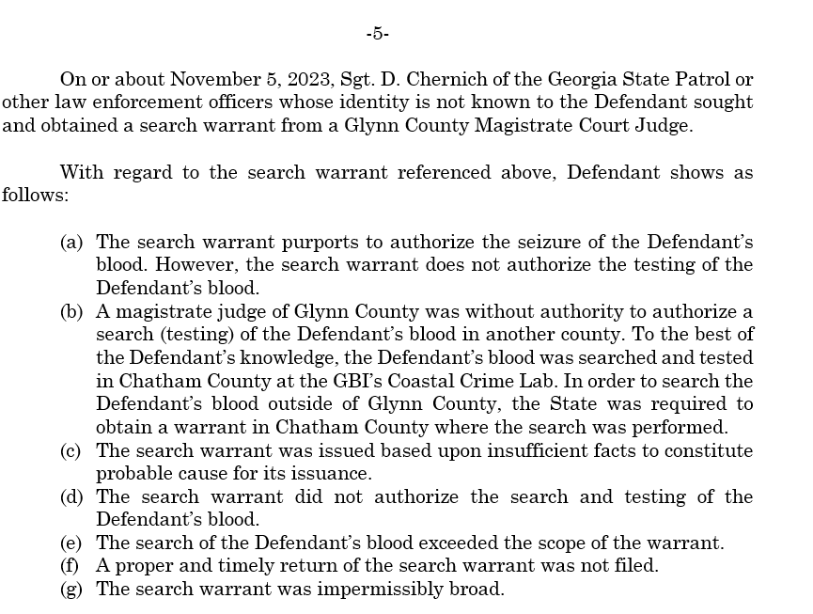

Slide 29
Remember De la Paz? The testing being a search is important!
In State v. De la Paz, officers received a warrant to search a defendant’s blood for alcohol. But, without seeking an additional warrant, they then tested his blood for drugs. The Court of Appeals held that this was a separate search and that, without a warrant to authorize that search, the officers could not conduct the additional test. “Because th[e] warrant was limited to alcohol testing and did not contemplate or authorize testing for drugs, the subsequent testing for drugs was unauthorized.”
State v. De la Paz, No. A23A1769, at *11 (Ga. Ct. App. Mar. 8, 2024).
Notes:
OTO

Slide 30
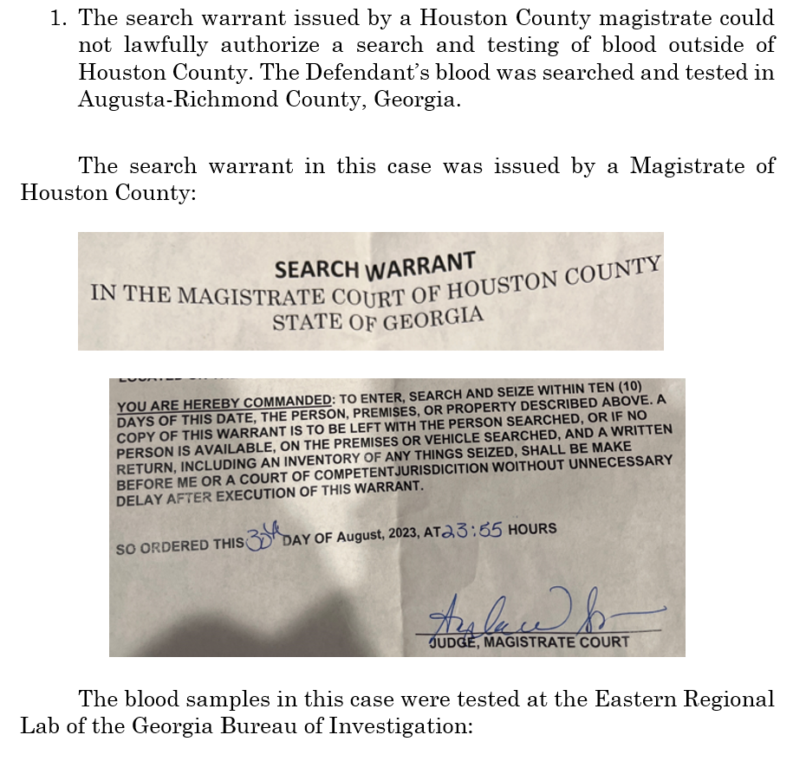
Notes:
BEN

Slide 31
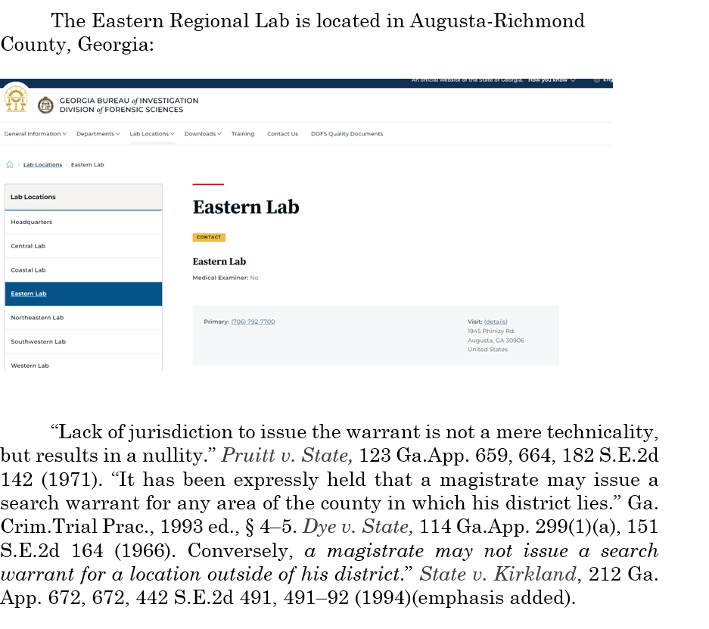
Notes:
BEN

Slide 32
Daubert
Showing that:
1) the testimony be based upon sufficient facts or data;
2) the testimony is the product of reliable principles/methods;
3) the witness has applied the principles and methods reliably to the facts of the case which have been or will be admitted into evidence. . .

Slide 33
Daubert
Courts to draw from Daubert and its progeny and consider:
Whether methodology derived from the scientific method. At 584-587. -described scientific methodology: process of formulating hypotheses and then conducting experiments to prove or falsify the hypothesis and recommended the that trial judges utilize the following “flexible” factors to determine the validity of scientific testimony:

Slide 34
Daubert
Courts to draw from Daubert and its progeny and consider:
a) Empirical testing: whether the theory or technique is falsifiable, refutable and/or testable.
b) Whether it has been subjected to peer review and publication.
c) The known or potential error rate.
d) The existence and maintenance of standards and controls concerning its operation.
e) The degree to which the theory and technique is generally accepted by a relevant scientific community.

Slide 35
Implied Consent Updates

Slide 36
Statutory Implied Consent Issues: Rapid Fire
If given the choice between what grounds to rely upon in excluding a test, CHOOSE THE STATUTORY GROUNDS.

Slide 37
Why do I say that?
“We take this opportunity to clarify that the totality-of-the-circumstances standard we use to evaluate
voluntariness claims includes Connelly’s coercion predicate. … Thus, even if a defendant gives a
statement while significantly intoxicated or influenced by drugs, the statement is not involuntary as a
matter of constitutional due process absent some evidence of coercive conduct by law enforcement in
eliciting the statement. See Connelly, 479 U.S. at 164-167.”
State v. Franklin, 318 Ga. 39, 897 S.E.2d 432 (January 17, 2024).

Slide 38
And the Georgia Supreme Court says so too…
Defendant here not only challenged the constitutionality of the statutes, but also argued for exclusion of the evidence under Rule 403 as being substantially more prejudicial than probative. The trial court erred by failing to rule on this argument before taking up the constitutionality issue. “[The Rule 403] argument ‘presents a threshold issue of constitutional avoidance’ because if evidence of his refusal to consent to the blood test is due to be excluded as more prejudicial than probative, there will be ‘no occasion to reach the merits of his constitutional claim.’ State v. Mondor, 306 Ga. 338, 344-345(2), 830 S.E.2d 206 (2019). Thus, rather than ‘jumping straight to the constitutional question[,] [t]he trial court should have resolved the statutory question first.’ Deal v. Coleman, 294 Ga. 170, 171(1) n.7, 751 S.E.2d 337 (2013).”
State v. Randall, 318 Ga. 79, 897 S.E.2d 444 (January 17, 2024).

Slide 39
Helpful cases
“…where consent is based at least in part on deceptively misleading information concerning a penalty for refusal which the State was unauthorized to implement, there was no informed choice and the test results are inadmissible. ”
State v. Pierce, 257 Ga. App. 623 (2002)

Slide 40
Helpful Cases
State v. Terry, 236 Ga. App. 248 (1999) - You can get independent test after bonding
Deckard v. State, 210 Ga. App. 421 (1993) - Refusal will suspend out of State D.L.
Kitchens v. State, 258 Ga. App. 411 (2002) - Overstating legal limit misled to take test
Hernandez v. State, 348 Ga. App. 569 (2019) - ICN correct, but answered ? About refusal and didn’t specify “this” state…but beware of Rojas v. State, 235 Ga. App. 524 (1998) (holding a misstatement harmless because it was made after Rojas refused, and didn’t coerce consent).
Must be after arrest-Hough/Handschuh
Officer says “May” rather than “Will be suspended” -State v. Stroud, 344 Ga. App. 885 (2018)
Wierson v. State, 372 Ga.App. 102, 903 S.E.2d 792 (June 25, 2024).

Slide 41
Got a crazy client? I’ve got some help for you.
Separately, the State moved “to restrict Wierson from asserting an insanity defense to the
charges of reckless driving and vehicular homicide predicated on reckless driving because
they are ‘strict liability’ offenses.” The trial court properly denied this motion. “Neither
this Court nor our Supreme Court has expressly addressed whether the defense of insanity
is available to strict liability traffic offenses,” but analogizing to State v. Ogilvie, 292 Ga.
6, 8(2)(a), 734 S.E.2d 50 (2012) (accident defense may be available in strict-liability
traffic cases), the court reasons that insanity is relevant to whether the defendant
“voluntarily commit[ted] the prohibited act. Id. at 9(2)(b), 734 S.E.2d 50.”
Wierson v. State, 372 Ga.App. 102, 903 S.E.2d 792 (June 25, 2024).

Slide 42
BEN SESSIONS
Sessions & Fleischman, LLC
(470) 225-7710
BEN@THESESSIONSLAWFIRM.COM

