Slide 1
A Practical Guide to DUI Motions Practice
Ben Sessions
@Ben_Sessions
TheSessionsLawFirm.com
Georgia Association of Criminal Defense Lawyers
Spring 2019

Slide 2
The Customary Rules
File your standard motions.
Review discovery.
Maybe argue a motion to suppress or exclude.
Motion is denied.
Trial or plea.

Slide 3
What are the common tactics that work?
There are no "common tactics" that consistently work.
It is the uncommon that works. (No, I'm not talking about wearing tennis shoes to court or fighting over what table in the courtroom you get to sit at.)

Slide 4
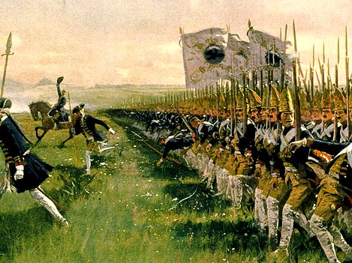

Slide 5


Slide 6


Slide 7
Do I fight on their terms?

Slide 8


Reconsider how and why you do what you do.
Yes, you are an “underdog”, battling giants, and you are probably a misfit.

Slide 9


Slide 10

The pursuit of motions can be a frustrating endeavor…
particularly if you only define success in terms having your motion granted.

Slide 11

We hardly ever hear “motion granted”…

Slide 12
Dirty Dozen Rules for Motions
1. We influence and/or control most issues that get litigated.
2. We should influence and/or control how most issues get litigated.
3. You do not have to win a motion to have it aid you in the case.
4. Not all issues must be litigated. What we do not litigate may be more important than what we do litigate.
5. Choose your battles. The goal is to win the war.
6. Do not ever underestimate the power of giving the other side the opportunity to muck up.
7. Know when and why to walk away from an issue. Plan on it.
8. Do not assume that the opposition knows anything about what you know.
9. Gratuitously being obnoxious usually accomplishes nothing. Planned obnoxiousness is different.
10. Be careful what you ask for, you may get it.
11. A half-cocked effort will usually produce half-assed results.
12. Do not make the other sides arguments for them: if they are not smart enough to make it themselves, you should be smart enough not to teach them their own argument.

Slide 13
Understanding Your Goals in a Motion Hearing
Five Basic Purposes of Motions:
1) Exclusion of unfavorable evidence;
2) Trial preparation;
3) Improving the plea offer;
4) Diversion; and,
5) Dismissal of the charges.

Slide 14
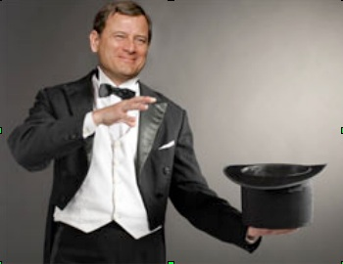
Exclusion of Unfavorable Evidence
A motion to suppress or motion in limine is your opportunity to change the facts of the case.

Slide 15
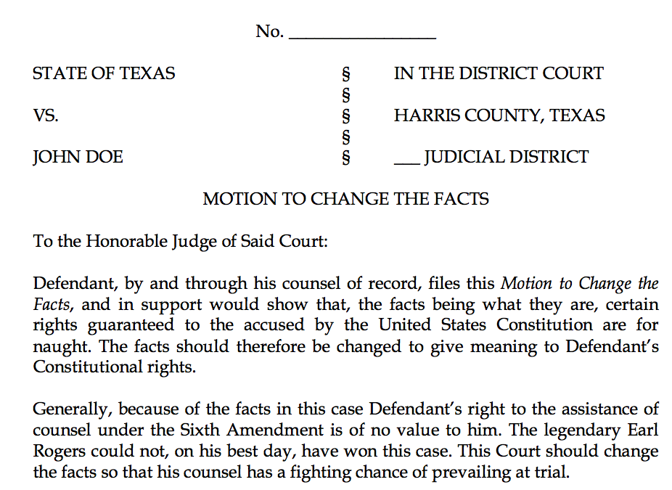

Slide 16
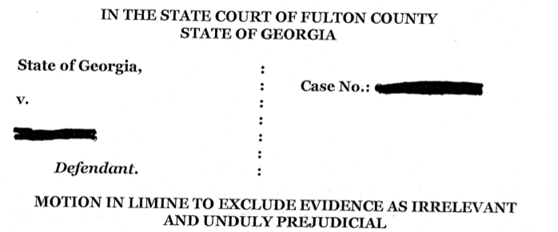
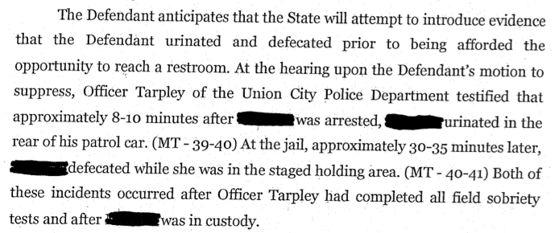

Slide 17
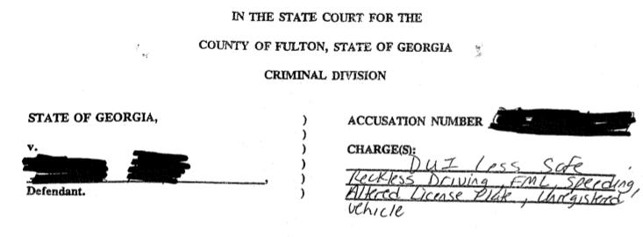
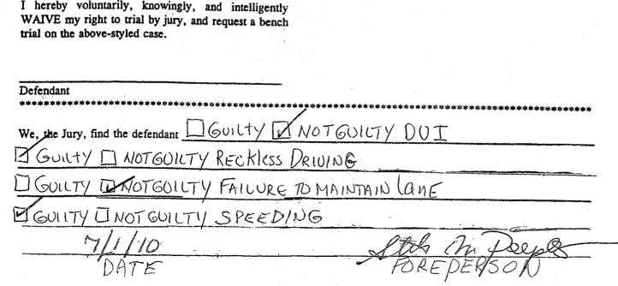

Slide 18
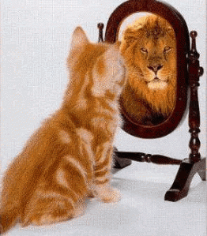
Show Them What They Really Are

Slide 19
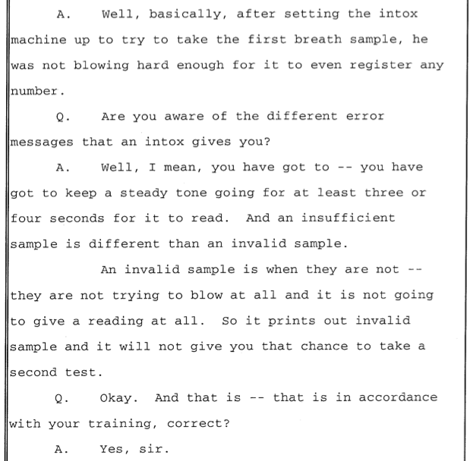

Slide 20
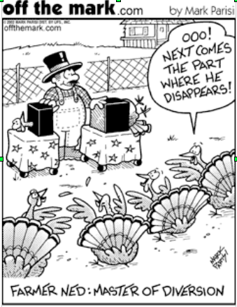

Use of a Motion Hearing as a Diversion
A motion hearing (where he/she gets torn up) is not something that an officer forgets.
Notes:
Officers remember attorneys who rigorously cross-examined them. Have you ever had an officer who knew NOTHING about the administration of the horizontal gaze nystagmus test at the time of the motion hearing, but by the time trial rolled around he testified as if he were an expert? Did this happen because the officer attended a SFST refresher course prior to trial? Not likely. Instead, officers (and prosecutors) remember the painful attack or humiliation they endured during the motion hearing and thus prepare accordingly, often with what I call a contrived-overemphasis. Over the course of the hearing and the trial, use the information you glean about the officer to assist you.

Slide 21
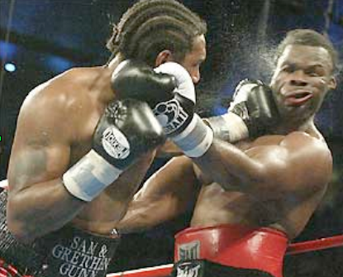
Dismissal of the Charges
A motion to suppress is the only tool available to test the sufficiency of the state’s evidence prior to trial. It is also your shot at delivering a knock-out blow.

Slide 22
Motion to Suppress or Motion in Limine:
Yes, It Does Matter
AUTHORITY
Motion to Suppress: O.C.G.A. 17-5-30, which is also referred to in older case law as Section 13 of an Act of 1966 (Ga.L.1966, pp. 567, 571; Code Ann. 27-313)
Motion in Limine: statutory, regulations, or common law
Notes:
O.C.G.A. 17-5-30, which is also referred to in older case law as Section 13 of an Act of 1966 (Ga.L.1966, pp. 567, 571; Code Ann. 27-313),

Slide 23
Motion to Suppress or Motion in Limine:
Yes, It Does Matter
Time Limitations on Filing
Motion to Suppress: within 10 days after the date of arraignment
Motion in Limine: at any time

Slide 24
Motion to Suppress or Motion in Limine:
Yes, It Does Matter
Particularization

Slide 25
Motion to Suppress or Motion in Limine:
What is sufficient “particularization” of a motion to suppress?
O.C.G.A. § 17-5-30 (b) states, in relevant part:
The motion shall be in writing and state facts showing that the search and seizure were unlawful.

Slide 26
What is sufficient “particularization” of a motion to suppress?
(1) the date of the stop,
(2) the identity of the person stopped,
(3) the identity of the officer who made the stop,
(4) the law enforcement organization with which he was affiliated,
(5) the nature of the stop (e.g., traffic stop),
(6) the offenses with which Goodman was charged, and
(7) the conclusion that no such violations occurred which would justify the stop.
State v. Goodman, 220 Ga. App. 169, 469 S.E.2d 327 (1996).

Slide 27
Motion to Suppress or Motion in Limine:
Yes, It Does Matter
O.C.G.A. 17-5-30, which is also referred to in older case law as Section 13 of an Act of 1966 (Ga.L.1966, pp. 567, 571; Code Ann. 27-313), illegal for reasons other than unlawful search and seizure. Norrell v. State, 116 Ga.App. 479(3), 157 S.E.2d 784. By its clear terms, Section 13 furnishes a procedural device for the protection of constitutional guaranties against unreasonable search and seizure only.
Hawkins v. State, 117 Ga. App. 70, 71, 159 S.E.2d 440 (1967)(emphasis added).

Slide 28
Motion to Suppress
Because the burden is on those officers who conduct a search without a warrant to show that the search was conducted pursuant to an exception to the Fourth Amendment warrant requirement, it can be said that a search without a warrant is presumed to be invalid and the burden is on the state to show that the warrantless search was valid. Mincey v. Arizona, 437 U.S. 385, 390-391, 98 S.Ct. 2408, 2412-2413, 57 L.Ed.2d 290 (1978); McDonald v. United States, 335 U.S. 451, 456, 69 S.Ct. 191, 193, 93 L.Ed. 153 (1948).

Slide 29
Motion to Suppress
Searches are conducted either with or without a search warrant. ‘The most basic constitutional rule in this area is that ‘searches conducted outside the judicial process, without prior approval by judge or magistrate, are per se unreasonable under the Fourth Amendment-subject only to a few specifically established and well-delineated exceptions.’ The exceptions are ‘jealously and carefully drawn,’ and there must be ‘a showing by those who seek ... that the exigencies of the situation made that course imperative.’ ‘[T]he burden is on those seeking the exemption to show the need for it.’’ Coolidge v. New Hampshire, 403 U.S. 443, 454-455, 91 S.Ct. 2022, 2032, 29 L.Ed.2d 564 (1971) (citations omitted).
State v. Slaughter, 252 Ga. 435, 436, 315 S.E.2d 865 (1984):

Slide 30
Motion to Suppress
“Once a defendant files a motion to suppress alleging an illegal search and seizure, the state bears the burden of proving that the search is lawful.”
State v. Kuhnhausen, 289 Ga. App. 489, 657 S.E.2d 592 (2008), citing State v. King, 287 Ga. App. 680, 652 S.E.2d 574 (2007).

Slide 31
Motion in Limine
“‘In limine’ means ‘at the threshold’ or before the trial begins.” State v. Johnston, 249 Ga. 413, 414 (fn. 3), 291 S.E.2d 543 (1982), quoting, Stevens v. State, 265 Ind. 411, 354 N.E.2d 727, 733 (1976).

Slide 32
Motion in Limine:
2 Possible Uses by the Trial Court
A motion in limine is a pretrial motion which may be used two ways:
1) The movant seeks, not a final ruling on the admissibility of evidence, but only to prevent the mention by anyone, during the trial, of a certain item of evidence or area of inquiry until its admissibility can be determined during the course of the trial outside the presence of the jury; and,

Slide 33
Motion in Limine:
2 Possible Uses by the Trial Court
A motion in limine is a pretrial motion which may be used two ways:
2) The movant seeks a ruling on the admissibility of evidence prior to the trial. The trial court has an absolute right to refuse to decide the admissibility of evidence, allegedly violative of some ordinary rule of evidence, prior to trial. If, however, the trial court decides to rule on the admissibility of evidence prior to trial, the court's determination of admissibility is similar to a preliminary ruling on evidence at a pretrial conference, and it controls the subsequent course of action, unless modified at trial to prevent manifest injustice.
Gaston v. State, 227 Ga. App. 666, 669, 490 S.E.2d 198 (1997)(citations and punctuation omitted), quoting, State v. Johnston, 249 Ga. 413, 415, 291 S.E.2d 543 (1982).

Slide 34
Motion in Limine
“Any challenge to the procedures used in reading [the defendant] his statutory implied consent warning, OCGA § 40-5-67.1(b)(2), and the proper working of the Intoxilyzer 5000 machine would have been appropriately raised by a motion in limine, which was not done here.”
Goddard v. State, 244 Ga. App. 730, 731, 536 S.E.2d 160 (2000).

Slide 35
Preparing for Motions

Slide 36
Preparing for Motions
If at all possible, go into motions with a developed theory of the case.
If you are doing motions immediately prior to trial, you better have a theory.

Slide 37
To Brief or Not to Brief?
That’s not really a question.
See Rule No. 11

Slide 38
Effectively Attacking Probable Cause:
Credibility is Key
Success in most probable cause hearings requires us to call into question the credibility of the evidence or the arresting officer.
Credibility of witnesses and the weight to be given their testimony is a decision-making power that lies solely with the trier of fact. The trier of fact is not obligated to believe a witness even if the testimony is uncontradicted and may accept or reject any portion of the testimony.
Tate v. State, 264 Ga. 53, 56, 440 S.E.2d 646 (1994).
A rational trier of fact can choose to reject even “undisputed” testimony if that fact finder believes that witness's testimony to be unreliable. Factors such as demeanor, contradictory or inconsistent statements and evidence that an officer had “ulterior motives” can all lead a finder of fact to disregard testimony by an officer that an accused was violating the law.
Tate v. State, 264 Ga. 53, 56 (fn. 5), 440 S.E.2d 646 (1994).

Slide 39
Learn Your Favorite Probable Cause Cases:
Pick out your favorite PC cases, learn them, and get really good at arguing that your facts fit within those cases.

Slide 40
 | State v. Handley 294 Ga. App. 236 (2008) | State v. Gray 267 Ga. App. 753 (2004) | State v. Batty 259 Ga. App. 431 (2003) | State v. Ellison 271 Ga. App. 898 (2005) | Case at Bar
Basis for Stop | Tag Violation | Traffic Accident | Red light violation and following too closely | Roadblock | Speeding
Odor of Alcohol | Odor of Alcohol (Noted on Test Printout as “Very Strong” but no testimony) | Odor of Alcohol | Odor of Alcohol | Strong Odor of Alcohol | Odor of Alcohol
Admission of Drinking | Initial Denial of Drinking but Later Admission | Admission of Drinking | Admission of Drinking | Initial Denial of Drinking but Later Admission | Admission of Drinking
Appearance of Eyes | Noted on Test Printout as Bloodshot Eyes but no testimony | Bloodshot Eyes | None | Red, Bloodshot, and Watery Eyers | Red and Bloodshot Eyes

Slide 41
 | State v. Handley 294 Ga. App. 236 (2008) | State v. Gray 267 Ga. App. 753 (2004) | State v. Batty 259 Ga. App. 431 (2003) | State v. Ellison 271 Ga. App. 898 (2005) | Case at Bar
Ability to Stand and Walk Normally | No indication | Unsteady Gait | Slight unsteadiness but walked to rear of car fine | No stumbling or loss of balance when exiting vehicle | No trouble exiting vehicle, standing, and walking
Alco-Sensor Result | Positive Alco-Sensor Result | Positive Alco-Sensor Result | Positive Alco-Sensor Result | None | Positive Alco-Sensor Result
Dazed | No indication | Dazed Manner | No indication | No indication | No indication
Speech | No indication | Slurred Speech | No indication | No indication | No Slurred Speech
HGN | None | Failed HGN Test | None | Refused and Stated “I’ve been arrested for DUI before, and I do not think I can do them” | Not Administered
Walk and Turn | No Walk and Turn | No Walk and Turn | Passed | Refused and Stated “I’ve been arrested for DUI before, and I do not think I can do them” | Not Administered
One Leg Stand | No One Leg Stand | No One Leg Stand | Passed | Refused and Stated “I’ve been arrested for DUI before, and I do not think I can do them” | Not Administered

Slide 42
 | State v. Handley 294 Ga. App. 236 (2008) | State v. Gray 267 Ga. App. 753 (2004) | State v. Batty 259 Ga. App. 431 (2003) | State v. Ellison 271 Ga. App. 898 (2005) | Case at Bar
Ability to Produce License | Failed to Produce License | No indication | No indication | No indication | Produced license
Summary of Holding | No credibility determination or disputed Facts. Held insufficient to establish probable cause | Affirmed trial court’s decision granting motion to suppress. | Affirmed trial court’s decision granting motion to suppress | Affirmed trial court’s decision granting motion to suppress

Slide 43
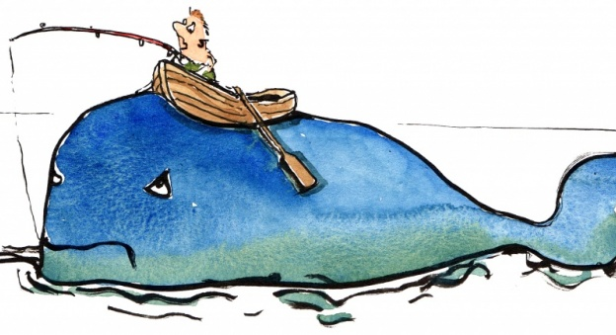
Don’t be afraid to catch a whale.

Slide 44
1. Constitutional Speedy Trial Motions
2. Constitutional Challenges to Voluntariness of Testing – Now, Elliott
3. Data Search / Source Code
The “Whale”

Slide 45
Implied Consent: The Advisement
        Timing of the Implied Consent Warning: After Arrest
Delay in the Advisement of Implied Consent Warning
Misstatement Regarding the Legal Limit
Coercion to Submit to the Breath Test: “Blow Below and You Go Home”
Rescission of the Refusal
Statements Regarding Out-of-State License Being Suspended

Slide 46
Implied Consent: Independent Test
Independent Test Requests
Timing of the Request for an Independent Test
Limitations on Facilities for the Administration of Independent Test

Slide 47
When you engage the State, you have options.
But you have to know some rules.

Slide 48
Where are their vulnerabilities?
Time
Inability to focus
Inability to recognize when they need help
Public humiliation

Slide 49
Where are your advantages?
Time
Repetition
Building upon prior experiences
Group think

Slide 50
So, what’s the catch?
Relentless effort.
It’s hard.
It’s mentally taxing.

Slide 51
Learn to break their rhythm
Speedy trial demands
Elliott
Constitutional speedy trial motions
Harper / scientific evidence challenges
Source code
Evidence code challenge
Burrell / custody issues
Refusal of field sobriety tests

Slide 52
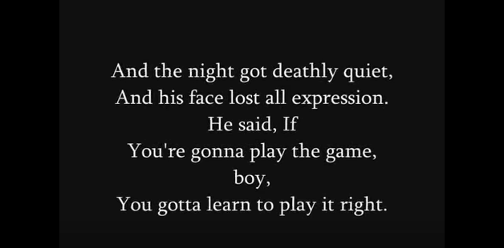
Statutory Speedy Trial Demands

Slide 53
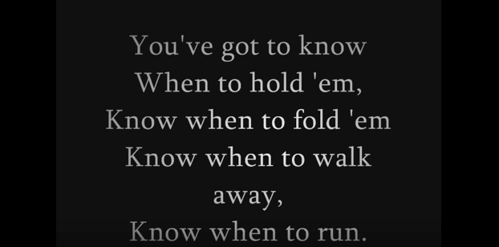
Statutory Speedy Trial Demands

Slide 54
Basics of the constitutional speedy analysis
The analysis has two stages. First, the court must determine whether the interval from the accused's arrest, indictment, or other formal accusation to the trial is sufficiently long to be considered “presumptively prejudicial.” If not, the speedy trial claim fails at the threshold. If, however, the delay has passed the point of presumptive prejudice, the court must proceed to the second step of the Barker-Doggett analysis, which requires the application of a delicate, context-sensitive, four-factor balancing test to determine whether the accused has been deprived of the right to a speedy trial.
Ruffin v. State, 284 Ga. 52, 55, 663 S.E.2d 189, 195 (2008) (citations omitted).

Slide 55
Where do we lose?
[W]ith respect to the Barker v. Wingo analysis, it should be recognized that delayed assertion of the right to a speedy trial and lack of prejudice are the two factors that most often weigh heavily against defendants and which then support the overall conclusion that speedy trial rights have not been violated.
Phan v. State, 287 Ga. 697, 700, 699 S.E.2d 9, 12 (2010) adopted, (Ga. Super. June 17, 2011)

Slide 56
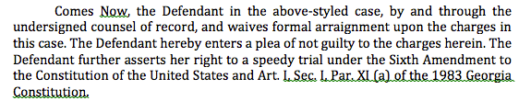
Assertion of the right: how do we do it?
It would also allow a court to weigh the frequency and force of the objections as opposed to attaching significant weight to a purely pro forma objection.
Barker v. Wingo, 407 U.S. 514, 528-29, 92 S. Ct. 2182, 2191, 33 L. Ed. 2d 101 (1972) (citations omitted).
* YELL AT ME IF I DON’T DISCUSS IMPORTANT STRATEGIC CONSIDERATIONS FOR CASES BEING BOUND OVER TO A STATE/SUPERIOR COURT.

Slide 57
Establishing prejudice in the constitutional speedy context
Prejudice, of course, should be assessed in the light of the interests of defendants which the speedy trial right was designed to protect. This Court has identified three such interests: (i) to prevent oppressive pretrial incarceration; (ii) to minimize anxiety and concern of the accused; and (iii) to limit the possibility that the defense will be impaired. Of these, the most serious is the last, because the inability of a defendant adequately to prepare his case skews the fairness of the entire system. If witnesses die or disappear during a delay, the prejudice is obvious. There is also prejudice if defense witnesses are unable to recall accurately events of the distant past. Loss of memory, however, is not always reflected in the record because what has been forgotten can rarely be shown.
Barker v. Wingo, 407 U.S. 514, 532, 92 S. Ct. 2182, 2193, 33 L. Ed. 2d 101 (1972) (citation omitted).

Slide 58
Specific issues relating to prejudice: late amendment

Slide 59
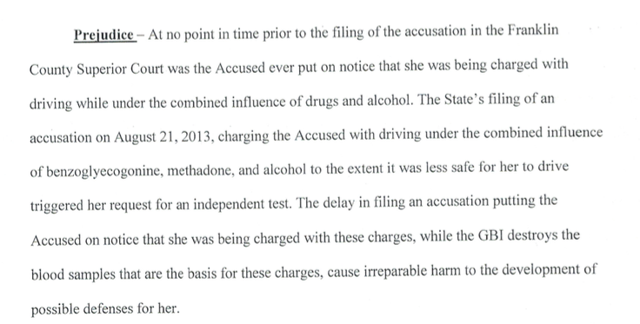
Specific issues relating to prejudice: destruction of samples

Slide 60
Specific issues relating to prejudice: pre-trial incarceration
However, we disagree with the trial court's determination that there was no evidence of prejudice for the period of time that Leopold subsequently served in jail after his release. The record shows that Leopold was later arrested for an unrelated probation violation, and as a result, was held in the DeKalb County jail from December 18, 2008 until the start of his trial. Leopold argues that the delay in this case caused him to lose the possibility of serving this sentence concurrently with the nine months he served on his sentence for the probation violation. This Court has previously recognized that with respect to a defendant incarcerated on other charges, a delay in bringing such a person to trial may be prejudicial because the defendant may forego the opportunity to receive a sentence that is at least partially concurrent with the one he is serving. Johnson, 313 Ga.App. at 904(2)(d), 723 S.E.2d 100 (citing Smith v. Hooey, 393 U.S. 374, 378, 89 S.Ct. 575, 21 L.Ed.2d 607 (1969)). Thus, the trial court erred in failing to consider this factor. However, our Supreme Court has consistently held that “when a defendant is already incarcerated for unrelated offenses, there is minimal possibility of oppressive pretrial incarceration.” See Williams, 279 Ga. at 109(1)(d), 610 S.E.2d 32 (citing cases).
Leopold v. State, No. A15A0783, 2015 WL 5238136, at *5 (Ga. Ct. App. Sept. 8, 2015) (emphasis added).

Slide 61
Specific issues relating to prejudice: inability to produce witnesses - THINK STRATEGICALLY ABOUT THIS ISSUE
And with respect to the impairment of his defense, Leopold argues that had Blackford not testified at trial, the testimony of two defense witnesses as to allegedly exculpatory statements made by Blackford would have been uncontroverted. However, Leopold provides no citation to authority to support his argument that the State's inability to locate and present testimony from Blackford in order to make its case is the type of prejudice the Barker factors are designed to address, and we find none. The record confirms that Leopold was able to present evidence in support of his defense, he does not argue that the delay prevented him from obtaining any evidence or testimony, and his only contention is that the delay strengthened the State's case, to his detriment. See Robinson v. State, 287 Ga. 265, 269(1)(d), 695 S.E.2d 201 (2010) (prejudice factor does not weigh in the defendants' favor where “no witnesses have died or disappeared; there is no evidence that witnesses have lost their memories; and the defense strategy remained unchanged”). Cf. Johnson, 313 Ga.App. at 905(2)(d)(iii), 723 S.E.2d 100 (if a witness that could supply material evidence for the defense dies or disappears during the delay, prejudice may be established). Moreover, the State's need to locate a missing witness whose testimony is required for trial is one of the specific reasons recognized by the United States Supreme Court that may justify a delayed trial. See Barker, 407 U.S. at 531, 92 S.Ct. 2182 (“[A] valid reason, such as a missing witness, should serve to justify appropriate delay.”).
Leopold v. State, No. A15A0783, 2015 WL 5238136, at *5 (Ga. Ct. App. Sept. 8, 2015) (citation omitted).

Slide 62
Specific issues relating to prejudice: anxiety and concern suffered by the Defendant
Regarding anxiety and concern, the trial court found that Takyi suffered unusual and extreme anxiety and emotional pain due to her uncertain immigration status, such that she was “frightened that at any time her unresolved immigration status could force her to leave the U.S.” The trial court heard testimony from Takyi and her attorneys about the actions they took regarding her pending citizenship application and the emotional impact the attorneys understood the situation to have on Takyi.
Takyi, 314 Ga.App. at 448(1), 724 S.E.2d 459. On remand, the trial court, explicitly disregarding hearsay and relying exclusively on the uncontradicted testimony of Takyi and her attorneys, found that Takyi suffered an unusual amount of stress and anxiety due to the delayed resolution of her case. Because it ignored the hearsay identified in the prior appeal to reach its decision, the trial court properly exercised its discretion in weighing the final factor slightly in Takyi's favor.
State v. Takyi, 322 Ga. App. 832, 838-39, 747 S.E.2d 24, 30 (2013)

Slide 63
Harper Challenges
The Harper rule requires that the Court in a criminal case determine “whether a given scientific principle or technique is a phenomenon that may be verified with such certainty that it is competent evidence in a court of law....” Id. at 525. Otherwise stated, the Court must determine whether the scientific principle or technique “has reached a scientific stage of verifiable certainty” or “‘rests upon the laws of nature.’” Id. (citations omitted). “[E]vidence based on a scientific principle or technique is admissible only if the science underlying the evidence is a phenomenon that may be verified with such certainty that it is competent evidence in a court of law.” Parker v. State, 307 Ga.App. 61, 704 S.E.2d 438 (2010).

Slide 64
Harper Challenges
Opinion of toxicologist as to impairment by drugs
Lack of convergence
Rhomberg / Romberg Test
HGN for drugs

Slide 65
Demurrers

Slide 66

Burrell / Custody Issues
“It was therefore incumbent upon the State to secure the necessary witnesses to meet its burden of proof that the initial encounter was lawful.”
Burrell v. State, 261 Ga. App. 677, 583 S.E.2d 521, 522 (2003)

Slide 67


Refusal of field sobriety tests
The issue of refusal of fields constituting a violation of Miranda is relatively well settled, but the whether the refusal of field sobriety tests constitutes an impermissible comment upon a search remains open.

Slide 68
Thank you!
Ben Sessions
@Ben_Sessions
SessionsCriminalDefense.com
Got a question?
Follow me @Ben_Sessions and send me tweet

