Slide 1
  Attacking a DUI Breath Test Case on a Budget
Ben Sessions
@Ben_Sessions
TheSessionsLawFirm.com
ben@thesessionslawfirm.com
(470) 225-7710
Georgia ICLE
Atlanta, Georgia
December 7, 2018

Slide 2
State of Georgia
v.
Sober Ben
Notes:
I told you all that I was concerned that you would jump to a conclusion about the breath test. Everyone promised that they would wait to see if the rules were followed and if they thought the evidence showed that the test was proved to be reliable in this case.
We all talked about and agreed that following rules in the administration of the test was really important.
When the officers couldn’t tell us that they followed their training and followed the 20-minute observation requirement, they brought in Mr. Tilson to try to clean up the mess.
He only gave us more questions and doubts though. .11 with no BAC. .049 with cake?

Slide 3
Totality of circumstances v.
Totality of the negative circumstances

Slide 4
The Presumption of Innocence
Mr. Ben is presumed to be innocent unless and until the State produces enough evidence to convince you beyond a reasonable doubt that the defendant is guilty of the offenses charged.

Slide 5
Compare the Role of the State and the Accused
There is no burden of proof upon the defendant whatsoever, and the burden never shifts to the defendant to introduce evidence or to prove innocence.
When a defense is raised by the evidence, the burden is on the State to negate or disprove it beyond a reasonable doubt.

Slide 6
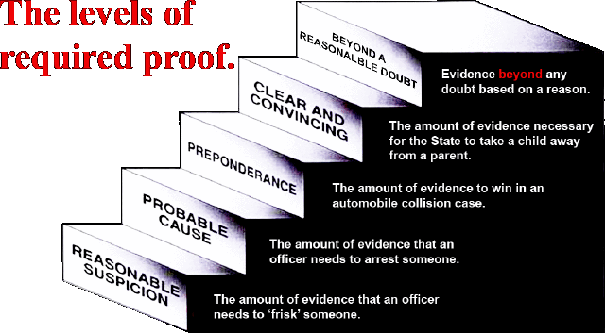

Slide 7
Not Guilty = Not Proven Beyond a Reasonable Doubt
Grave Suspicion Is Not Enough
Facts and circumstances that merely place upon the defendant a grave suspicion of the crime charged or that merely raise a speculation or conjecture of the defendant's guilt are not sufficient to authorize a conviction of the defendant.
They did not offer any evidence of compliance with the 20-minute observation requirement before the administration of the breath test.

Slide 8
What is a reasonable doubt?
A reasonable doubt is a doubt for which a reason can be given, arising from a consideration of:
the evidence,
a lack of evidence, or
a conflict in the evidence.
After giving consideration to all of the facts and circumstances of this case, if your minds are wavering, unsettled, or unsatisfied, then that is a doubt of the law, and you must acquit the defendant.

Slide 9
What is a reasonable doubt?
After giving consideration to all of the facts and circumstances of this case, if your minds are:
wavering,
unsettled, or
unsatisfied,
then that is a doubt of the law, and it requires that Mr. Ben be acquitted.
Acquitted means found not guilty / not proven beyond a reasonable doubt.

Slide 10
2 different types of DUI charges

Slide 11
Reasons for Doubt From the Evidence
DUI Per Se – Count 2
  From their witness – Mr. Tilson:
  .118 based upon mouth alcohol
  .02 from breath spray
  .032 cake
  .049 gum
  The mouth alcohol problem is a real problem in this case.

Slide 12
3 things are necessary to protect against mouth alcohol
1. 20-minute “wait” (OBSERVATION) period
2. .02 agreement of the samples
3. the slope detector in the machine (.049 on cake & .11 when no alcohol should have been detected)

Slide 13
Reasons for Doubt From the Evidence
DUI Per Se – Count 2
Officer Janke
Cannot say that the 20-minute rule that he was trained on was followed
Mr. Tilson
Cannot say the 20-minute rule was followed

Slide 14
Reasons for Doubt From a Lack of Evidence
DUI Per Se – Count 2
Where is their evidence of compliance with the 20-minute observation requirement?
Where is their witness who overcomes the doubts raised by Dr. Hlastala?
Biological uncertainties completely unrebutted.
Where is the witness that negates Dr. Hlastala’s testimony about the conversion from breath to blood?
Where is the witness that negates temperature’s affect?

Slide 15
Reasons for Doubt From a Conflict in the Evidence
DUI Per Se – Count 2
  Where is the evidence that is consistent with intoxication?
    No impairment of speech
    No impairment of ability to stand and walk
    No impairment of ability to balance
  Dr. Hlastala v. Mr. Tilson
  Mr. Tilson – “You can rely upon it”, but 36% of the time it missed mouth alcohol.

Slide 16
What are we asking for?
Count 1 – DUI Less Safe – Not Guilty – Not Proved Beyond a Reasonable Doubt
Count 2 – DUI Per Se – Not Guilty – Not Proved Beyond a Reasonable Doubt
  Underage possession of alcohol
Count 3 – Failure to Maintain Lane – Guilty

Slide 17
Why is the Mouth Alcohol Defense my
“go-to” defense?
1. My clients are broke, and it is affordable.
2. They want a Not Guilty, and it works.
Notes:
A mouth alcohol defense can be presented with very little expense, or you can spend a lot of money on it. Generally, my clients don’t have a lot to spend on experts so I have to do some of the heavy lifting on my own.
I want to be clear about 1 thing at the outset: This is not a complicated breath test defense. It requires about 20 minutes of study of the Intox manual, and some planning for motions or ALS hearings and open records requests.
My goal today is to walk you through a Mouth Alcohol Defense, and give you enough information to walk into court monday and use it. I use this defense all of the time, and if I can do it, I know that you can do it effectively.
I have heard very, very good lawyers say things, such as, “I don’t plow with the other man’s mule.” Translated: They don’t try a case and use the state’s witnesses as their own. “Would you buy a Ferrari and put re-tread tires on it?” - Translated: Don’t hire a good lawyer and not equip with the tools to do the job. I understand this sentiment, but I don’t agree with it.
Breath test cases can be tried well and won without a breath test expert. It’s can be more work. It can be gutwrenching. But it can be done. But you have to have a defense that can be developed through the State’s evidence.

Slide 18
Let’s prepare ourselves.
Why are you doing this?
Who is this about?
Can we accept losing?
*Are you sure you must do this on a budget?
Notes:
A mouth alcohol defense can be presented with very little expense, or you can spend a lot of money on it. Generally, my clients don’t have a lot to spend on experts so I have to do some of the heavy lifting on my own.
I want to be clear about 1 thing at the outset: This is not a complicated breath test defense. It requires about 20 minutes of study of the Intox manual, and some planning for motions or ALS hearings and open records requests.
My goal today is to walk you through a Mouth Alcohol Defense, and give you enough information to walk into court monday and use it. I use this defense all of the time, and if I can do it, I know that you can do it effectively.
I have heard very, very good lawyers say things, such as, “I don’t plow with the other man’s mule.” Translated: They don’t try a case and use the state’s witnesses as their own. “Would you buy a Ferrari and put re-tread tires on it?” - Translated: Don’t hire a good lawyer and not equip with the tools to do the job. I understand this sentiment, but I don’t agree with it.
Breath test cases can be tried well and won without a breath test expert. It’s can be more work. It can be gutwrenching. But it can be done. But you have to have a defense that can be developed through the State’s evidence.

Slide 19
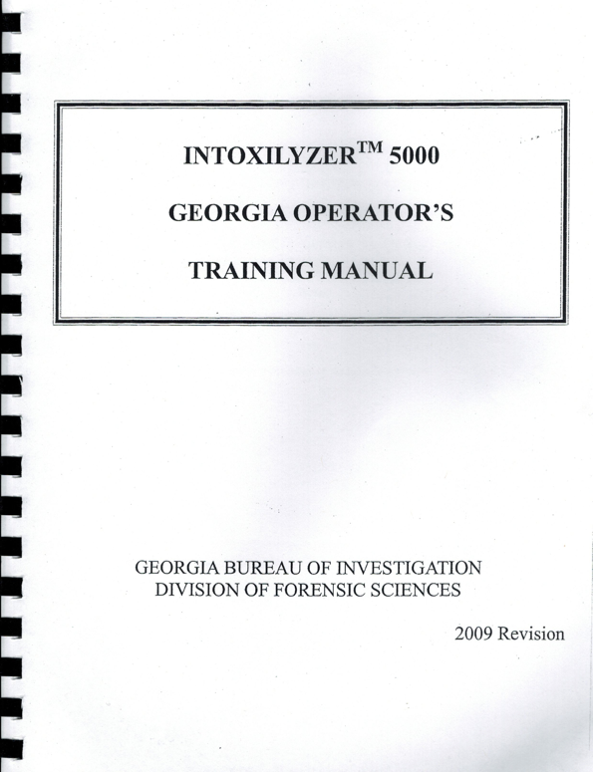
The Mouth Alcohol Defense starts with the Intoxilyzer Operator’s Manual
Notes:
Great thing about the mouth alcohol defense: it’s based on the training of the breath test operator. We can build upon it fairly simply, but if you needed to try the case without an expert and the state did not call their expert to testify, you could win this case simply using the manual.
If the State calls their expert, as we’ll talk about shortly, there are some very good things you can do to improve your case.

Slide 20
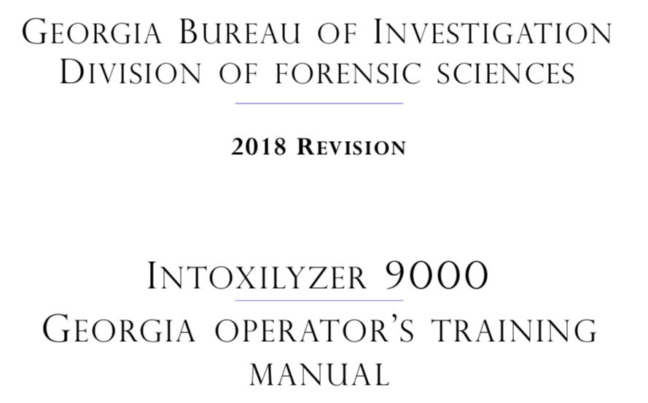
The Mouth Alcohol Defense starts with the Intoxilyzer Operator’s Manual
Notes:
Great thing about the mouth alcohol defense: it’s based on the training of the breath test operator. We can build upon it fairly simply, but if you needed to try the case without an expert and the state did not call their expert to testify, you could win this case simply using the manual.
If the State calls their expert, as we’ll talk about shortly, there are some very good things you can do to improve your case.

Slide 21

The possibility of mouth alcohol is dangerous stuff when the State relies upon a breath test to prove a “per se” charge.
2012 Refresher Manual, p. 9
** This quote is not present in prior Operator Manuals

Slide 22
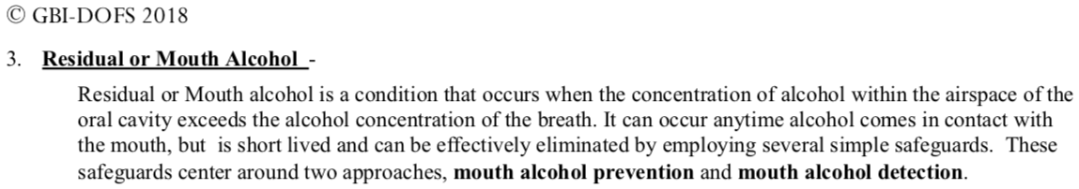
The importance of eliminating mouth alcohol/residual alcohol didn’t change with the Intoxilyzer 9000.

Slide 23
3 Safeguards Against Mouth Alcohol From the Manual
20-minute “wait” (OBSERVATION) period
.02 agreement of the samples (the consecutive samples vary by more than .02)
the slope detector in the machine (Invalid Sample)
2009 Manual, p. 26 | 2007 Manual, p. 27 | 2003 Manual, p. 22
2002 Manual, p. 22 | 2012 Refresher Manual, p. 10
Notes:
Every manual that I have includes the statment, “By utilizing the 20 minute wait, the Intoxilyzer 5000’s built in slope or mouth alcohol detector, and the use of replicate samples, the operator can be assured that residual or mouth alcohol with not influence the printed alcohol concentration.”
It does not say that any of 2 of these 3 will assure us that mouth alcohol will not influence the result. The Division of Forensic Sciences of the GBI has determined that all 3 conditions are necessary to assure us that mouth alcohol did not affect the results.

Slide 24
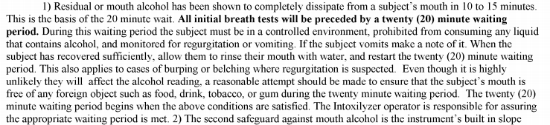
The Mouth Alcohol Problem:
The Intoxilyzer 5000 Operator’s Manual
2009 Manual, p. 25 | 2007 Manual, p. 26 | 2003 Manual, p. 21
2002 Manual, p. 21 | 2012 Refresher Manual, p. 9

Slide 25
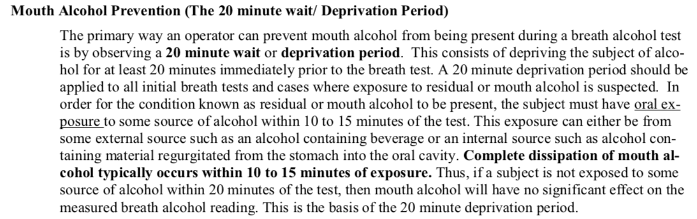
Mouth/residual alcohol is no less of a problem on the Intoxilyzer 9000.
Notes:
Every manual that I have includes the statment, “By utilizing the 20 minute wait, the Intoxilyzer 5000’s built in slope or mouth alcohol detector, and the use of replicate samples, the operator can be assured that residual or mouth alcohol with not influence the printed alcohol concentration.”
It does not say that any of 2 of these 3 will assure us that mouth alcohol will not influence the result. The Division of Forensic Sciences of the GBI has determined that all 3 conditions are necessary to assure us that mouth alcohol did not affect the results.

Slide 26
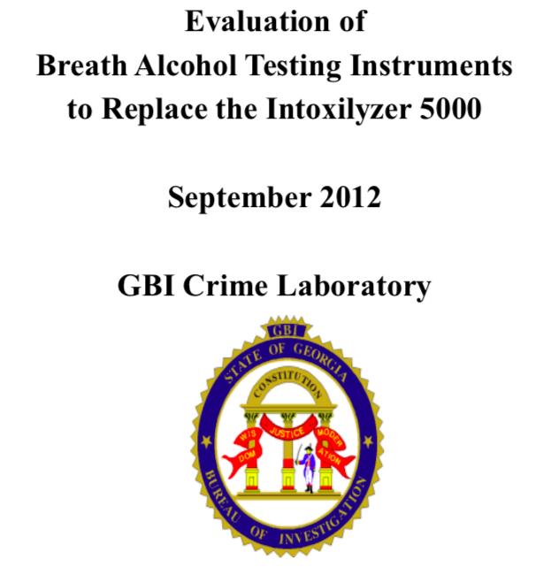
Notes:
A mouth alcohol defense can be presented with very little expense, or you can spend a lot of money on it. Generally, my clients don’t have a lot to spend on experts so I have to do some of the heavy lifting on my own.
I want to be clear about 1 thing at the outset: This is not a complicated breath test defense. It requires about 20 minutes of study of the Intox manual, and some planning for motions or ALS hearings and open records requests.
My goal today is to walk you through a Mouth Alcohol Defense, and give you enough information to walk into court monday and use it. I use this defense all of the time, and if I can do it, I know that you can do it effectively.
I have heard very, very good lawyers say things, such as, “I don’t plow with the other man’s mule.” Translated: They don’t try a case and use the state’s witnesses as their own. “Would you buy a Ferrari and put re-tread tires on it?” - Translated: Don’t hire a good lawyer and not equip with the tools to do the job. I understand this sentiment, but I don’t agree with it.
Breath test cases can be tried well and won without a breath test expert. It’s can be more work. It can be gutwrenching. But it can be done. But you have to have a defense that can be developed through the State’s evidence.

Slide 27
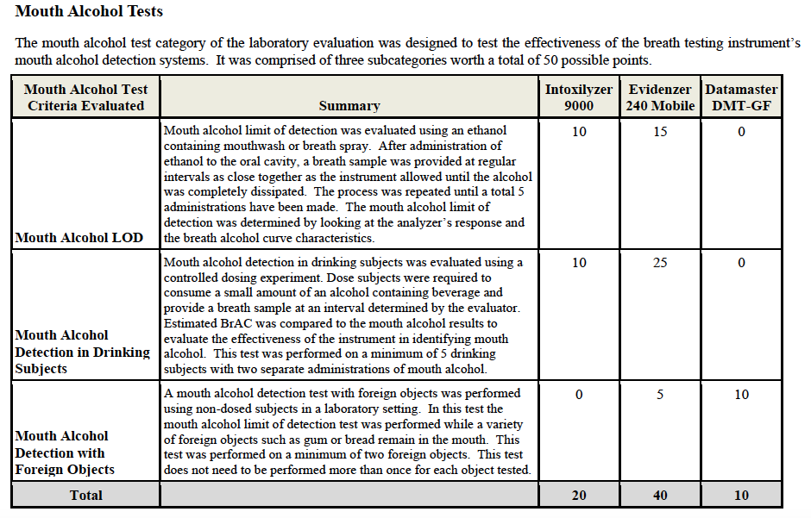
The Intoxilyzer 9000 is not the best device at detecting mouth/residual alcohol
Notes:
A mouth alcohol defense can be presented with very little expense, or you can spend a lot of money on it. Generally, my clients don’t have a lot to spend on experts so I have to do some of the heavy lifting on my own.
I want to be clear about 1 thing at the outset: This is not a complicated breath test defense. It requires about 20 minutes of study of the Intox manual, and some planning for motions or ALS hearings and open records requests.
My goal today is to walk you through a Mouth Alcohol Defense, and give you enough information to walk into court monday and use it. I use this defense all of the time, and if I can do it, I know that you can do it effectively.
I have heard very, very good lawyers say things, such as, “I don’t plow with the other man’s mule.” Translated: They don’t try a case and use the state’s witnesses as their own. “Would you buy a Ferrari and put re-tread tires on it?” - Translated: Don’t hire a good lawyer and not equip with the tools to do the job. I understand this sentiment, but I don’t agree with it.
Breath test cases can be tried well and won without a breath test expert. It’s can be more work. It can be gutwrenching. But it can be done. But you have to have a defense that can be developed through the State’s evidence.

Slide 28
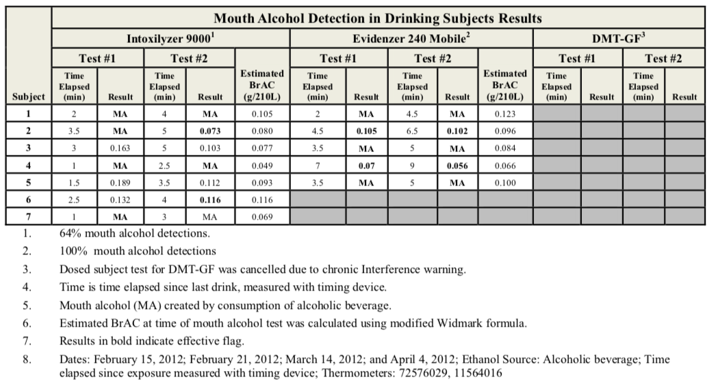
The Intoxilyzer 9000 is not the best device at detecting mouth/residual alcohol
Notes:
A mouth alcohol defense can be presented with very little expense, or you can spend a lot of money on it. Generally, my clients don’t have a lot to spend on experts so I have to do some of the heavy lifting on my own.
I want to be clear about 1 thing at the outset: This is not a complicated breath test defense. It requires about 20 minutes of study of the Intox manual, and some planning for motions or ALS hearings and open records requests.
My goal today is to walk you through a Mouth Alcohol Defense, and give you enough information to walk into court monday and use it. I use this defense all of the time, and if I can do it, I know that you can do it effectively.
I have heard very, very good lawyers say things, such as, “I don’t plow with the other man’s mule.” Translated: They don’t try a case and use the state’s witnesses as their own. “Would you buy a Ferrari and put re-tread tires on it?” - Translated: Don’t hire a good lawyer and not equip with the tools to do the job. I understand this sentiment, but I don’t agree with it.
Breath test cases can be tried well and won without a breath test expert. It’s can be more work. It can be gutwrenching. But it can be done. But you have to have a defense that can be developed through the State’s evidence.

Slide 29
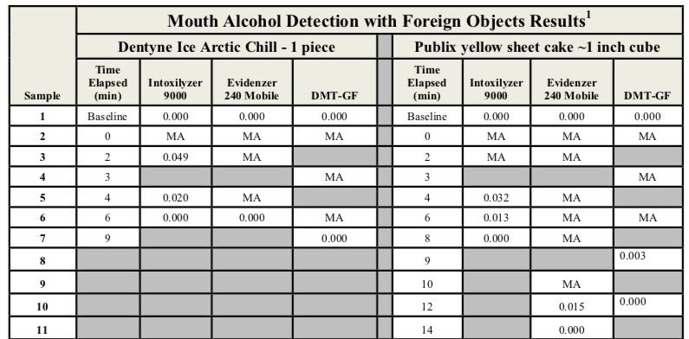
The Intoxilyzer 9000 is not the best device at distinguishing cake from alcohol
Notes:
A mouth alcohol defense can be presented with very little expense, or you can spend a lot of money on it. Generally, my clients don’t have a lot to spend on experts so I have to do some of the heavy lifting on my own.
I want to be clear about 1 thing at the outset: This is not a complicated breath test defense. It requires about 20 minutes of study of the Intox manual, and some planning for motions or ALS hearings and open records requests.
My goal today is to walk you through a Mouth Alcohol Defense, and give you enough information to walk into court monday and use it. I use this defense all of the time, and if I can do it, I know that you can do it effectively.
I have heard very, very good lawyers say things, such as, “I don’t plow with the other man’s mule.” Translated: They don’t try a case and use the state’s witnesses as their own. “Would you buy a Ferrari and put re-tread tires on it?” - Translated: Don’t hire a good lawyer and not equip with the tools to do the job. I understand this sentiment, but I don’t agree with it.
Breath test cases can be tried well and won without a breath test expert. It’s can be more work. It can be gutwrenching. But it can be done. But you have to have a defense that can be developed through the State’s evidence.

Slide 30
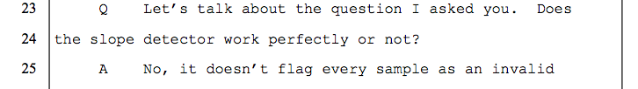
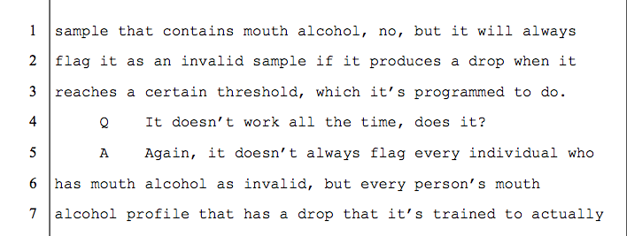
The Mouth Alcohol Detector (SLOPE DETECTOR) is not perfect.

Slide 31
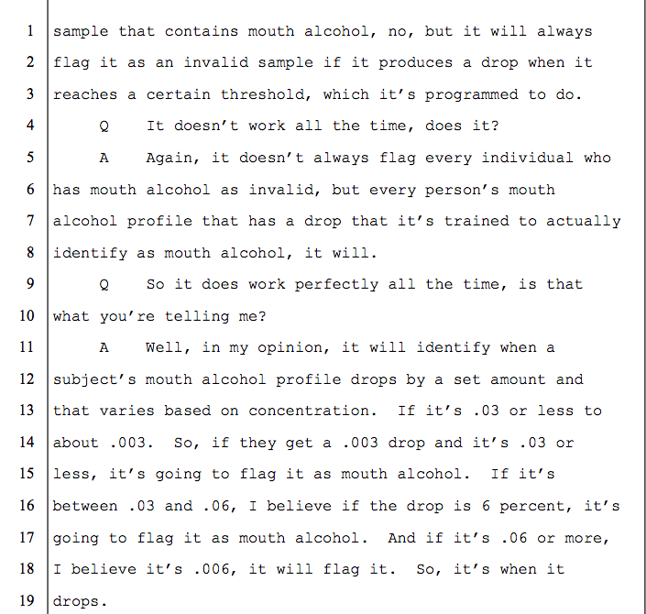
The Mouth Alcohol Detector (SLOPE DETECTOR) is not perfect.

Slide 32
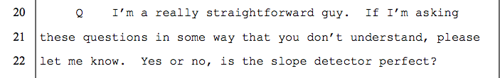
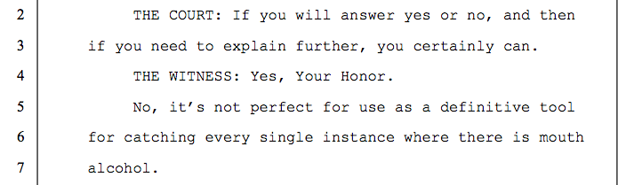
The Mouth Alcohol Detector (SLOPE DETECTOR) is not perfect.

Slide 33
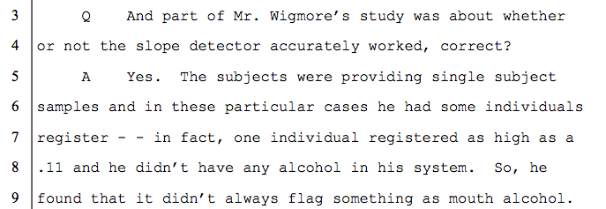
The Mouth Alcohol Detector (SLOPE DETECTOR) - A .11 Result With a True BAC of .00?

Slide 34
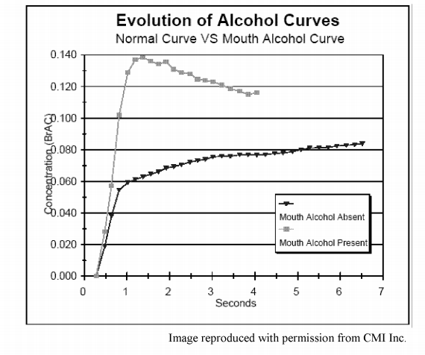
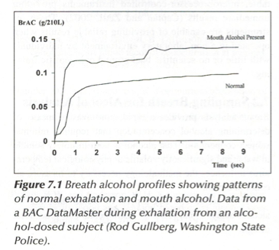
Comparison of Mouth Alcohol Curves
Operator’s Manual
Garriott’s Medical-Legal

Slide 35
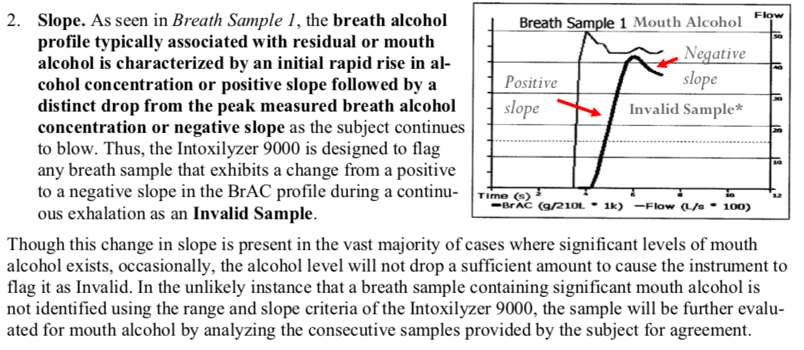
Comparison of Mouth Alcohol Curves

Slide 36
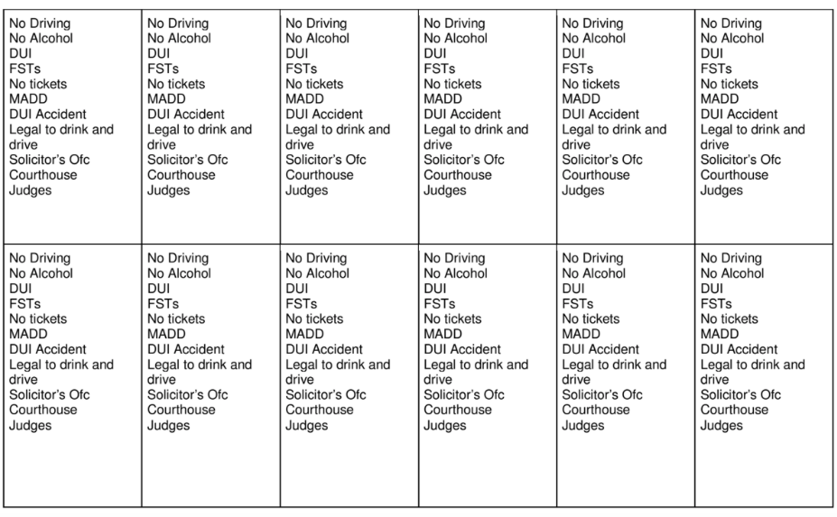
Jury Selection Ideas:
Carl Bettinger, Twelve Heroes, One Voice
Notes:
I used to think that I was a very dry, stick-to-the-facts kind of person in the way that I picked juries and tried cases. Well, it turned out that who I thought I was didn’t translate into wins in front a jury. There is nothing like losing a lot of cases to make you change your personality.
So, what I try to do in jury selection is show juries a little bit of who I am, and I try to show them something that I am not too proud of. For example, when a client sits down at an initial consultation and tells me that they blew a .12 and they don’t have any medical issues, all I think about is that # and, in my heart-of-hearts, I think they are screwed. I rush to judgment without knowing anything else about the case.

Slide 37
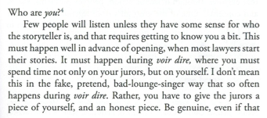
Jury Selection Ideas:
If you show them, they’ll show you
Carl Bettinger, Twelve Heroes, One Voice
Notes:
I used to think that I was a very dry, stick-to-the-facts kind of person in the way that I picked juries and tried cases. Well, it turned out that who I thought I was didn’t translate into wins in front a jury. There is nothing like losing a lot of cases to make you change your personality.
So, what I try to do in jury selection is show juries a little bit of who I am, and I try to show them something that I am not too proud of. For example, when a client sits down at an initial consultation and tells me that they blew a .12 and they don’t have any medical issues, all I think about is that # and, in my heart-of-hearts, I think they are screwed. I rush to judgment without knowing anything else about the case.

Slide 38
Jury Selection Ideas:
Common Ground / Shared Values
Rule Followers – The Pros and The Cons

Slide 39
Opening Statement
I spoke with you about my fear of the number.
Ask that they reserve judgment on it until the conclusion.
Challenge the State to show compliance with the 20-minute observation requirement.
Let them know that they will not see compliance with the 20-minute observation requirement established by the
Notes:
When you don’t have an expert, you need to be more aggressive.

Slide 40
Goals in Cross-Examination of the Arresting Officer and Breath Test Operator
1. Lock them down with regard to the timeline
2. Lock them down with regard to their observation of your client
3. Their observation period consisted of times when they were not watching your client
4. Lock them into their training on the observation period

Slide 41
Cross-Examination of the Operator:
Observation of My Client
1. Did not watch my client during the entirety of the 20-minute period
2. He was in the rear of your patrol car during part of the 20-minutes prior to the breath test
3. Possible he could have burped during the 20-minute period

Slide 42
Cross-Examination of the Operator:
Training on the 20-Minute Wait Period
1. 20-minute wait period is required before each test
2. During the 20-minute period, the suspect is to be:
(1) in a controlled environment,
(2) prohibited from consuming alcohol, and
(3)monitored for regurgitation or vomiting.
3. If vomit, allow them to rinse their mouth with water, and restart the 20-minute wait period.
4. This applies to cases of burping or belching where regurgitation is suspected.

Slide 43
Cross-Examination of the State’s Expert:
STAY FOCUSED ON YOUR GOALS?
1. The mouth alcohol detector is not perfect.
2. The Intoxilyzer 5000 can produce results as high as .11 when a person has a true Blood-Alcohol Concentration of .000.
Additional Cross-Examination Areas:
3. You wrote the Intoxilyzer Operator’s Training Manual.
4. You established the Intoxilyzer Operator’s Training Curriculum.
5. In order to be assured that mouth alcohol will not influence the printed alcohol concentration, the 20-minute observation period must followed.

Slide 44
Closing
We’re not here fighting over general reliability.
We’re here because we think it’s important that they follow THEIR rules in performing a test.
We asked at the beginning of the trial if the State would simply show us that the rules for performing a breath test were followed.
The evidence does not eliminate mouth alcohol as a problem.

Slide 45
Closing Argument –
Mouth Alcohol Defense
Presumptions:
Jurors will have to make a decision based on their values.
“I charge you that breath alcohol measuring equipment approved by the State Crime Lab is considered accurate if properly operated.”
Johnson v. State
The presumption of innocence, the burden of proof, and the standard of proof are the fundamental doctrines of American criminal jurisprudence and the bedrock of determining guilt or innocence in a criminal case.”
Little v. State, 230 Ga.App. 803, 806(2), 498 S.E.2d 284 (1998).

Slide 46


Slide 47
  Attacking a DUI Breath Test Case on a Budget
  Thank you!
Ben Sessions
@Ben_Sessions
TheSessionsLawFirm.com
ben@thesessionslawfim.com
470-225-7710
Defense of Drinking Drivers Institute
Atlanta, Georgia
December 7, 2018

