Slide 1
Defending An Under-21 DUI
Breath Test Case
Ben Sessions
McIlhinney & Sessions
Norcross, Georgia

Slide 2
Why Would You Try An Under-21 Breath Test Case?
A continuance until after the client turns 21 years of age is not a possibility.
You are in a reasonable court.
Pleading isn’t an option.

Slide 3
Develop a Challenge for the Prosecution Early On
Will the prosecution ever produce evidence that the Intoxilyzer 5000 in this case was tested for accuracy below .08?
Has any Intoxilyzer 5000 been verified for accuracy below .08 in this state?

Slide 4
The Best Defense Is a Good Offense
Use some of the customary issues about the unreliability of the Intoxilyzer, but make your theme focused:
They cannot show accuracy below .08.

Slide 5
Jury Selection
Sighting in the Rifle = Accuracy at 25 yards, doesn’t tell me anything about accuracy at 100 yards.
Look for jurors that work “quality-control” types of occupations.
Children and, particularly, that have been charged with MIP.
Prepare your client’s appearance.

Slide 6
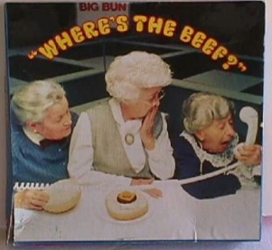
Use the Opening Statement to Layout Your Challenge

Slide 7
Cross-Examination of the Breath Test Operator and the State’s Expert
Primacy
Recency

Slide 8
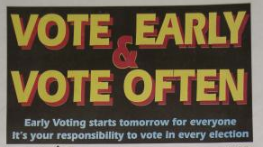
Establish Your Theme Early
Establish Your Theme Often

Slide 9
PRIMACY and
RECENCY

Slide 10
Primacy
Strong but Non-Confrontational
Go for the Kill!
Some type of Shock Value
(Let them know things are about to be more worth listening to)

Slide 11
Recency
The last thing jurors hear
Timing of particular questions for impact

Slide 12
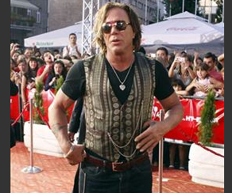
Fundamental Chapters
Move away from the ordinary, generalized attack upon the breath test.

Slide 13
Breath Testing Chapter:
Sample Pages
Radio Frequency Interference (RFI)
Blood v. Breath Test
Conversion Ratio
Diagnostics Mean Nothing

Slide 14
Radio Frequency Interference
How do you communicate with your dispatcher
About how big is this county
Your radio is powerful enough to transmit a signal across that many miles
There is a big tower at the police station that picks up your radio frequency
Where were you (or the arresting officer) standing when the test was performed in this case

Slide 15
Radio Frequency Interference
Where was your radio
Were there other officers with radios at the precinct
Were other officers patrolling the county when this test was given
At that time of night, there is pretty much constant radio communication
What is RFI
When something interferes, it means something has gone wrong?

Slide 16
Blood v. Breath
You have a choice to request blood or breath
Tell the jury what “BAC” stands for
You have chosen a blood test in other cases
But in this case you chose breath
Tell the jury which is the most accurate
Blood is considered the Gold Standard

Slide 17
Blood v. Breath
Worked wrecks
Assisted in taking the injured to the hospital
Where does the hospital keep its Intoxilyzer
Doctors need accuracy
Life or Death decision

Slide 18
Conversion Ratio
Breath testing requires a conversion to a reading as if it were a blood test
Blood/Breath comparison is 1:1L/1:210L
So when we hear about a breath test result it has been converted into what it would be if it were a blood test
The sample chamber in the Intoxilyzer 5000 is only about 80 cubic centimeters

Slide 19
Conversion Ratio
And the government captures that amount of breath, shines a light through the sample chamber and whatever light doesn’t make it to the other end of that 80 cc chamber gives the machine a reading
And then the machine does some internal math and converts that to 210 Liters of Breath
Do you know how much 210 liters of breath is
Its the about the same as a 55 gallon drum
Its about the same as 105 Two liter bottles of Coke

Slide 20
Diagnostics mean nothing
Don’t know what is checked by diagnostics of intoxilyzer
Don’t know if every component is tested
Don’t test accuracy of intoxilyzer prior to test
Don’t run an interferent through the intox during diagnostics
Don’t know all of parts of intox
Don’t know what happens to intox if RFI plug is unplugged during diagnostics
78

Slide 21
Try Your Case:
You don’t have to always play by their rules.

Slide 22
Fundamental Chapters in the Under-21 Case
Assumptions
Where is the calibration check that shows the machine my client was tested on is accurate below .08?
Internal components

Slide 23
Assumptions
We don’t want you to guess about anything.
Agree that you should not guess about anything in a case.
You rely on facts that you observe.
Rely on facts that you collect.
You don’t make assumptions in the field.

Slide 24
Verification of Accuracy Below .08
Bring in the test slips that show that the breath test machine in this case is accurate below .08?
Because it is verified for accuracy at .08, it is accurate below .08.
Assume it is accurate below .08.

Slide 25

Know Your Audience
...And our audience is always the jury.
Notes:
He attended more seminars

Slide 26
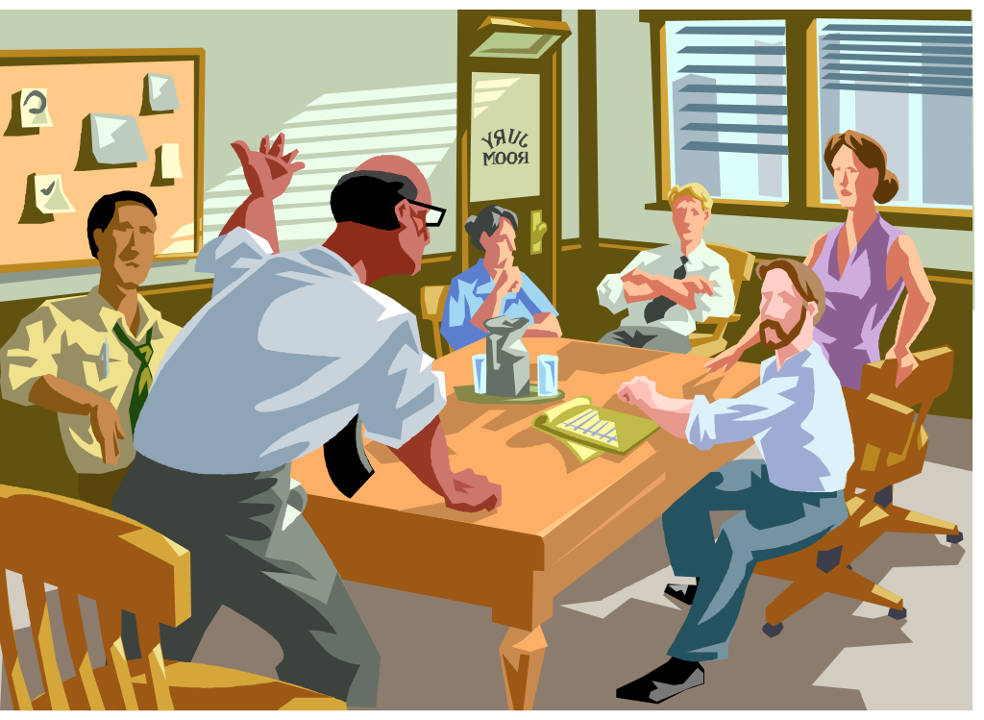

Slide 27
Closing
Presumption/Assumption: What presumption does the Judge instruct the jury to make?
Presume/Assume the accuracy of the Intoxilyzer below .08?

Slide 28
Closing
Analogize the lack of verification of accuracy of the Intox below .08 to things that are important to you will not trust to assumptions.

Slide 29
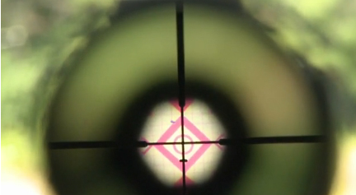
Closing
Go back to jury selection.
Quality control.

Slide 30

Closing

Slide 31
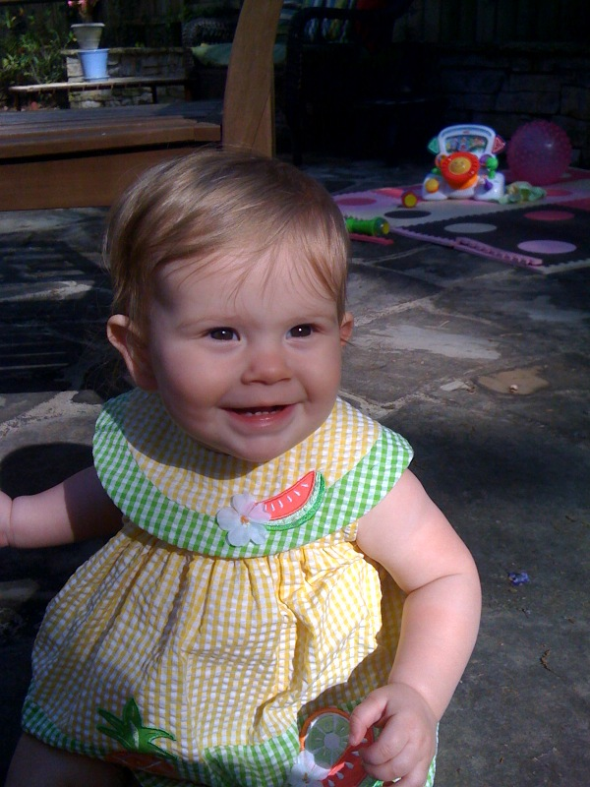
Closing
Would you put her at risk based on an assumption?

