Slide 1

  A Practical Guide to the Defense of Breath Tests at Trial
Ben Sessions
Sessions & Fleischman, LLC
@BenSessions
TheSessionsLawFirm.com
ben@thesessionslawfirm.com
Salt Lake City, Utah
April 26, 2024

Slide 2
State of Utah
v.
Sober Susan Smith
Notes:
I told you all that I was concerned that you would jump to a conclusion about the breath test. Everyone promised that they would wait to see if the rules were followed and if they thought the evidence showed that the test was proved to be reliable in this case.
We all talked about and agreed that following rules in the administration of the test was really important.
When the officers told us that they followed their training by doing a15-minute observation of the defendant in the back of the patrol car while they were driving to the police. We were left scratching our heads.
So, they brought in Mr. Tilson to try to clean up the mess.
He only gave us more questions and doubts though. .11 with no BAC. .049 with cake?

Slide 3
We asked that you do 2 things:
Hold them to their own rules.
Make sure that they employed reasonable safeguards to remove mouth alcohol as a concern.
Show .02 agreement of replicate samples as required by National Safety Council standards
Show that they oberserved Susan for 15 minutes prior to protect against something like a burp or belch

Slide 4
How do you view this case?
The law presumes that Susan is not guilty of the crime(s) charged.
This presumption persists unless the prosecution's evidence convinces you beyond a reasonable doubt that the defendant is guilty.
CR104 Presumption of Innocence.
https://legacy.utcourts.gov/muji/?cat=2
Notes:
The lens through which we view this case – like most anything in life is important.
Most of us have children. And if you have children, you have seen those days when they are just grumpy as all get out. We know how powerful our predisposition to things is. That’s why we try to encourage them to hit the reset the button – to go into the day in a better/more positive way.
Are you a merciful person? Are you a positive person? Do you hope that in you, you can see the best in others?
On my best days, I hope to be that person. And truthfully, because you are here, we saw that in you.
We saw your willingness to be thoughtful. We saw your willingness to say “I am going to presume that stranger to be not guilty of these charges.”

Slide 5
Compare the Role of the State and the Accused
There is no burden of proof upon the defendant whatsoever, and the burden never shifts to the defendant to introduce evidence or to prove innocence.
When a defense is raised by the evidence, the burden is on the State to negate or disprove it beyond a reasonable doubt.
They made no effort to introduce any evidence that the test was reliable despite not having a second test with .02 agreement.
No effort to show that Susan didn’t burp or belch in the rear of the patrol car.

Slide 6
Not Guilty = Not Proven Beyond a Reasonable Doubt
Grave Suspicion Is Not Enough
Facts and circumstances that merely place upon the defendant a grave suspicion of the crime charged or that merely raise a speculation or conjecture of the defendant's guilt are not sufficient to authorize a conviction of the defendant.
Do you think it is good enough to “observe” a person that is in the back of a patrol car? Do you think that was the intent of the 15-minute observation requirement?
Do you assume that the machine’s slope detector is good enough when it has been show time and time again to miss mouth alcohol?

Slide 7
What is a reasonable doubt?
Proof beyond a reasonable doubt is proof that leaves you firmly convinced of the defendant's guilt. There are very few things in this world that we know with absolute certainty and in criminal cases the law does not require proof that overcomes every possible doubt. If, based on your consideration of the evidence, you are firmly convinced that the defendant is guilty of the crime charged, you must find her guilty. If, on the other hand, you think there is a real possibility that she is not guilty, you must give her the benefit of the doubt and find her not guilty.
https://legacy.utcourts.gov/muji/?cat=2

Slide 8
What is a reasonable doubt? Where do you see this “real possibility”?
A reasonable doubt is a doubt for which a reason can be given. Where do you look to see if there are doubts?
The evidence,
A lack of evidence, or
A conflict in the evidence.
If your mind is wavering, unsettled, or unsatisfied, then that is reasonable doubt and you must find the defendant not guilty.

Slide 9
What is a reasonable doubt?
After giving consideration to all of the facts and circumstances of this case, if your minds are:
wavering,
unsettled, or
unsatisfied,
then that is a doubt of the law, and it requires that Ms. Smith be acquitted.
Acquitted means found not guilty / not proven beyond a reasonable doubt.

Slide 10
Comparing Reasonable Doubt to Other Levels of Proof
The prosecution has the burden of proving the defendant guilty beyond a reasonable doubt. Some of you may have served as jurors in civil cases, where you were told that it is only necessary to prove that a fact is more likely true than not true. In criminal cases, the prosecution's proof must be more powerful than that. It must be beyond a reasonable doubt.
https://legacy.utcourts.gov/muji/?cat=2

Slide 11
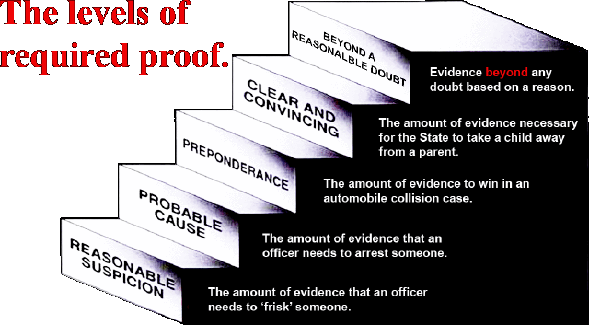

Slide 12
Count 1 – Unlawful Alcohol Concentration
For now, we are just talking about the reasons for doubt as to Count 1.
Has the State proved beyond a reasonable doubt that Sober Susan Smith’s breath alcohol concentration was .05 grams or greater at the time of the test?
They chose to get 1 sample and cannot show .02 agreement. They don’t do what the National Safety Council recommends. They don’t do what the world’s foremost breath testing expert recommends.

Slide 13
Section R714-500-7 - Breath Alcohol Concentration Test Analytical Results
A. The instrument should be operated by either a certified operator or technician.
B. Breath specimen analyzed for breath alcohol concentration shall be essentially alveolar or end expiratory in composition according to the analysis method utilized.
1. The results of tests to determine breath alcohol concentration shall be expressed as equivalent grams of alcohol per 210 liters of breath.
2. Analytical results on a breath alcohol concentration test shall be recorded using terminology established by State statute and reported to three decimal places.
a. For example, a result of 0.237g/210L shall be reported as 0.237.
C. Results of breath alcohol concentration tests will be printed by the instrument.
D. Results are deemed to be an exact representation of breath alcohol concentration at the time of test.
E. The printed results of a breath alcohol concentration test will be retained by the operator or the operator's individual agencies' designated record or evidence custodian.
F. Instrument internal standards on a breath alcohol concentration test do not have to be recorded numerically.
Section R714-500-7 - Breath Alcohol Concentration Test Analytical Results
Notes:
Does Utah even care if the results of the breath test are mouth alcohol or alveolar air?
The air is yes. Our rules require that the breath sample tested be alveolar air.

Slide 14
Reasonable Doubt requires following the rules and using reasonably available safeguards.
Make sure that the observation period involves trying to make sure that the person does not burp or belch.
Use the .02 agreement of samples.
Notes:
Does Utah even care if the results of the breath test are mouth alcohol or alveolar air?
The air is yes. Our rules require that the breath sample tested be alveolar air.

Slide 15
3 things are necessary to protect against mouth alcohol
1. 15-minute “wait” (OBSERVATION) period
2. .02 agreement of the samples
3. the slope detector in the machine (.049 on cake & .11 when no alcohol should have been detected)

Slide 16
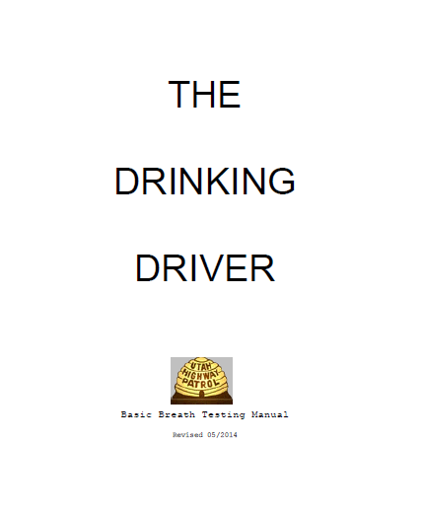

Slide 17
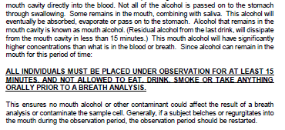

Slide 18
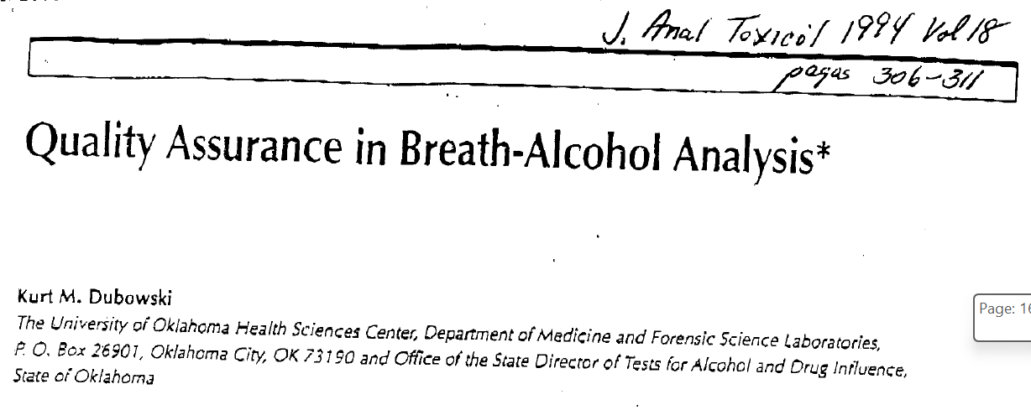
The best breath test expert in the world says replicate test is needed:
Notes:
Great thing about the mouth alcohol defense: it’s based on the training of the breath test operator. We can build upon it fairly simply, but if you needed to try the case without an expert and the state did not call their expert to testify, you could win this case simply using the manual.
If the State calls their expert, as we’ll talk about shortly, there are some very good things you can do to improve your case.

Slide 19
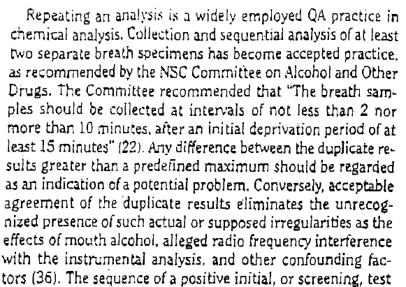
Is there a State expert in Utah that would dare disagree with Dr. Dubowski?
Notes:
Great thing about the mouth alcohol defense: it’s based on the training of the breath test operator. We can build upon it fairly simply, but if you needed to try the case without an expert and the state did not call their expert to testify, you could win this case simply using the manual.
If the State calls their expert, as we’ll talk about shortly, there are some very good things you can do to improve your case.

Slide 20
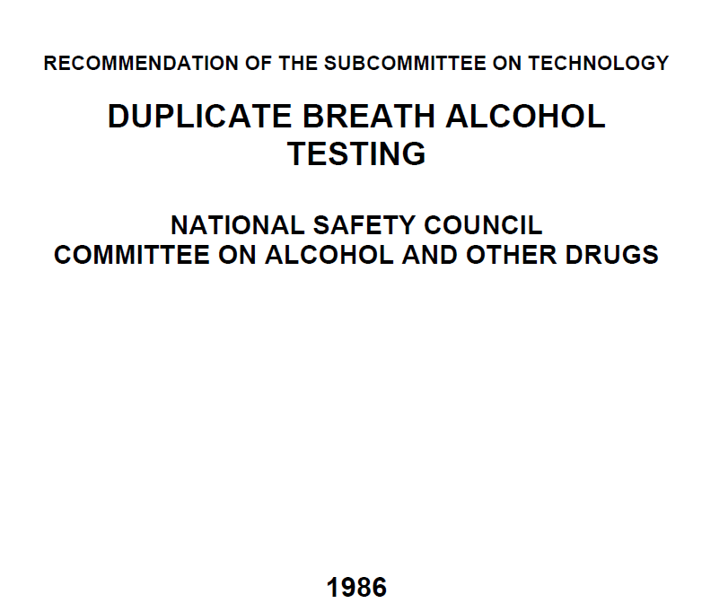
The National Safety Council says that we need replicate tests… and they have since 1986.
Notes:
Great thing about the mouth alcohol defense: it’s based on the training of the breath test operator. We can build upon it fairly simply, but if you needed to try the case without an expert and the state did not call their expert to testify, you could win this case simply using the manual.
If the State calls their expert, as we’ll talk about shortly, there are some very good things you can do to improve your case.

Slide 21
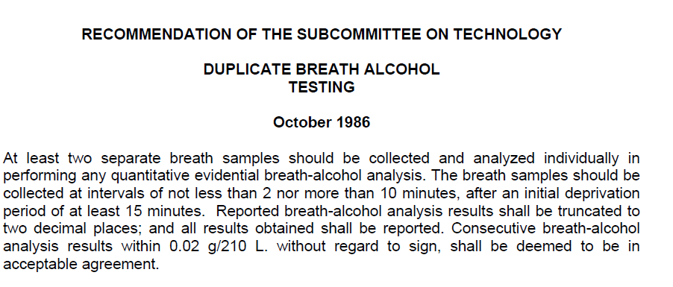
Even the National Safety Council says we need 2 samples:
Notes:
Great thing about the mouth alcohol defense: it’s based on the training of the breath test operator. We can build upon it fairly simply, but if you needed to try the case without an expert and the state did not call their expert to testify, you could win this case simply using the manual.
If the State calls their expert, as we’ll talk about shortly, there are some very good things you can do to improve your case.

Slide 22
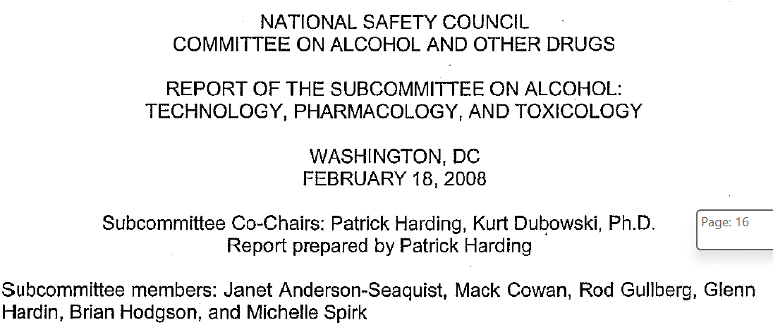
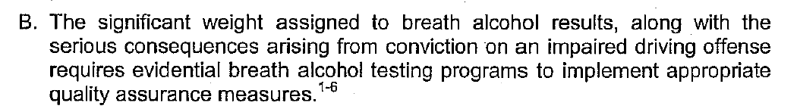
And the National Safety Council CONTINUES to state how important 2 tests are:
Notes:
Great thing about the mouth alcohol defense: it’s based on the training of the breath test operator. We can build upon it fairly simply, but if you needed to try the case without an expert and the state did not call their expert to testify, you could win this case simply using the manual.
If the State calls their expert, as we’ll talk about shortly, there are some very good things you can do to improve your case.

Slide 23
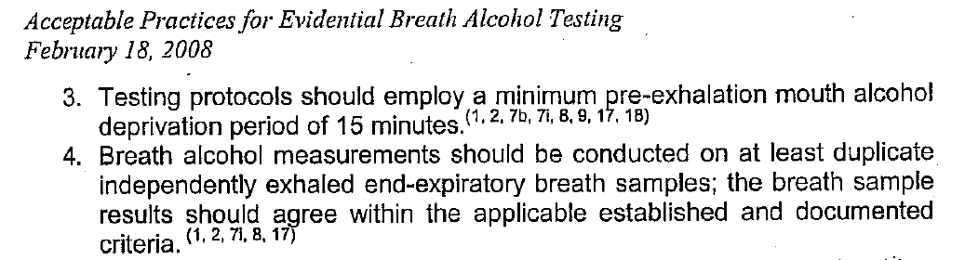
Why doesn’t the State of Utah want to follow basic requirements to eliminate mouth alcohol in Ms. Smith’s case?
Notes:
Great thing about the mouth alcohol defense: it’s based on the training of the breath test operator. We can build upon it fairly simply, but if you needed to try the case without an expert and the state did not call their expert to testify, you could win this case simply using the manual.
If the State calls their expert, as we’ll talk about shortly, there are some very good things you can do to improve your case.

Slide 24
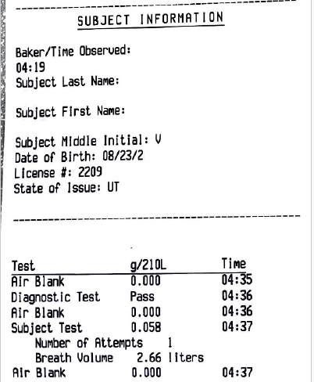

Slide 25
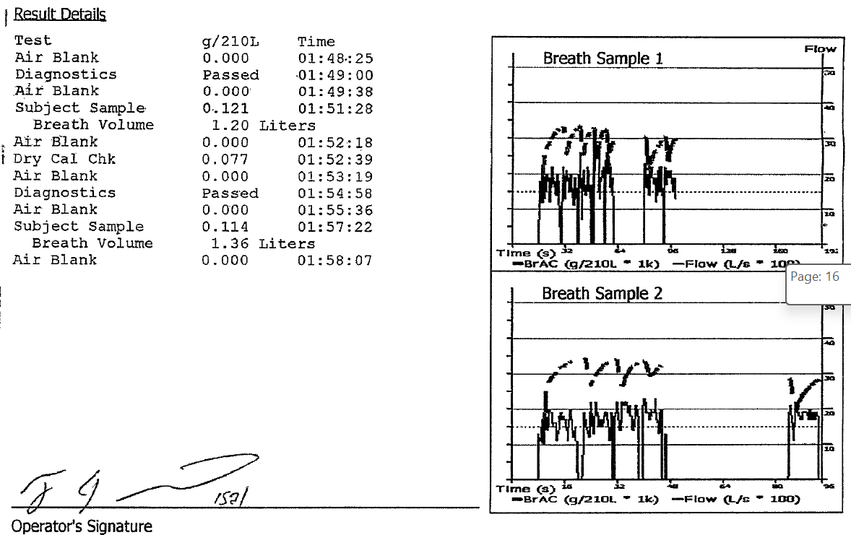

Slide 26
Reasons for Doubt From the Evidence
Unlawful Alcohol Concentration – Count 1
  From their witness – Mr. Tilson:
  .118 based upon mouth alcohol
  .02 from breath spray
  .032 cake
  .049 gum
  The mouth alcohol problem is a real problem in this case.

Slide 27
Reasons for Doubt From the Evidence
Unlawful Alcohol Concentration – Count 2
Officer Janke
Part of the 15-minute observation period was when Susan was in the rear of the patrol car on the way to the police station.
Divided by a plexiglass cage.
Mr. Tilson
Cannot say the 15-minute observation period was sufficiently followed
He chose not to enable the Intoxilyzer 8000 to produce 2 samples
He eliminated 1 of the essential safeguards to mouth alcohol

Slide 28
Reasons for Doubt From a Conflict in the Evidence
Unlawful Alcohol Concentration – Count 2
  Where is the evidence that is consistent with intoxication?
    No impairment of speech
    No impairment of ability to stand and walk
    No impairment of ability to balance
  “Observation” in this case v. what we all know observation means
  Mr. Tilson – “You can rely upon it”, but 36% of the time it missed mouth alcohol.

Slide 29

Reasons for Doubt From a Lack of Evidence
Unlawful Alcohol Concentration – Count 2
  Why wouldn’t you have the safeguard of 2 samples to show .02 agreement? It’s so easy to check for.

Slide 30
What are we asking for?
Count 1 – Unlawful Alcohol Concentration – Not Guilty – Not Proved Beyond a Reasonable Doubt
Count 2 – Failure to Maintain Lane – Guilty

Slide 31
Why is the Mouth Alcohol Defense my
“go-to” defense?
1. My clients are broke, and it is affordable.
2. They want a Not Guilty, and it works.
Notes:
A mouth alcohol defense can be presented with very little expense, or you can spend a lot of money on it. Generally, my clients don’t have a lot to spend on experts so I have to do some of the heavy lifting on my own.
I want to be clear about 1 thing at the outset: This is not a complicated breath test defense. It requires about 20 minutes of study of the Intox manual, and some planning for motions or ALS hearings and open records requests.
My goal today is to walk you through a Mouth Alcohol Defense, and give you enough information to walk into court monday and use it. I use this defense all of the time, and if I can do it, I know that you can do it effectively.
I have heard very, very good lawyers say things, such as, “I don’t plow with the other man’s mule.” Translated: They don’t try a case and use the state’s witnesses as their own. “Would you buy a Ferrari and put re-tread tires on it?” - Translated: Don’t hire a good lawyer and not equip with the tools to do the job. I understand this sentiment, but I don’t agree with it.
Breath test cases can be tried well and won without a breath test expert. It’s can be more work. It can be gutwrenching. But it can be done. But you have to have a defense that can be developed through the State’s evidence.

Slide 32
Some caveats…
Y’all = you all
Fix’n to = something has not occurred yet, but it is about to.
I curse (when I’m nervous and) when I’m in the company of friends.
I’m not a Utah lawyer.
The stuff I say here is just for the purposes of this presentation for Utah lawyers. And for you Georgia prosecutors that see this know that I’m just kidding.
Notes:
A mouth alcohol defense can be presented with very little expense, or you can spend a lot of money on it. Generally, my clients don’t have a lot to spend on experts so I have to do some of the heavy lifting on my own.
I want to be clear about 1 thing at the outset: This is not a complicated breath test defense. It requires about 20 minutes of study of the Intox manual, and some planning for motions or ALS hearings and open records requests.
My goal today is to walk you through a Mouth Alcohol Defense, and give you enough information to walk into court monday and use it. I use this defense all of the time, and if I can do it, I know that you can do it effectively.
I have heard very, very good lawyers say things, such as, “I don’t plow with the other man’s mule.” Translated: They don’t try a case and use the state’s witnesses as their own. “Would you buy a Ferrari and put re-tread tires on it?” - Translated: Don’t hire a good lawyer and not equip with the tools to do the job. I understand this sentiment, but I don’t agree with it.
Breath test cases can be tried well and won without a breath test expert. It’s can be more work. It can be gutwrenching. But it can be done. But you have to have a defense that can be developed through the State’s evidence.

Slide 33
Admissible doesn’t mean that it should not be challenged at trial.
State v. Vialpando, 2004 UT App 95, 89 P.3d 209 –
the suspect was in the officer's presence for the entire period;
it is clear that the suspect had no opportunity to ingest or regurgitate anything during the minimum observation period; and
nothing impeded the officer's powers of observations during the observation period.

Slide 34
Let’s prepare ourselves.
Why are you doing this?
Who is this about?
I am not perfect. I lose (a lot). (Truth be told, I love the feeling of being an underdog and representing underdogs. Also, a huge Taylor Swift/TTPD fan.)
*Are you sure you must do this on a budget?
Notes:
A mouth alcohol defense can be presented with very little expense, or you can spend a lot of money on it. Generally, my clients don’t have a lot to spend on experts so I have to do some of the heavy lifting on my own.
I want to be clear about 1 thing at the outset: This is not a complicated breath test defense. It requires about 20 minutes of study of the Intox manual, and some planning for motions or ALS hearings and open records requests.
My goal today is to walk you through a Mouth Alcohol Defense, and give you enough information to walk into court monday and use it. I use this defense all of the time, and if I can do it, I know that you can do it effectively.
I have heard very, very good lawyers say things, such as, “I don’t plow with the other man’s mule.” Translated: They don’t try a case and use the state’s witnesses as their own. “Would you buy a Ferrari and put re-tread tires on it?” - Translated: Don’t hire a good lawyer and not equip with the tools to do the job. I understand this sentiment, but I don’t agree with it.
Breath test cases can be tried well and won without a breath test expert. It’s can be more work. It can be gutwrenching. But it can be done. But you have to have a defense that can be developed through the State’s evidence.

Slide 35
3 Safeguards Against Mouth Alcohol From the Manual
.02 agreement of the samples (the consecutive samples may not vary by more than .02)
15-minute “wait” (OBSERVATION) period
the slope detector in the machine (Invalid Sample)
Notes:
Every manual that I have includes the statment, “By utilizing the 20 minute wait, the Intoxilyzer 5000’s built in slope or mouth alcohol detector, and the use of replicate samples, the operator can be assured that residual or mouth alcohol with not influence the printed alcohol concentration.”
It does not say that any of 2 of these 3 will assure us that mouth alcohol will not influence the result. The Division of Forensic Sciences of the GBI has determined that all 3 conditions are necessary to assure us that mouth alcohol did not affect the results.

Slide 37
Utah has given you a couple of little gifts. This is #1.
A. The instrument should be operated by either a certified operator or technician.
B. Breath specimen analyzed for breath alcohol concentration shall be essentially alveolar or end expiratory in composition according to the analysis method utilized.
1. The results of tests to determine breath alcohol concentration shall be expressed as equivalent grams of alcohol per 210 liters of breath.
2. Analytical results on a breath alcohol concentration test shall be recorded using terminology established by State statute and reported to three decimal places.
a. For example, a result of 0.237g/210L shall be reported as 0.237.
C. Results of breath alcohol concentration tests will be printed by the instrument.
D. Results are deemed to be an exact representation of breath alcohol concentration at the time of test.
E. The printed results of a breath alcohol concentration test will be retained by the operator or the operator's individual agencies' designated record or evidence custodian.
F. Instrument internal standards on a breath alcohol concentration test do not have to be recorded numerically.
Section R714-500-7 - Breath Alcohol Concentration Test Analytical Results
Notes:
Does Utah even care if the results of the breath test are mouth alcohol or alveolar air?
The air is yes. Our rules require that the breath sample tested be alveolar air.
It doesn’t say RFI, it doesn’t say temperature, or any other variable. They think that mouth alcohol is that important.

Slide 38
The Mouth Alcohol Defense starts with the Intoxilyzer Operator’s Manual
Notes:
Great thing about the mouth alcohol defense: it’s based on the training of the breath test operator. We can build upon it fairly simply, but if you needed to try the case without an expert and the state did not call their expert to testify, you could win this case simply using the manual.
If the State calls their expert, as we’ll talk about shortly, there are some very good things you can do to improve your case.

Slide 39
The possibility of mouth alcohol is dangerous stuff when the State relies upon a breath test to prove an “unlawful alcohol concentration” charge.

Slide 40
Gift #2 that Utah has given you
Notes:
Great thing about the mouth alcohol defense: it’s based on the training of the breath test operator. We can build upon it fairly simply, but if you needed to try the case without an expert and the state did not call their expert to testify, you could win this case simply using the manual.
If the State calls their expert, as we’ll talk about shortly, there are some very good things you can do to improve your case.

Slide 41
Is there a State expert in Utah that would dare disagree with Dr. Dubowski?
Notes:
Great thing about the mouth alcohol defense: it’s based on the training of the breath test operator. We can build upon it fairly simply, but if you needed to try the case without an expert and the state did not call their expert to testify, you could win this case simply using the manual.
If the State calls their expert, as we’ll talk about shortly, there are some very good things you can do to improve your case.

Slide 42
Even the National Safety Council says we need 2 samples:
Notes:
Great thing about the mouth alcohol defense: it’s based on the training of the breath test operator. We can build upon it fairly simply, but if you needed to try the case without an expert and the state did not call their expert to testify, you could win this case simply using the manual.
If the State calls their expert, as we’ll talk about shortly, there are some very good things you can do to improve your case.

Slide 43
Even the National Safety Council says that we need replicate tests… and they have since 1986.
Notes:
Great thing about the mouth alcohol defense: it’s based on the training of the breath test operator. We can build upon it fairly simply, but if you needed to try the case without an expert and the state did not call their expert to testify, you could win this case simply using the manual.
If the State calls their expert, as we’ll talk about shortly, there are some very good things you can do to improve your case.

Slide 44
Even the National Safety Council says we need 2 samples:
Notes:
Great thing about the mouth alcohol defense: it’s based on the training of the breath test operator. We can build upon it fairly simply, but if you needed to try the case without an expert and the state did not call their expert to testify, you could win this case simply using the manual.
If the State calls their expert, as we’ll talk about shortly, there are some very good things you can do to improve your case.

Slide 45
And the National Safety Council continues to state how important 2 tests are:
Notes:
Great thing about the mouth alcohol defense: it’s based on the training of the breath test operator. We can build upon it fairly simply, but if you needed to try the case without an expert and the state did not call their expert to testify, you could win this case simply using the manual.
If the State calls their expert, as we’ll talk about shortly, there are some very good things you can do to improve your case.

Slide 46
Why doesn’t the State of Utah want to follow basic requirements to eliminate mouth alcohol in Ms. Smith’s case?
Notes:
Great thing about the mouth alcohol defense: it’s based on the training of the breath test operator. We can build upon it fairly simply, but if you needed to try the case without an expert and the state did not call their expert to testify, you could win this case simply using the manual.
If the State calls their expert, as we’ll talk about shortly, there are some very good things you can do to improve your case.

Slide 49
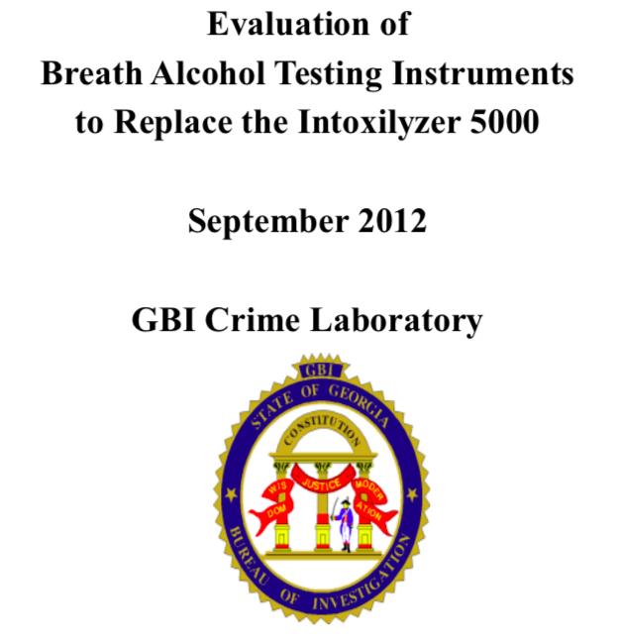
Notes:
A mouth alcohol defense can be presented with very little expense, or you can spend a lot of money on it. Generally, my clients don’t have a lot to spend on experts so I have to do some of the heavy lifting on my own.
I want to be clear about 1 thing at the outset: This is not a complicated breath test defense. It requires about 20 minutes of study of the Intox manual, and some planning for motions or ALS hearings and open records requests.
My goal today is to walk you through a Mouth Alcohol Defense, and give you enough information to walk into court monday and use it. I use this defense all of the time, and if I can do it, I know that you can do it effectively.
I have heard very, very good lawyers say things, such as, “I don’t plow with the other man’s mule.” Translated: They don’t try a case and use the state’s witnesses as their own. “Would you buy a Ferrari and put re-tread tires on it?” - Translated: Don’t hire a good lawyer and not equip with the tools to do the job. I understand this sentiment, but I don’t agree with it.
Breath test cases can be tried well and won without a breath test expert. It’s can be more work. It can be gutwrenching. But it can be done. But you have to have a defense that can be developed through the State’s evidence.

Slide 50
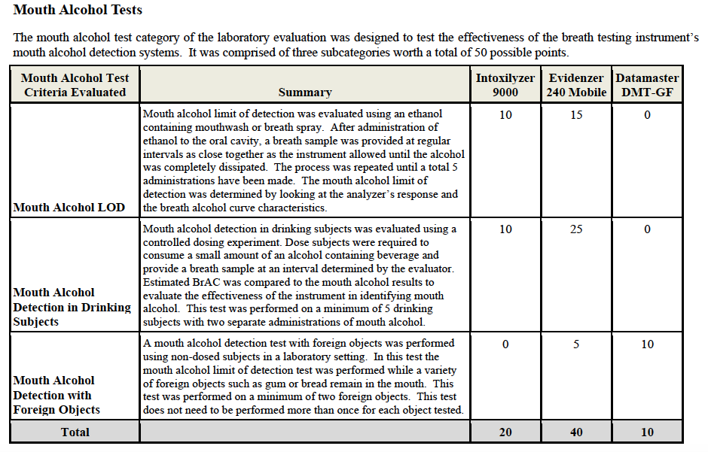
The Intoxilyzer 9000 is not the best device at detecting mouth/residual alcohol
Notes:
A mouth alcohol defense can be presented with very little expense, or you can spend a lot of money on it. Generally, my clients don’t have a lot to spend on experts so I have to do some of the heavy lifting on my own.
I want to be clear about 1 thing at the outset: This is not a complicated breath test defense. It requires about 20 minutes of study of the Intox manual, and some planning for motions or ALS hearings and open records requests.
My goal today is to walk you through a Mouth Alcohol Defense, and give you enough information to walk into court monday and use it. I use this defense all of the time, and if I can do it, I know that you can do it effectively.
I have heard very, very good lawyers say things, such as, “I don’t plow with the other man’s mule.” Translated: They don’t try a case and use the state’s witnesses as their own. “Would you buy a Ferrari and put re-tread tires on it?” - Translated: Don’t hire a good lawyer and not equip with the tools to do the job. I understand this sentiment, but I don’t agree with it.
Breath test cases can be tried well and won without a breath test expert. It’s can be more work. It can be gutwrenching. But it can be done. But you have to have a defense that can be developed through the State’s evidence.

Slide 51
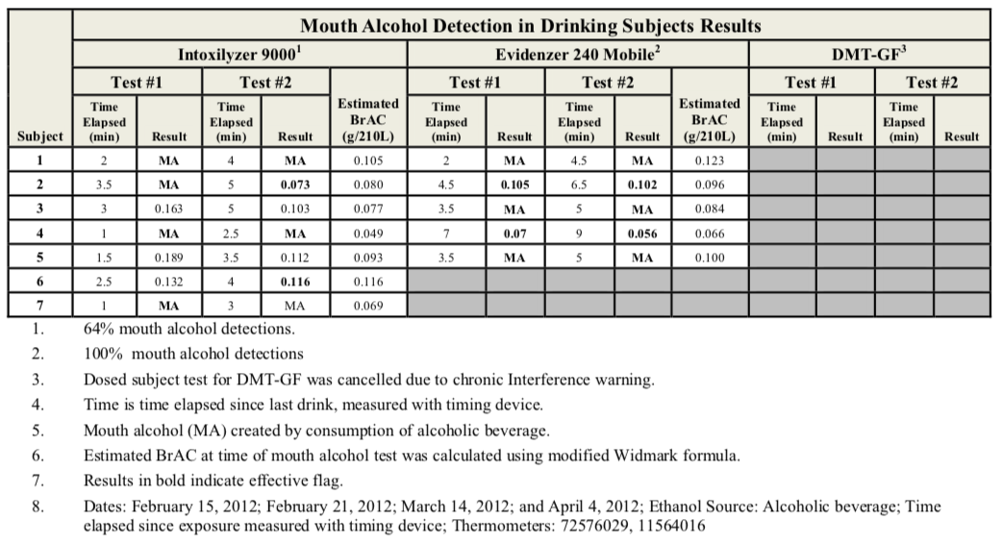
The Intoxilyzer 9000 is not the best device at detecting mouth/residual alcohol
Notes:
A mouth alcohol defense can be presented with very little expense, or you can spend a lot of money on it. Generally, my clients don’t have a lot to spend on experts so I have to do some of the heavy lifting on my own.
I want to be clear about 1 thing at the outset: This is not a complicated breath test defense. It requires about 20 minutes of study of the Intox manual, and some planning for motions or ALS hearings and open records requests.
My goal today is to walk you through a Mouth Alcohol Defense, and give you enough information to walk into court monday and use it. I use this defense all of the time, and if I can do it, I know that you can do it effectively.
I have heard very, very good lawyers say things, such as, “I don’t plow with the other man’s mule.” Translated: They don’t try a case and use the state’s witnesses as their own. “Would you buy a Ferrari and put re-tread tires on it?” - Translated: Don’t hire a good lawyer and not equip with the tools to do the job. I understand this sentiment, but I don’t agree with it.
Breath test cases can be tried well and won without a breath test expert. It’s can be more work. It can be gutwrenching. But it can be done. But you have to have a defense that can be developed through the State’s evidence.

Slide 52
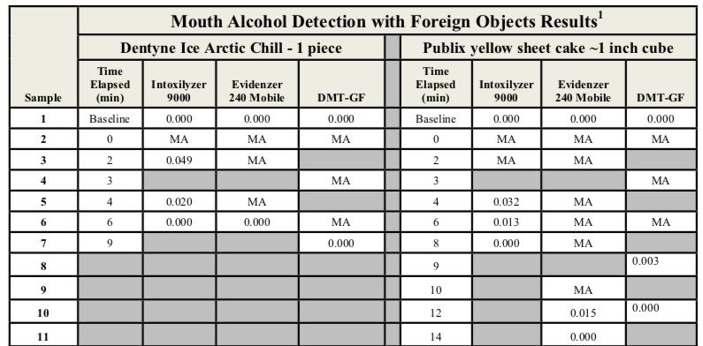
The Intoxilyzer 9000 is not the best device at distinguishing cake from alcohol
Notes:
A mouth alcohol defense can be presented with very little expense, or you can spend a lot of money on it. Generally, my clients don’t have a lot to spend on experts so I have to do some of the heavy lifting on my own.
I want to be clear about 1 thing at the outset: This is not a complicated breath test defense. It requires about 20 minutes of study of the Intox manual, and some planning for motions or ALS hearings and open records requests.
My goal today is to walk you through a Mouth Alcohol Defense, and give you enough information to walk into court monday and use it. I use this defense all of the time, and if I can do it, I know that you can do it effectively.
I have heard very, very good lawyers say things, such as, “I don’t plow with the other man’s mule.” Translated: They don’t try a case and use the state’s witnesses as their own. “Would you buy a Ferrari and put re-tread tires on it?” - Translated: Don’t hire a good lawyer and not equip with the tools to do the job. I understand this sentiment, but I don’t agree with it.
Breath test cases can be tried well and won without a breath test expert. It’s can be more work. It can be gutwrenching. But it can be done. But you have to have a defense that can be developed through the State’s evidence.

Slide 53
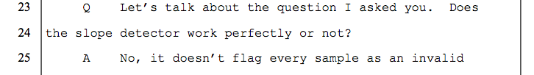
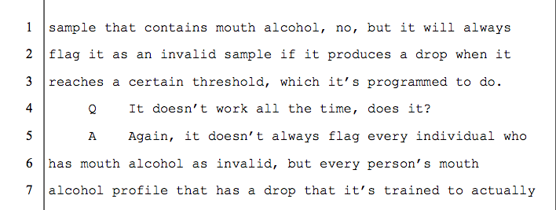
The Mouth Alcohol Detector (SLOPE DETECTOR) is not perfect.

Slide 54
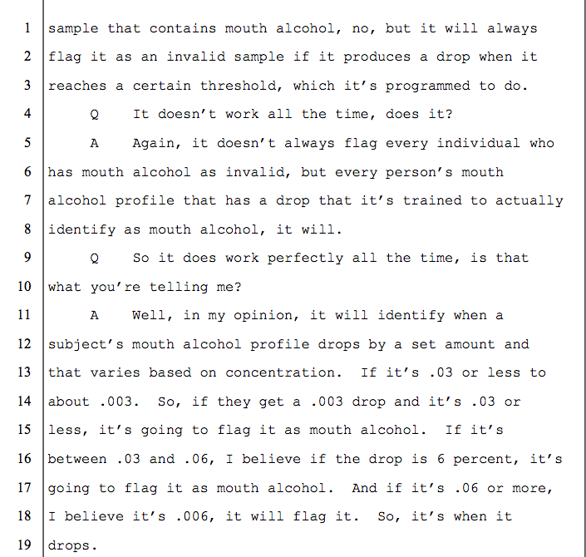
The Mouth Alcohol Detector (SLOPE DETECTOR) is not perfect.

Slide 55
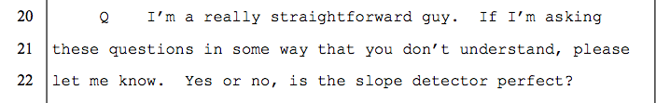
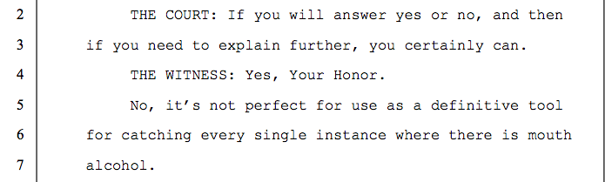
The Mouth Alcohol Detector (SLOPE DETECTOR) is not perfect.

Slide 56
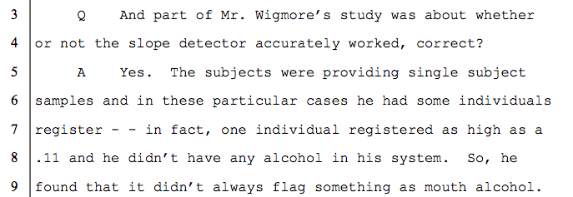
The Mouth Alcohol Detector (SLOPE DETECTOR) - A .11 Result With a True BAC of .00?
*Did you see what the State expert said about it being a single sample study?*

Slide 57
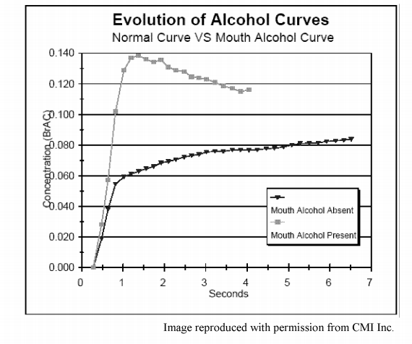
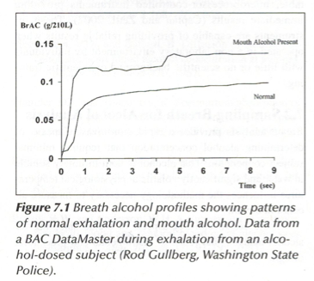
Comparison of Mouth Alcohol Curves
Operator’s Manual
Garriott’s Medical-Legal

Slide 58
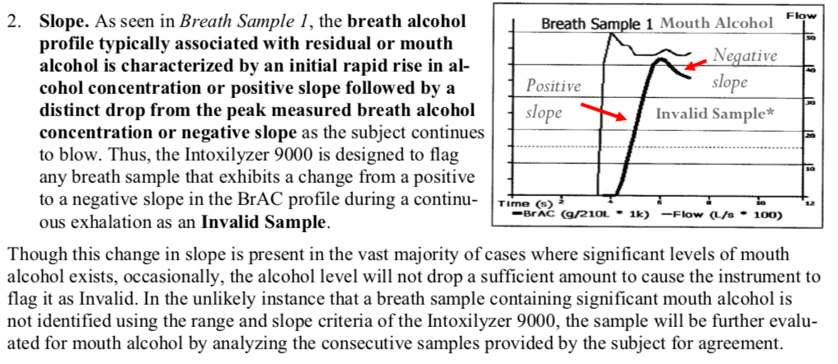
Comparison of Mouth Alcohol Curves

Slide 59
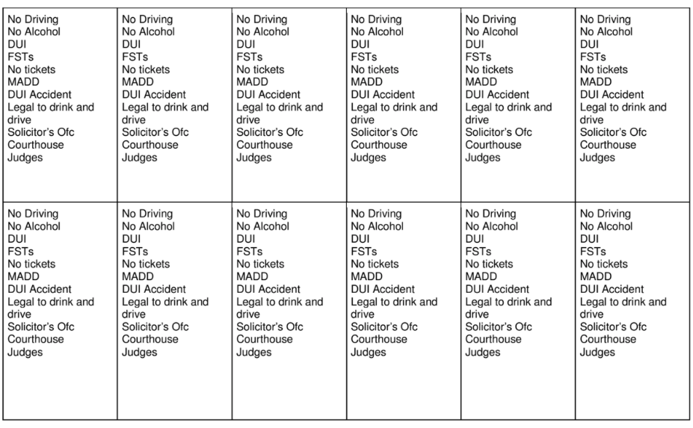
Jury Selection Ideas:
Carl Bettinger, Twelve Heroes, One Voice
Notes:
I used to think that I was a very dry, stick-to-the-facts kind of person in the way that I picked juries and tried cases. Well, it turned out that who I thought I was didn’t translate into wins in front a jury. There is nothing like losing a lot of cases to make you change your personality.
So, what I try to do in jury selection is show juries a little bit of who I am, and I try to show them something that I am not too proud of. For example, when a client sits down at an initial consultation and tells me that they blew a .12 and they don’t have any medical issues, all I think about is that # and, in my heart-of-hearts, I think they are screwed. I rush to judgment without knowing anything else about the case.

Slide 60
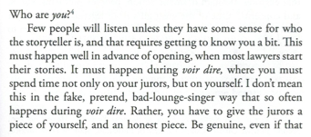
Jury Selection Ideas:
If you show them, they’ll show you
Carl Bettinger, Twelve Heroes, One Voice
Notes:
I used to think that I was a very dry, stick-to-the-facts kind of person in the way that I picked juries and tried cases. Well, it turned out that who I thought I was didn’t translate into wins in front a jury. There is nothing like losing a lot of cases to make you change your personality.
So, what I try to do in jury selection is show juries a little bit of who I am, and I try to show them something that I am not too proud of. For example, when a client sits down at an initial consultation and tells me that they blew a .12 and they don’t have any medical issues, all I think about is that # and, in my heart-of-hearts, I think they are screwed. I rush to judgment without knowing anything else about the case.

Slide 61
Jury Selection Ideas:
Common Ground / Shared Values
Rule Followers – The Pros and The Cons

Slide 62
Opening Statement
I spoke with you about my fear of the number.
Ask that they reserve judgment on it until the conclusion.
Challenge the State to show compliance with the 15-minute observation requirement.
Let them know that they will not see compliance with the 15-minute observation requirement established by the State
Notes:
When you don’t have an expert, you need to be more aggressive.

Slide 63
Opening Statement
How long did it take the State to perform that test?
How much more would it cost the State to do that test (the cost of the plastic breath tube and the printout)?
Why don’t they have a second test to show .02 agreement?
Notes:
When you don’t have an expert, you need to be more aggressive.

Slide 64
Cross-Examination of the Operator:
Why is there no replicate/confirmatory test?
Ask how long it took to perform that test
Ask how much more it cost the State to do that test (the cost of the plastic breath tube and the printout)
And they don’t have a second test to show .02 agreement

Slide 65
Goals in Cross-Examination of the Arresting Officer and Breath Test Operator: 15-minute Observation
1. Lock them down with regard to the timeline
2. Lock them down with regard to their observation of your client
3. Their observation period consisted of times when they were not watching your client
4. Lock them into their training on the observation period

Slide 66
Cross-Examination of the Operator:
Observation of My Client
1. Did not watch my client during the entirety of the 15-minute period
2. She was in the rear of your patrol car during part of the 15-minutes prior to the breath test
3. Possible she could have burped during the 15-minute period

Slide 67
Cross-Examination of the Operator:
Training on the 15-Minute Wait Period
1. 15-minute wait period is required before each test
2. During the 15-minute period, the suspect is to be:
(1) in a controlled environment,
(2) prohibited from consuming alcohol, and
(3)monitored for regurgitation or vomiting.
3. If vomit or regurgitate, allow them to rinse their mouth with water, and restart the 15-minute wait period.
4. This applies to cases of burping or belching where regurgitation is suspected.

Slide 68
Cross-Examination of the State’s Expert:
STAY FOCUSED ON YOUR GOALS?
1. The mouth alcohol detector is not perfect.
2. The Intoxilyzer 9000 can produce results as high as .11 when a person has a true Blood-Alcohol Concentration of .000.
Additional Cross-Examination Areas:
3. You wrote the Intoxilyzer Operator’s Training Manual.
4. You established the Intoxilyzer Operator’s Training Curriculum.
5. In order to be assured that mouth alcohol will not influence the printed alcohol concentration, the 15-minute observation period must followed.

Slide 69
Closing
We’re not here fighting over general reliability.
We’re here because we think it’s important that they follow THEIR rules in performing a test.
We asked at the beginning of the trial if the State would simply show us that the rules for performing a breath test were followed.
The evidence does not eliminate mouth alcohol as a problem.

Slide 70
Thank you!
  Want to keep in touch?
Follow me on the ‘Gram:
https://www.instagram.com/bensessions/
@bensessions
Or on YouTube:
https://www.youtube.com/@BenSessions

