Slide 1
Lunch & Learn: DUI Practice
December 8, 2023

Slide 2
Let’s first look at the state and federal constitutional lens through which we view the major pieces of evidence in DUI cases.
Field sobriety tests
Roadside breath tests
Post-arrest breath tests
Blood tests
Urine tests
and refusals of each.

Slide 3
 | Par. 16 | 4th Amendment | Misleading Info
Field Tests | Applicable – Totality of circumstances (Woods) | Not applicable | **
Refusal of Field Tests | Inadmissible - Ammons | Not applicable | **
Breath Tests | Totality of circumstances | Not a winner – SIA - SCOTUS | Statutory grounds remain
Refusal of Breath Tests | Inadmissible - Elliott |  | **
Blood Tests | Look at the administration | Totality of the circumstances & Randall | Statutory grounds remain
Refusal of Blood Tests | Not Applicable** | Randall is pending | Statutory grounds remain
Urine Tests | Applicable | Should be applicable – case not pending* | Should be applicable – case not pending*
Refusal of Urine Tests | Inadmissible – Awad | ** | **

Slide 4
What do you do with blood refusals in light of Randall II?
        Hold? – With all of the collateral consequences.
        What if holding isn’t an option? – (1) Admit it for the limited purpose of explaining the absence of a test (and instruct the jury of it), and (2) conduct a Rule 403 (O.C.G.A. 24-4-403) analysis to determine admissibility.

Slide 5
Submission to Breath (and URINE) Test After Elliott
Old implied consent or new?
Old implied consent? Challenge voluntariness and misleading information.
  He/she was told refusal could be introduced. That’s false, and it is the type of information that would lead to submission to the test. Sauls, Kitchens, etc.
  New implied consent? Voluntariness analysis.

Slide 6
Submission to a Blood Test
Old implied consent or new?
Old implied consent? Challenge voluntariness and misleading information.
  He/she was told refusal could be introduced. That’s false, and it is the type of information that would lead to submission to the test. Sauls, Kitchens, etc.
  Randall?
  New implied consent? Voluntariness analysis.

Slide 7
Implied Consent: The Advisement
        Constitutional challenges to the admissibility of the state-administered tests are common these days, but if given the choice between a constitutional challenge and viable statutory challenge, you’re safer with the statutory grounds.

Slide 8
Implied Consent: The Advisement
        Timing of the Implied Consent Warning: After Arrest
Delay in the Advisement of Implied Consent Warning
Misstatement Regarding the Legal Limit
Coercion to Submit to the Breath Test: “Blow Below and You Go Home”
Rescission of the Refusal
Statements Regarding Out-of-State License Being Suspended

Slide 9
Implied Consent: Independent Test
Independent Test Requests
Timing of the Request for an Independent Test
Limitations on Facilities for the Administration of Independent Test

Slide 10
Demurrers – Citation-Specific Problems
[A] citation — if used as a charging instrument — should provide at least a bare minimum of facts alleging how the defendant violated the Code section or at least track the language of the Code section — not just the title of the Code section — to set out all of the elements of the offense.
In conclusion, we find that the citation at issue is substantively defective because it simply alleges that Strickland violated a certain statute, which is insufficient to survive a motion to quash. See Jackson, 301 Ga. at 140 (1), 800 S.E.2d 356.
Accordingly, the trial court erred in denying Strickland's motion to quash the citation, and Strickland's conviction is reversed. See Spence v. State, 263 Ga. App. 25, 28 (2), 587 S.E.2d 183 (2003); Ross v. State, 235 Ga. App. 7, 508 S.E.2d 424 (1998).
Strickland v. State, 349 Ga. App. 673, 680, 824 S.E.2d 555, 560–61 (2019)

Slide 11
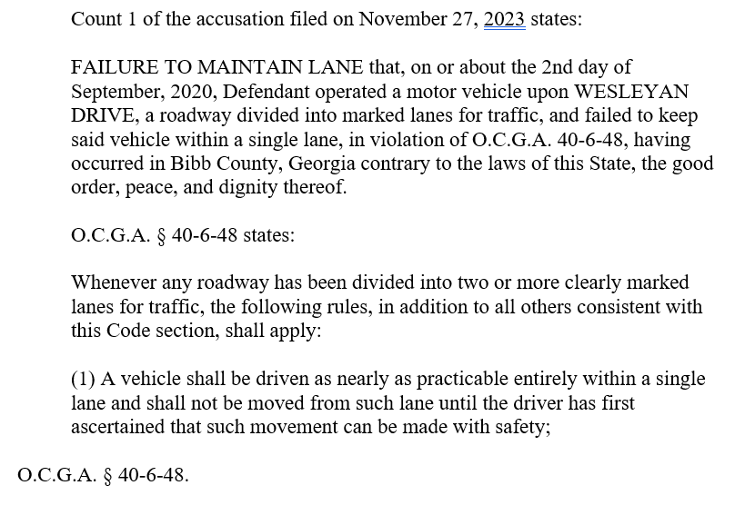
Demurrers – Not Limited to Citations

Slide 12
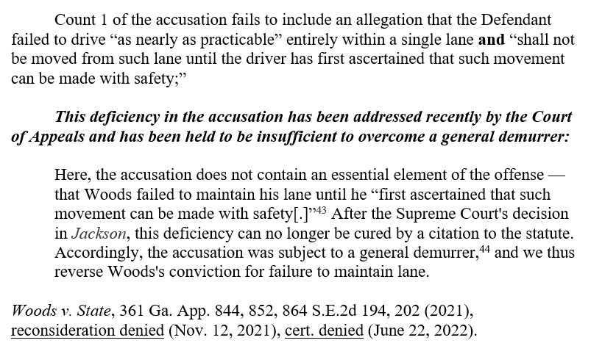
Demurrers – Not Limited to Citations

Slide 13
Statutory Speedy Trial Demands
a) Any defendant against whom a true bill of indictment or an accusation is filed with the clerk for an offense not affecting the defendant's life may enter a demand for speedy trial at the court term at which the indictment or accusation is filed or at the next succeeding regular court term thereafter; or, by special permission of the court, the defendant may at any subsequent court term thereafter demand a speedy trial. In either case, the demand for speedy trial shall be filed with the clerk of court and served upon the prosecutor and upon the judge to whom the case is assigned or, if the case is not assigned, upon the chief judge of the court in which the case is pending. A demand for speedy trial filed pursuant to this Code section shall be filed as a separate, distinct, and individual document and shall not be a part of any other pleading or document. Such demand shall clearly be titled “Demand for Speedy Trial”; reference this Code section within the pleading; and identify the indictment number or accusation number for which such demand is being made. The demand for speedy trial shall be binding only in the court in which the demand for speedy trial is filed, except where the case is transferred from one court to another without a request from the defendant.
O.C.G.A. § 17-7-170.

Slide 14
Statutory Speedy Trial Demands
Emanuel County
State Court trial terms are reserved for the last Monday of April, July, and October of each year.
Bryan County
In accordance with Ga. L. 1996, p. 4404, Bryan County State Court terms last one month. That local legislation provides, “The terms of said court shall be monthly for the trial and disposition of as (sic) criminal and civil business of whatever kind or nature of which said court has jurisdiction under the laws and Constitution of the State of Georgia.”
Chatham County
Effective on and after the first Tuesday in September, 1997, there shall be four terms of the state court each year. The terms of such court shall begin on the first Monday in March, the first Monday in June, the first Tuesday after the first Monday in September, and the first Monday in December."

Slide 15
Statutory Speedy Trial Demands
DO NOT RELY ON O.C.G.A. § 15-6-3 FOR YOUR STATE COURT TERMS
Chatham County
Effective on and after the first Tuesday in September, 1997, there shall be four terms of the state court each year. The terms of such court shall begin on the first Monday in March, the first Monday in June, the first Tuesday after the first Monday in September, and the first Monday in December."
Compare Superior Court:
Eastern Circuit:
Chatham County--First Monday in March, June, September, and December.
O.C.G.A. § 15-6-3.

Slide 16
Statutory Speedy Trial Demands
Candler County
I looked for the State Court terms, and I couldn’t find them.
Jenkins County
I looked for the State Court terms, and I couldn’t find them.

Slide 17
Statutory Speedy Trial Demands
Timeliness of Statutory Speedy Trial Demand
Any defendant against whom a true bill of indictment or an accusation is filed with the clerk for an offense not affecting the defendant's life may enter a demand for speedy trial at the court term at which the indictment or accusation is filed or at the next succeeding regular court term thereafter; or, by special permission of the court, the defendant may at any subsequent court term thereafter demand a speedy trial.
Ga. Code Ann. § 17-7-170.
Query: Can the State file an accusation, which triggers the right to demand a statutory speedy trial, and not give the Defendant notice of the filing? (And later argue the filing was
untimely?)

Slide 18
Statutory Speedy Trial Demands
Service and Filing of the Statutory Speedy Trial Demand
In either case, the demand for speedy trial shall be filed with the clerk of court and served upon the prosecutor and upon the judge to whom the case is assigned or, if the case is not assigned, upon the chief judge of the court in which the case is pending.
Ga. Code Ann. § 17-7-170.

Slide 19
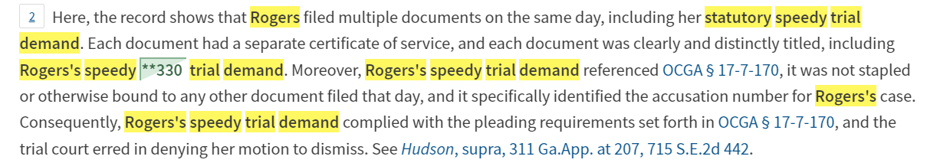
Statutory Speedy Trial Demands
Form of Statutory Speedy Trial Demand
A demand for speedy trial filed pursuant to this Code section shall be filed as a separate, distinct, and individual document and shall not be a part of any other pleading or document. Such demand shall clearly be titled “Demand for Speedy Trial”; reference this Code section within the pleading; and identify the indictment number or accusation number for which such demand is being made.
Ga. Code Ann. § 17-7-170.
Rogers v. State, 340 Ga. App. 24, 25, 795 S.E.2d 328, 330 (2016).

Slide 20
Basics of the Constitutional Speedy Analysis
The analysis has two stages. First, the court must determine whether the interval from the accused's arrest, indictment, or other formal accusation to the trial is sufficiently long to be considered “presumptively prejudicial.” If not, the speedy trial claim fails at the threshold. If, however, the delay has passed the point of presumptive prejudice, the court must proceed to the second step of the Barker-Doggett analysis, which requires the application of a delicate, context-sensitive, four-factor balancing test to determine whether the accused has been deprived of the right to a speedy trial.
Ruffin v. State, 284 Ga. 52, 55, 663 S.E.2d 189, 195 (2008) (citations omitted).

Slide 21
Constitutional Speedy Motions: Where do they fail?
[W]ith respect to the Barker v. Wingo analysis, it should be recognized that delayed assertion of the right to a speedy trial and lack of prejudice are the two factors that most often weigh heavily against defendants and which then support the overall conclusion that speedy trial rights have not been violated.
Phan v. State, 287 Ga. 697, 700, 699 S.E.2d 9, 12 (2010) adopted, (Ga. Super. June 17, 2011)

Slide 22
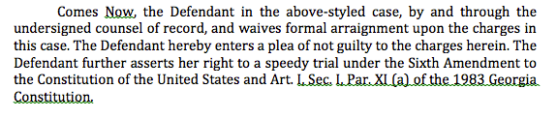
Constitutional Speedy Motions: Asserting the Right
It would also allow a court to weigh the frequency and force of the objections as opposed to attaching significant weight to a purely pro forma objection.
Barker v. Wingo, 407 U.S. 514, 528-29, 92 S. Ct. 2182, 2191, 33 L. Ed. 2d 101 (1972) (citations omitted).
* YELL AT ME IF I DON’T DISCUSS IMPORTANT STRATEGIC CONSIDERATIONS FOR CASES BEING BOUND OVER TO A STATE/SUPERIOR COURT.

Slide 23
Establishing prejudice in the constitutional speedy context
Prejudice, of course, should be assessed in the light of the interests of defendants which the speedy trial right was designed to protect. This Court has identified three such interests: (i) to prevent oppressive pretrial incarceration; (ii) to minimize anxiety and concern of the accused; and (iii) to limit the possibility that the defense will be impaired. Of these, the most serious is the last, because the inability of a defendant adequately to prepare his case skews the fairness of the entire system. If witnesses die or disappear during a delay, the prejudice is obvious. There is also prejudice if defense witnesses are unable to recall accurately events of the distant past. Loss of memory, however, is not always reflected in the record because what has been forgotten can rarely be shown.
Barker v. Wingo, 407 U.S. 514, 532, 92 S. Ct. 2182, 2193, 33 L. Ed. 2d 101 (1972) (citation omitted).

Slide 24
Specific issues relating to prejudice: late amendment

Slide 25
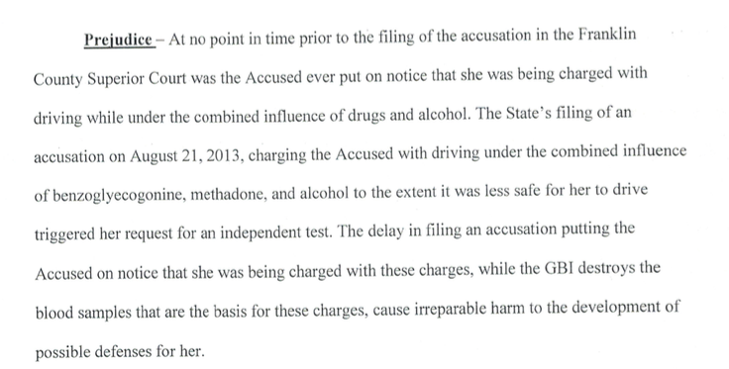
Specific issues relating to prejudice: destruction of samples

Slide 26
Specific issues relating to prejudice: pre-trial incarceration
However, we disagree with the trial court's determination that there was no evidence of prejudice for the period of time that Leopold subsequently served in jail after his release. The record shows that Leopold was later arrested for an unrelated probation violation, and as a result, was held in the DeKalb County jail from December 18, 2008 until the start of his trial. Leopold argues that the delay in this case caused him to lose the possibility of serving this sentence concurrently with the nine months he served on his sentence for the probation violation. This Court has previously recognized that with respect to a defendant incarcerated on other charges, a delay in bringing such a person to trial may be prejudicial because the defendant may forego the opportunity to receive a sentence that is at least partially concurrent with the one he is serving. Johnson, 313 Ga.App. at 904(2)(d), 723 S.E.2d 100 (citing Smith v. Hooey, 393 U.S. 374, 378, 89 S.Ct. 575, 21 L.Ed.2d 607 (1969)). Thus, the trial court erred in failing to consider this factor. However, our Supreme Court has consistently held that “when a defendant is already incarcerated for unrelated offenses, there is minimal possibility of oppressive pretrial incarceration.” See Williams, 279 Ga. at 109(1)(d), 610 S.E.2d 32 (citing cases).
Leopold v. State, No. A15A0783, 2015 WL 5238136, at *5 (Ga. Ct. App. Sept. 8, 2015) (emphasis added).

Slide 27
Specific issues relating to prejudice: inability to produce witnesses - THINK STRATEGICALLY ABOUT THIS ISSUE
And with respect to the impairment of his defense, Leopold argues that had Blackford not testified at trial, the testimony of two defense witnesses as to allegedly exculpatory statements made by Blackford would have been uncontroverted. However, Leopold provides no citation to authority to support his argument that the State's inability to locate and present testimony from Blackford in order to make its case is the type of prejudice the Barker factors are designed to address, and we find none. The record confirms that Leopold was able to present evidence in support of his defense, he does not argue that the delay prevented him from obtaining any evidence or testimony, and his only contention is that the delay strengthened the State's case, to his detriment. See Robinson v. State, 287 Ga. 265, 269(1)(d), 695 S.E.2d 201 (2010) (prejudice factor does not weigh in the defendants' favor where “no witnesses have died or disappeared; there is no evidence that witnesses have lost their memories; and the defense strategy remained unchanged”). Cf. Johnson, 313 Ga.App. at 905(2)(d)(iii), 723 S.E.2d 100 (if a witness that could supply material evidence for the defense dies or disappears during the delay, prejudice may be established). Moreover, the State's need to locate a missing witness whose testimony is required for trial is one of the specific reasons recognized by the United States Supreme Court that may justify a delayed trial. See Barker, 407 U.S. at 531, 92 S.Ct. 2182 (“[A] valid reason, such as a missing witness, should serve to justify appropriate delay.”).
Leopold v. State, No. A15A0783, 2015 WL 5238136, at *5 (Ga. Ct. App. Sept. 8, 2015) (citation omitted).

Slide 28
Specific issues relating to prejudice: anxiety and concern suffered by the Defendant
Regarding anxiety and concern, the trial court found that Takyi suffered unusual and extreme anxiety and emotional pain due to her uncertain immigration status, such that she was “frightened that at any time her unresolved immigration status could force her to leave the U.S.” The trial court heard testimony from Takyi and her attorneys about the actions they took regarding her pending citizenship application and the emotional impact the attorneys understood the situation to have on Takyi.
Takyi, 314 Ga.App. at 448(1), 724 S.E.2d 459. On remand, the trial court, explicitly disregarding hearsay and relying exclusively on the uncontradicted testimony of Takyi and her attorneys, found that Takyi suffered an unusual amount of stress and anxiety due to the delayed resolution of her case. Because it ignored the hearsay identified in the prior appeal to reach its decision, the trial court properly exercised its discretion in weighing the final factor slightly in Takyi's favor.
State v. Takyi, 322 Ga. App. 832, 838-39, 747 S.E.2d 24, 30 (2013)

Slide 29
Daubert Challenges – Scientific Reliabilty (Generally and As Administered In Case)
Opinion of toxicologist as to impairment by drugs
Lack of convergence & DRE Protocol Generally
Rhomberg / Romberg Test (Mitchell v. State)
HGN for drugs

Slide 30
Thank you!
MORE BRIEFS, & ORDERS at
https://www.thesessionslawfirm.com/resources/
Ben Sessions
ben@thesessionslawfirm.com
TheSessionsLawFirm.com

