Slide 1
Missed Opportunities in Motions Practice
ALL MOTIONS, BRIEFS, & ORDERS at:
https://www.thesessionslawfirm.com/resources/
DODD – Winter Meeting
February 8, 2020

Slide 2
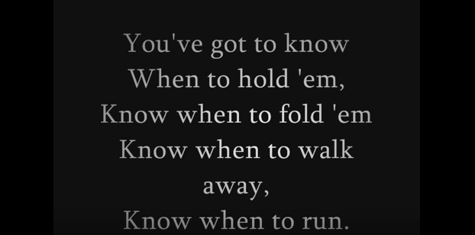
Statutory Speedy Trial Demands

Slide 3
Basics of the constitutional speedy analysis
The analysis has two stages. First, the court must determine whether the interval from the accused's arrest, indictment, or other formal accusation to the trial is sufficiently long to be considered “presumptively prejudicial.” If not, the speedy trial claim fails at the threshold. If, however, the delay has passed the point of presumptive prejudice, the court must proceed to the second step of the Barker-Doggett analysis, which requires the application of a delicate, context-sensitive, four-factor balancing test to determine whether the accused has been deprived of the right to a speedy trial.
Ruffin v. State, 284 Ga. 52, 55, 663 S.E.2d 189, 195 (2008) (citations omitted).

Slide 4
Where do we lose?
[W]ith respect to the Barker v. Wingo analysis, it should be recognized that delayed assertion of the right to a speedy trial and lack of prejudice are the two factors that most often weigh heavily against defendants and which then support the overall conclusion that speedy trial rights have not been violated.
Phan v. State, 287 Ga. 697, 700, 699 S.E.2d 9, 12 (2010) adopted, (Ga. Super. June 17, 2011)

Slide 5
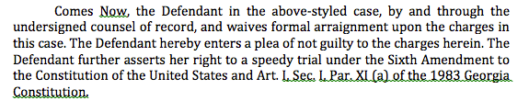
Assertion of the right: how do we do it?
It would also allow a court to weigh the frequency and force of the objections as opposed to attaching significant weight to a purely pro forma objection.
Barker v. Wingo, 407 U.S. 514, 528-29, 92 S. Ct. 2182, 2191, 33 L. Ed. 2d 101 (1972) (citations omitted).
* YELL AT ME IF I DON’T DISCUSS IMPORTANT STRATEGIC CONSIDERATIONS FOR CASES BEING BOUND OVER TO A STATE/SUPERIOR COURT.

Slide 6
Establishing prejudice in the constitutional speedy context
Prejudice, of course, should be assessed in the light of the interests of defendants which the speedy trial right was designed to protect. This Court has identified three such interests: (i) to prevent oppressive pretrial incarceration; (ii) to minimize anxiety and concern of the accused; and (iii) to limit the possibility that the defense will be impaired. Of these, the most serious is the last, because the inability of a defendant adequately to prepare his case skews the fairness of the entire system. If witnesses die or disappear during a delay, the prejudice is obvious. There is also prejudice if defense witnesses are unable to recall accurately events of the distant past. Loss of memory, however, is not always reflected in the record because what has been forgotten can rarely be shown.
Barker v. Wingo, 407 U.S. 514, 532, 92 S. Ct. 2182, 2193, 33 L. Ed. 2d 101 (1972) (citation omitted).

Slide 7
Specific issues relating to prejudice: late amendment

Slide 8
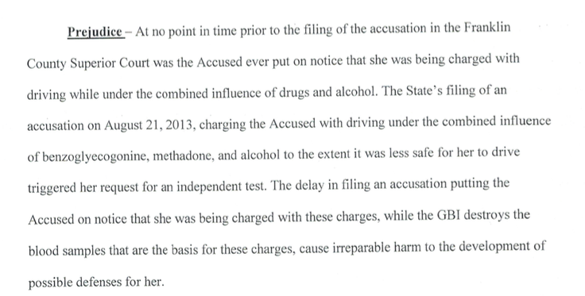
Specific issues relating to prejudice: destruction of samples

Slide 9
Specific issues relating to prejudice: pre-trial incarceration
However, we disagree with the trial court's determination that there was no evidence of prejudice for the period of time that Leopold subsequently served in jail after his release. The record shows that Leopold was later arrested for an unrelated probation violation, and as a result, was held in the DeKalb County jail from December 18, 2008 until the start of his trial. Leopold argues that the delay in this case caused him to lose the possibility of serving this sentence concurrently with the nine months he served on his sentence for the probation violation. This Court has previously recognized that with respect to a defendant incarcerated on other charges, a delay in bringing such a person to trial may be prejudicial because the defendant may forego the opportunity to receive a sentence that is at least partially concurrent with the one he is serving. Johnson, 313 Ga.App. at 904(2)(d), 723 S.E.2d 100 (citing Smith v. Hooey, 393 U.S. 374, 378, 89 S.Ct. 575, 21 L.Ed.2d 607 (1969)). Thus, the trial court erred in failing to consider this factor. However, our Supreme Court has consistently held that “when a defendant is already incarcerated for unrelated offenses, there is minimal possibility of oppressive pretrial incarceration.” See Williams, 279 Ga. at 109(1)(d), 610 S.E.2d 32 (citing cases).
Leopold v. State, No. A15A0783, 2015 WL 5238136, at *5 (Ga. Ct. App. Sept. 8, 2015) (emphasis added).

Slide 10
Implied Consent: The Advisement
        Timing of the Implied Consent Warning: After Arrest
Delay in the Advisement of Implied Consent Warning
Misstatement Regarding the Legal Limit
Coercion to Submit to the Breath Test: “Blow Below and You Go Home”
Rescission of the Refusal
Statements Regarding Out-of-State License Being Suspended

Slide 11
Implied Consent: Independent Test
Independent Test Requests
Timing of the Request for an Independent Test
Limitations on Facilities for the Administration of Independent Test

Slide 12
 | Par. 16 | 4th Amendment | Misleading Info
Field Tests | Applicable – look to circumstances | Not applicable | **
Refusal of Field Tests | Inadmissible | Not applicable | **
Breath Tests | Currently pending in Bob’s case | Not a winner | Currently pending in Bob’s case
Refusal of Breath Tests | Inadmissible | ** | **
Blood Tests | Look at the administration | Cases pending* | Cases pending*
Refusal of Blood Tests | Look at the administration | Cases pending* | **
Urine Tests | Should be applicable – case not pending* | Should be applicable – case not pending* | Should be applicable – case not pending*
Refusal of Urine Tests | Currently pending | May be addressed | **

Slide 13
Specific issues relating to prejudice: inability to produce witnesses - THINK STRATEGICALLY ABOUT THIS ISSUE
And with respect to the impairment of his defense, Leopold argues that had Blackford not testified at trial, the testimony of two defense witnesses as to allegedly exculpatory statements made by Blackford would have been uncontroverted. However, Leopold provides no citation to authority to support his argument that the State's inability to locate and present testimony from Blackford in order to make its case is the type of prejudice the Barker factors are designed to address, and we find none. The record confirms that Leopold was able to present evidence in support of his defense, he does not argue that the delay prevented him from obtaining any evidence or testimony, and his only contention is that the delay strengthened the State's case, to his detriment. See Robinson v. State, 287 Ga. 265, 269(1)(d), 695 S.E.2d 201 (2010) (prejudice factor does not weigh in the defendants' favor where “no witnesses have died or disappeared; there is no evidence that witnesses have lost their memories; and the defense strategy remained unchanged”). Cf. Johnson, 313 Ga.App. at 905(2)(d)(iii), 723 S.E.2d 100 (if a witness that could supply material evidence for the defense dies or disappears during the delay, prejudice may be established). Moreover, the State's need to locate a missing witness whose testimony is required for trial is one of the specific reasons recognized by the United States Supreme Court that may justify a delayed trial. See Barker, 407 U.S. at 531, 92 S.Ct. 2182 (“[A] valid reason, such as a missing witness, should serve to justify appropriate delay.”).
Leopold v. State, No. A15A0783, 2015 WL 5238136, at *5 (Ga. Ct. App. Sept. 8, 2015) (citation omitted).

Slide 14
Specific issues relating to prejudice: anxiety and concern suffered by the Defendant
Regarding anxiety and concern, the trial court found that Takyi suffered unusual and extreme anxiety and emotional pain due to her uncertain immigration status, such that she was “frightened that at any time her unresolved immigration status could force her to leave the U.S.” The trial court heard testimony from Takyi and her attorneys about the actions they took regarding her pending citizenship application and the emotional impact the attorneys understood the situation to have on Takyi.
Takyi, 314 Ga.App. at 448(1), 724 S.E.2d 459. On remand, the trial court, explicitly disregarding hearsay and relying exclusively on the uncontradicted testimony of Takyi and her attorneys, found that Takyi suffered an unusual amount of stress and anxiety due to the delayed resolution of her case. Because it ignored the hearsay identified in the prior appeal to reach its decision, the trial court properly exercised its discretion in weighing the final factor slightly in Takyi's favor.
State v. Takyi, 322 Ga. App. 832, 838-39, 747 S.E.2d 24, 30 (2013)

Slide 15
1. Refusal to submit to field sobriety tests (I messed up in Mitchell)
2. Constitutional Challenges to Voluntariness (AND MISLEADING INFORMATION) of Breath Testing –Elliott
3. Constitutional Challenges to Voluntariness (AND MISLEADING INFORMATION) of Blood Testing – Nightingale, et al.
3. Harper challenges – HGN for drugs, DRE tests (almost all), toxicologist opinions of impairment
What are the issues that are coming?

Slide 16
Refusal to Submit to Field Sobriety Tests
Whatever the specific basis for Price’s holding, it is at odds with our conclusion that neither Georgia statutory nor constitutional law requires a Miranda warning or something like it in this context. Although Price’s holding about field sobriety tests — which encompass a variety of tests with different characteristics, but not a breath test of the sort at issue here and in Olevik and Elliott — does not directly control the issue of whether the giving of Miranda warnings or something similar is a condition of admissibility of the results of a breath test performed by a suspect in custody, there is no principled basis for distinguishing Price’s holding from the issue before us today.
**State v. Turnquest, 305 Ga. 758, 773, 827 S.E.2d 865, 877 (2019) – DON’T LET ME GO FORWARD WITHOUT DISCUSSING THIS CASE. MIRANDA DOESN’T APPLY TO PAR. 16.

Slide 17
Refusal to Submit to Field Sobriety Tests
Elliott v. State, No. S18A1204, 2019 WL 654178, at *26 (Ga. Feb. 18, 2019):
Having considered the text of Paragraph XVI and the context in which it was enacted, as well as all of the arguments made by the parties and the amici, we conclude that Paragraph XVI precludes admission of evidence that a suspect refused to consent to a breath test.³¹ Consequently, we conclude that OCGA §§ 40-5-67.1 (b) and 40-6-392 (d) are unconstitutional to the extent that they allow a defendant’s refusal to submit to a breath test to be admitted into evidence at a criminal trial.

Slide 18
Submission to Breath (and URINE) Test After Elliott
Old implied consent or new?
Old implied consent? Challenge voluntariness and misleading information.
  He/she was told refusal could be introduced. That’s false, and it is the type of information that would lead to submission to the test. Sauls, Kitchens, etc.
  New implied consent? Voluntariness analysis.

Slide 19
Submission to a Blood Test
Old implied consent or new?
Old implied consent? Challenge voluntariness and misleading information.
  He/she was told refusal could be introduced. That’s false, and it is the type of information that would lead to submission to the test. Sauls, Kitchens, etc.
  Rely upon Miley, Mackey, Gardiner, etc. for proposition that refusal of search cannot be used against a defendant.
  New implied consent? Voluntariness analysis.

Slide 20


Refusal of field sobriety tests
The issue of refusal of fields constituting a violation of Miranda is relatively well settled, but the whether the refusal of field sobriety tests constitutes an impermissible comment upon a search remains open.

Slide 21
Harper Challenges
The Harper rule requires that the Court in a criminal case determine “whether a given scientific principle or technique is a phenomenon that may be verified with such certainty that it is competent evidence in a court of law....” Id. at 525. Otherwise stated, the Court must determine whether the scientific principle or technique “has reached a scientific stage of verifiable certainty” or “‘rests upon the laws of nature.’” Id. (citations omitted). “[E]vidence based on a scientific principle or technique is admissible only if the science underlying the evidence is a phenomenon that may be verified with such certainty that it is competent evidence in a court of law.” Parker v. State, 307 Ga.App. 61, 704 S.E.2d 438 (2010).

Slide 22
Harper Challenges – Scientific Reliabilty (Generally and As Administered In Case)
Opinion of toxicologist as to impairment by drugs
Lack of convergence & DRE Protocol Generally
Rhomberg / Romberg Test (Mitchell v. State)
HGN for drugs

Slide 23
Thank you!
ALL MOTIONS, BRIEFS, & ORDERS at:
https://www.thesessionslawfirm.com/resources/
Ben Sessions
@Ben_Sessions
TheSessionsLawFirm.com
Got a question?
Follow me @Ben_Sessions and send me tweet

