Slide 1
Surviving the Courtroom
ALL MOTIONS, BRIEFS, & ORDERS at:
https://tinyurl.com/y3oanma9
Ben Sessions
@Ben_Sessions
TheSessionsLawFirm.com
Lister & Holt’s 12th Annual Criminal Law Seminar
October 17, 2019

Slide 2

The pursuit of motions can be a frustrating endeavor…
particularly if you only define success in terms having your motion granted.

Slide 3

We hardly ever hear “motion granted”…

Slide 4
Dirty Dozen Rules for Motions
1. We influence and/or control most issues that get litigated.
2. We should influence and/or control how most issues get litigated.
3. You do not have to win a motion to have it aid you in the case.
4. Not all issues must be litigated. What we do not litigate may be more important than what we do litigate.
5. Choose your battles. The goal is to win the war.
6. Do not ever underestimate the power of giving the other side the opportunity to muck up.
7. Know when and why to walk away from an issue. Plan on it.
8. Do not assume that the opposition knows anything about what you know.
9. Gratuitously being obnoxious usually accomplishes nothing. Planned obnoxiousness is different.
10. Be careful what you ask for, you may get it.
11. A half-cocked effort will usually produce half-assed results.
12. Do not make the other sides arguments for them: if they are not smart enough to make it themselves, you should be smart enough not to teach them their own argument.

Slide 5
Understanding Your Goals in a Motion Hearing
Five Basic Purposes of Motions:
1) Exclusion of unfavorable evidence;
2) Trial preparation;
3) Improving the plea offer;
4) Diversion; and,
5) Dismissal of the charges.

Slide 6
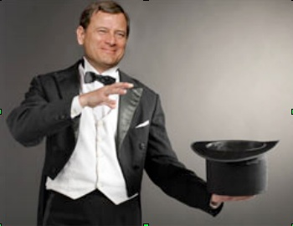
Exclusion of Unfavorable Evidence
A motion to suppress or motion in limine is your opportunity to change the facts of the case.

Slide 7
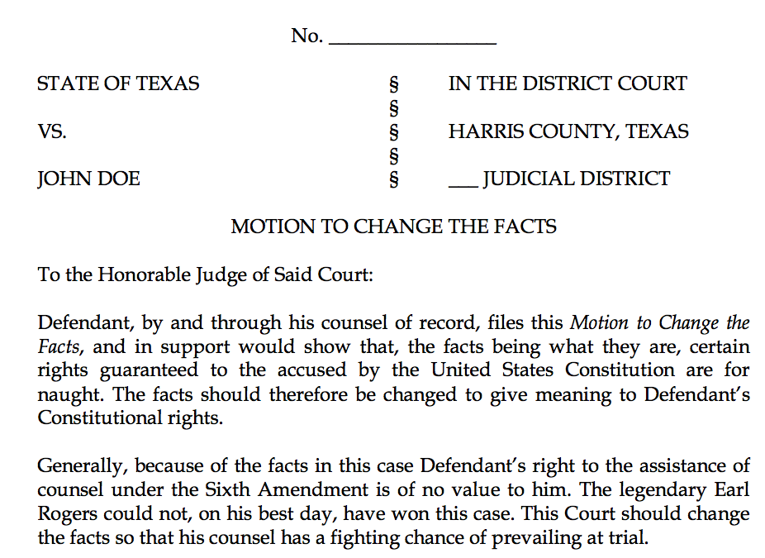

Slide 8
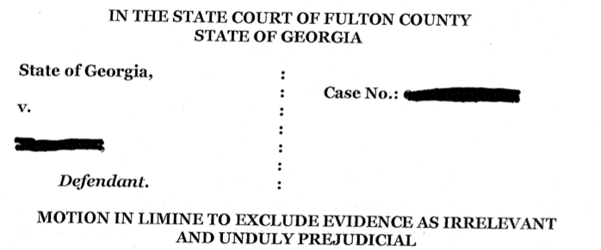
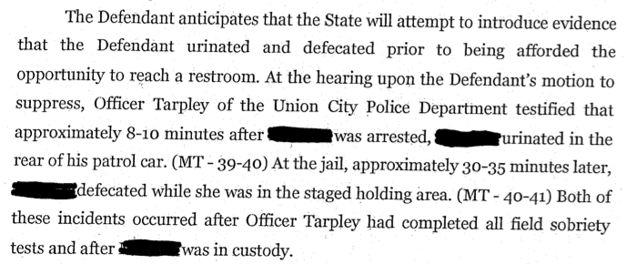

Slide 9
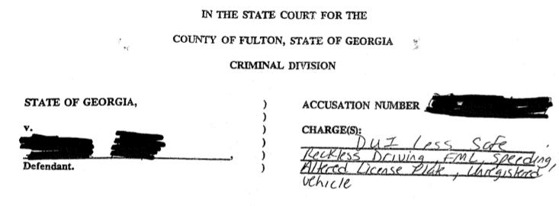
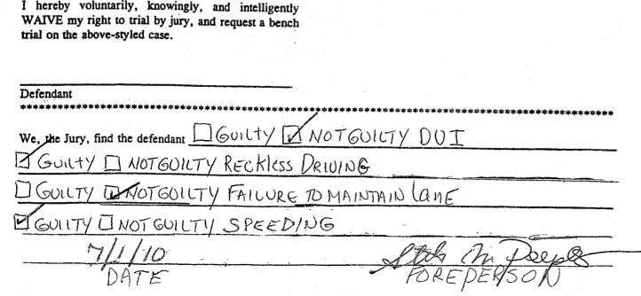

Slide 10
Motion to Suppress or Motion in Limine:
Yes, It Does Matter
AUTHORITY
Motion to Suppress: O.C.G.A. 17-5-30, which is also referred to in older case law as Section 13 of an Act of 1966 (Ga.L.1966, pp. 567, 571; Code Ann. 27-313)
Motion in Limine: statutory, regulations, or common law
Notes:
O.C.G.A. 17-5-30, which is also referred to in older case law as Section 13 of an Act of 1966 (Ga.L.1966, pp. 567, 571; Code Ann. 27-313),

Slide 11

Motion to Suppress or Motion in Limine:
Yes, It Does Matter
Time Limitations on Filing
Motion to Suppress: within 10 days after the date of arraignment
Motion in Limine: at any time

Slide 12
Motion to Suppress or Motion in Limine:
Yes, It Does Matter
Particularization

Slide 13
Motion to Suppress or Motion in Limine:
What is sufficient “particularization” of a motion to suppress?
O.C.G.A. § 17-5-30 (b) states, in relevant part:
The motion shall be in writing and state facts showing that the search and seizure were unlawful.

Slide 14
What is sufficient “particularization” of a motion to suppress?
(1) the date of the stop,
(2) the identity of the person stopped,
(3) the identity of the officer who made the stop,
(4) the law enforcement organization with which he was affiliated,
(5) the nature of the stop (e.g., traffic stop),
(6) the offenses with which Goodman was charged, and
(7) the conclusion that no such violations occurred which would justify the stop.
State v. Goodman, 220 Ga. App. 169, 469 S.E.2d 327 (1996).

Slide 15
Motion to Suppress or Motion in Limine:
Yes, It Does Matter
O.C.G.A. 17-5-30, which is also referred to in older case law as Section 13 of an Act of 1966 (Ga.L.1966, pp. 567, 571; Code Ann. 27-313), illegal for reasons other than unlawful search and seizure. Norrell v. State, 116 Ga.App. 479(3), 157 S.E.2d 784. By its clear terms, Section 13 furnishes a procedural device for the protection of constitutional guaranties against unreasonable search and seizure only.
Hawkins v. State, 117 Ga. App. 70, 71, 159 S.E.2d 440 (1967)(emphasis added).

Slide 16
Motion to Suppress
Because the burden is on those officers who conduct a search without a warrant to show that the search was conducted pursuant to an exception to the Fourth Amendment warrant requirement, it can be said that a search without a warrant is presumed to be invalid and the burden is on the state to show that the warrantless search was valid. Mincey v. Arizona, 437 U.S. 385, 390-391, 98 S.Ct. 2408, 2412-2413, 57 L.Ed.2d 290 (1978); McDonald v. United States, 335 U.S. 451, 456, 69 S.Ct. 191, 193, 93 L.Ed. 153 (1948).

Slide 17
Motion to Suppress
Searches are conducted either with or without a search warrant. ‘The most basic constitutional rule in this area is that ‘searches conducted outside the judicial process, without prior approval by judge or magistrate, are per se unreasonable under the Fourth Amendment-subject only to a few specifically established and well-delineated exceptions.’ The exceptions are ‘jealously and carefully drawn,’ and there must be ‘a showing by those who seek ... that the exigencies of the situation made that course imperative.’ ‘[T]he burden is on those seeking the exemption to show the need for it.’’ Coolidge v. New Hampshire, 403 U.S. 443, 454-455, 91 S.Ct. 2022, 2032, 29 L.Ed.2d 564 (1971) (citations omitted).
State v. Slaughter, 252 Ga. 435, 436, 315 S.E.2d 865 (1984):

Slide 18
Motion to Suppress
“Once a defendant files a motion to suppress alleging an illegal search and seizure, the state bears the burden of proving that the search is lawful.”
State v. Kuhnhausen, 289 Ga. App. 489, 657 S.E.2d 592 (2008), citing State v. King, 287 Ga. App. 680, 652 S.E.2d 574 (2007).

Slide 19
Motion in Limine
“‘In limine’ means ‘at the threshold’ or before the trial begins.” State v. Johnston, 249 Ga. 413, 414 (fn. 3), 291 S.E.2d 543 (1982), quoting, Stevens v. State, 265 Ind. 411, 354 N.E.2d 727, 733 (1976).

Slide 20
Motion in Limine
“Any challenge to the procedures used in reading [the defendant] his statutory implied consent warning, OCGA § 40-5-67.1(b)(2), and the proper working of the Intoxilyzer 5000 machine would have been appropriately raised by a motion in limine, which was not done here.”
Goddard v. State, 244 Ga. App. 730, 731, 536 S.E.2d 160 (2000).

Slide 21
Preparing for Motions
If at all possible, go into motions with a developed theory of the case.
If you are doing motions immediately prior to trial, you better have a theory.

Slide 22
To Brief or Not to Brief?
That’s not really a question.
See Rule No. 11

Slide 23
Effectively Attacking Probable Cause:
Credibility is Key
Success in most probable cause hearings requires us to call into question the credibility of the evidence or the arresting officer.
Credibility of witnesses and the weight to be given their testimony is a decision-making power that lies solely with the trier of fact. The trier of fact is not obligated to believe a witness even if the testimony is uncontradicted and may accept or reject any portion of the testimony.
Tate v. State, 264 Ga. 53, 56, 440 S.E.2d 646 (1994).
A rational trier of fact can choose to reject even “undisputed” testimony if that fact finder believes that witness's testimony to be unreliable. Factors such as demeanor, contradictory or inconsistent statements and evidence that an officer had “ulterior motives” can all lead a finder of fact to disregard testimony by an officer that an accused was violating the law.
Tate v. State, 264 Ga. 53, 56 (fn. 5), 440 S.E.2d 646 (1994).

Slide 24
Learn Your Favorite Probable Cause Cases:
Pick out your favorite PC cases, learn them, and get really good at arguing that your facts fit within those cases.

Slide 25
 | State v. Handley 294 Ga. App. 236 (2008) | State v. Gray 267 Ga. App. 753 (2004) | State v. Batty 259 Ga. App. 431 (2003) | State v. Ellison 271 Ga. App. 898 (2005) | Case at Bar
Basis for Stop | Tag Violation | Traffic Accident | Red light violation and following too closely | Roadblock | Speeding
Odor of Alcohol | Odor of Alcohol (Noted on Test Printout as “Very Strong” but no testimony) | Odor of Alcohol | Odor of Alcohol | Strong Odor of Alcohol | Odor of Alcohol
Admission of Drinking | Initial Denial of Drinking but Later Admission | Admission of Drinking | Admission of Drinking | Initial Denial of Drinking but Later Admission | Admission of Drinking
Appearance of Eyes | Noted on Test Printout as Bloodshot Eyes but no testimony | Bloodshot Eyes | None | Red, Bloodshot, and Watery Eyers | Red and Bloodshot Eyes

Slide 26
 | State v. Handley 294 Ga. App. 236 (2008) | State v. Gray 267 Ga. App. 753 (2004) | State v. Batty 259 Ga. App. 431 (2003) | State v. Ellison 271 Ga. App. 898 (2005) | Case at Bar
Ability to Stand and Walk Normally | No indication | Unsteady Gait | Slight unsteadiness but walked to rear of car fine | No stumbling or loss of balance when exiting vehicle | No trouble exiting vehicle, standing, and walking
Alco-Sensor Result | Positive Alco-Sensor Result | Positive Alco-Sensor Result | Positive Alco-Sensor Result | None | Positive Alco-Sensor Result
Dazed | No indication | Dazed Manner | No indication | No indication | No indication
Speech | No indication | Slurred Speech | No indication | No indication | No Slurred Speech
HGN | None | Failed HGN Test | None | Refused and Stated “I’ve been arrested for DUI before, and I do not think I can do them” | Not Administered
Walk and Turn | No Walk and Turn | No Walk and Turn | Passed | Refused and Stated “I’ve been arrested for DUI before, and I do not think I can do them” | Not Administered
One Leg Stand | No One Leg Stand | No One Leg Stand | Passed | Refused and Stated “I’ve been arrested for DUI before, and I do not think I can do them” | Not Administered

Slide 27
 | State v. Handley 294 Ga. App. 236 (2008) | State v. Gray 267 Ga. App. 753 (2004) | State v. Batty 259 Ga. App. 431 (2003) | State v. Ellison 271 Ga. App. 898 (2005) | Case at Bar
Ability to Produce License | Failed to Produce License | No indication | No indication | No indication | Produced license
Summary of Holding | No credibility determination or disputed Facts. Held insufficient to establish probable cause | Affirmed trial court’s decision granting motion to suppress. | Affirmed trial court’s decision granting motion to suppress | Affirmed trial court’s decision granting motion to suppress

Slide 28
Implied Consent: The Advisement
        Timing of the Implied Consent Warning: After Arrest
Delay in the Advisement of Implied Consent Warning
Misstatement Regarding the Legal Limit
Coercion to Submit to the Breath Test: “Blow Below and You Go Home”
Rescission of the Refusal
Statements Regarding Out-of-State License Being Suspended

Slide 29
Implied Consent: Independent Test
Independent Test Requests
Timing of the Request for an Independent Test
Limitations on Facilities for the Administration of Independent Test

Slide 30
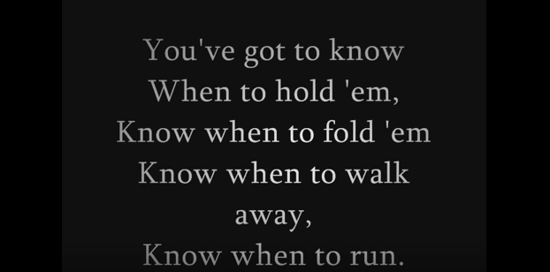
Statutory Speedy Trial Demands

Slide 31
Basics of the constitutional speedy analysis
The analysis has two stages. First, the court must determine whether the interval from the accused's arrest, indictment, or other formal accusation to the trial is sufficiently long to be considered “presumptively prejudicial.” If not, the speedy trial claim fails at the threshold. If, however, the delay has passed the point of presumptive prejudice, the court must proceed to the second step of the Barker-Doggett analysis, which requires the application of a delicate, context-sensitive, four-factor balancing test to determine whether the accused has been deprived of the right to a speedy trial.
Ruffin v. State, 284 Ga. 52, 55, 663 S.E.2d 189, 195 (2008) (citations omitted).

Slide 32
Where do we lose?
[W]ith respect to the Barker v. Wingo analysis, it should be recognized that delayed assertion of the right to a speedy trial and lack of prejudice are the two factors that most often weigh heavily against defendants and which then support the overall conclusion that speedy trial rights have not been violated.
Phan v. State, 287 Ga. 697, 700, 699 S.E.2d 9, 12 (2010) adopted, (Ga. Super. June 17, 2011)

Slide 33
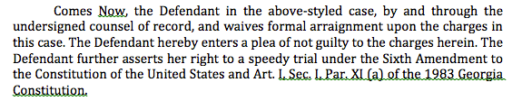
Assertion of the right: how do we do it?
It would also allow a court to weigh the frequency and force of the objections as opposed to attaching significant weight to a purely pro forma objection.
Barker v. Wingo, 407 U.S. 514, 528-29, 92 S. Ct. 2182, 2191, 33 L. Ed. 2d 101 (1972) (citations omitted).
* YELL AT ME IF I DON’T DISCUSS IMPORTANT STRATEGIC CONSIDERATIONS FOR CASES BEING BOUND OVER TO A STATE/SUPERIOR COURT.

Slide 34
Establishing prejudice in the constitutional speedy context
Prejudice, of course, should be assessed in the light of the interests of defendants which the speedy trial right was designed to protect. This Court has identified three such interests: (i) to prevent oppressive pretrial incarceration; (ii) to minimize anxiety and concern of the accused; and (iii) to limit the possibility that the defense will be impaired. Of these, the most serious is the last, because the inability of a defendant adequately to prepare his case skews the fairness of the entire system. If witnesses die or disappear during a delay, the prejudice is obvious. There is also prejudice if defense witnesses are unable to recall accurately events of the distant past. Loss of memory, however, is not always reflected in the record because what has been forgotten can rarely be shown.
Barker v. Wingo, 407 U.S. 514, 532, 92 S. Ct. 2182, 2193, 33 L. Ed. 2d 101 (1972) (citation omitted).

Slide 35
Specific issues relating to prejudice: late amendment

Slide 36
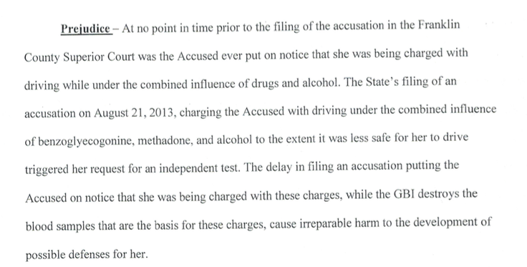
Specific issues relating to prejudice: destruction of samples

Slide 37
Specific issues relating to prejudice: pre-trial incarceration
However, we disagree with the trial court's determination that there was no evidence of prejudice for the period of time that Leopold subsequently served in jail after his release. The record shows that Leopold was later arrested for an unrelated probation violation, and as a result, was held in the DeKalb County jail from December 18, 2008 until the start of his trial. Leopold argues that the delay in this case caused him to lose the possibility of serving this sentence concurrently with the nine months he served on his sentence for the probation violation. This Court has previously recognized that with respect to a defendant incarcerated on other charges, a delay in bringing such a person to trial may be prejudicial because the defendant may forego the opportunity to receive a sentence that is at least partially concurrent with the one he is serving. Johnson, 313 Ga.App. at 904(2)(d), 723 S.E.2d 100 (citing Smith v. Hooey, 393 U.S. 374, 378, 89 S.Ct. 575, 21 L.Ed.2d 607 (1969)). Thus, the trial court erred in failing to consider this factor. However, our Supreme Court has consistently held that “when a defendant is already incarcerated for unrelated offenses, there is minimal possibility of oppressive pretrial incarceration.” See Williams, 279 Ga. at 109(1)(d), 610 S.E.2d 32 (citing cases).
Leopold v. State, No. A15A0783, 2015 WL 5238136, at *5 (Ga. Ct. App. Sept. 8, 2015) (emphasis added).

Slide 38
Specific issues relating to prejudice: inability to produce witnesses - THINK STRATEGICALLY ABOUT THIS ISSUE
And with respect to the impairment of his defense, Leopold argues that had Blackford not testified at trial, the testimony of two defense witnesses as to allegedly exculpatory statements made by Blackford would have been uncontroverted. However, Leopold provides no citation to authority to support his argument that the State's inability to locate and present testimony from Blackford in order to make its case is the type of prejudice the Barker factors are designed to address, and we find none. The record confirms that Leopold was able to present evidence in support of his defense, he does not argue that the delay prevented him from obtaining any evidence or testimony, and his only contention is that the delay strengthened the State's case, to his detriment. See Robinson v. State, 287 Ga. 265, 269(1)(d), 695 S.E.2d 201 (2010) (prejudice factor does not weigh in the defendants' favor where “no witnesses have died or disappeared; there is no evidence that witnesses have lost their memories; and the defense strategy remained unchanged”). Cf. Johnson, 313 Ga.App. at 905(2)(d)(iii), 723 S.E.2d 100 (if a witness that could supply material evidence for the defense dies or disappears during the delay, prejudice may be established). Moreover, the State's need to locate a missing witness whose testimony is required for trial is one of the specific reasons recognized by the United States Supreme Court that may justify a delayed trial. See Barker, 407 U.S. at 531, 92 S.Ct. 2182 (“[A] valid reason, such as a missing witness, should serve to justify appropriate delay.”).
Leopold v. State, No. A15A0783, 2015 WL 5238136, at *5 (Ga. Ct. App. Sept. 8, 2015) (citation omitted).

Slide 39
Specific issues relating to prejudice: anxiety and concern suffered by the Defendant
Regarding anxiety and concern, the trial court found that Takyi suffered unusual and extreme anxiety and emotional pain due to her uncertain immigration status, such that she was “frightened that at any time her unresolved immigration status could force her to leave the U.S.” The trial court heard testimony from Takyi and her attorneys about the actions they took regarding her pending citizenship application and the emotional impact the attorneys understood the situation to have on Takyi.
Takyi, 314 Ga.App. at 448(1), 724 S.E.2d 459. On remand, the trial court, explicitly disregarding hearsay and relying exclusively on the uncontradicted testimony of Takyi and her attorneys, found that Takyi suffered an unusual amount of stress and anxiety due to the delayed resolution of her case. Because it ignored the hearsay identified in the prior appeal to reach its decision, the trial court properly exercised its discretion in weighing the final factor slightly in Takyi's favor.
State v. Takyi, 322 Ga. App. 832, 838-39, 747 S.E.2d 24, 30 (2013)

Slide 40
1. Refusal to submit to field sobriety tests (I messed up in Mitchell)
2. Constitutional Challenges to Voluntariness (AND MISLEADING INFORMATION) of Breath Testing –Elliott
3. Constitutional Challenges to Voluntariness (AND MISLEADING INFORMATION) of Blood Testing – Nightingale, et al.
3. Harper challenges – HGN for drugs, DRE tests (almost all), toxicologist opinions of impairment
What are the issues that are coming?

Slide 41
Refusal to Submit to Field Sobriety Tests
Whatever the specific basis for Price’s holding, it is at odds with our conclusion that neither Georgia statutory nor constitutional law requires a Miranda warning or something like it in this context. Although Price’s holding about field sobriety tests — which encompass a variety of tests with different characteristics, but not a breath test of the sort at issue here and in Olevik and Elliott — does not directly control the issue of whether the giving of Miranda warnings or something similar is a condition of admissibility of the results of a breath test performed by a suspect in custody, there is no principled basis for distinguishing Price’s holding from the issue before us today.
**State v. Turnquest, 305 Ga. 758, 773, 827 S.E.2d 865, 877 (2019) – DON’T LET ME GO FORWARD WITHOUT DISCUSSING THIS CASE. MIRANDA DOESN’T APPLY TO PAR. 16.

Slide 42
Refusal to Submit to Field Sobriety Tests
Elliott v. State, No. S18A1204, 2019 WL 654178, at *26 (Ga. Feb. 18, 2019):
Having considered the text of Paragraph XVI and the context in which it was enacted, as well as all of the arguments made by the parties and the amici, we conclude that Paragraph XVI precludes admission of evidence that a suspect refused to consent to a breath test.³¹ Consequently, we conclude that OCGA §§ 40-5-67.1 (b) and 40-6-392 (d) are unconstitutional to the extent that they allow a defendant’s refusal to submit to a breath test to be admitted into evidence at a criminal trial.

Slide 43
Submission to Breath (and URINE) Test After Elliott
Old implied consent or new?
Old implied consent? Challenge voluntariness and misleading information.
  He/she was told refusal could be introduced. That’s false, and it is the type of information that would lead to submission to the test. Sauls, Kitchens, etc.
  New implied consent? Voluntariness analysis.

Slide 44
Submission to a Blood Test
Old implied consent or new?
Old implied consent? Challenge voluntariness and misleading information.
  He/she was told refusal could be introduced. That’s false, and it is the type of information that would lead to submission to the test. Sauls, Kitchens, etc.
  Rely upon Miley, Mackey, Gardiner, etc. for proposition that refusal of search cannot be used against a defendant.
  New implied consent? Voluntariness analysis.

Slide 45


Refusal of field sobriety tests
The issue of refusal of fields constituting a violation of Miranda is relatively well settled, but the whether the refusal of field sobriety tests constitutes an impermissible comment upon a search remains open.

Slide 46
Harper Challenges
The Harper rule requires that the Court in a criminal case determine “whether a given scientific principle or technique is a phenomenon that may be verified with such certainty that it is competent evidence in a court of law....” Id. at 525. Otherwise stated, the Court must determine whether the scientific principle or technique “has reached a scientific stage of verifiable certainty” or “‘rests upon the laws of nature.’” Id. (citations omitted). “[E]vidence based on a scientific principle or technique is admissible only if the science underlying the evidence is a phenomenon that may be verified with such certainty that it is competent evidence in a court of law.” Parker v. State, 307 Ga.App. 61, 704 S.E.2d 438 (2010).

Slide 47
Harper Challenges – Scientific Reliabilty (Generally and As Administered In Case)
Opinion of toxicologist as to impairment by drugs
Lack of convergence & DRE Protocol Generally
Rhomberg / Romberg Test (Mitchell v. State)
HGN for drugs

Slide 48
Thank you!
ALL MATERIALS AT:
https://tinyurl.com/y3oanma9
Ben Sessions
@Ben_Sessions
TheSessionsLawFirm.com
Got a question?
Follow me @Ben_Sessions and send me tweet

