Slide 1
Ben Sessions
The Sessions Law Firm, LLC
(470) 225-7710
Ben@SessionsCriminalDefense.com www.SessionsCriminalDefense.com

Slide 2

The possibility of mouth alcohol is dangerous stuff when the State relies upon a breath test to prove a “per se” charge.
2012 Refresher Manual, p. 9
** This quote is not present in prior Operator Manuals

Slide 3


Slide 5
Why is the Mouth Alcohol Defense my “go-to” defense?
1. My clients are broke, and it is affordable.
2. They want a Not Guilty, and it works.
Notes:
A mouth alcohol defense can be presented with very little expense, or you can spend a lot of money on it. Generally, my clients don’t have a lot to spend on experts so I have to do some of the heavy lifting on my own.
I want to be clear about 1 thing at the outset: This is not a complicated breath test defense. It requires about 20 minutes of study of the Intox manual, and some planning for motions or ALS hearings and open records requests.
My goal today is to walk you through a Mouth Alcohol Defense, and give you enough information to walk into court monday and use it. I use this defense all of the time, and if I can do it, I know that you can do it effectively.
I have heard very, very good lawyers say things, such as, “I don’t plow with the other man’s mule.” Translated: They don’t try a case and use the state’s witnesses as their own. “Would you buy a Ferrari and put re-tread tires on it?” - Translated: Don’t hire a good lawyer and not equip with the tools to do the job. I understand this sentiment, but I don’t agree with it.
Breath test cases can be tried well and won without a breath test expert. It’s can be more work. It can be gutwrenching. But it can be done. But you have to have a defense that can be developed through the State’s evidence.

Slide 6
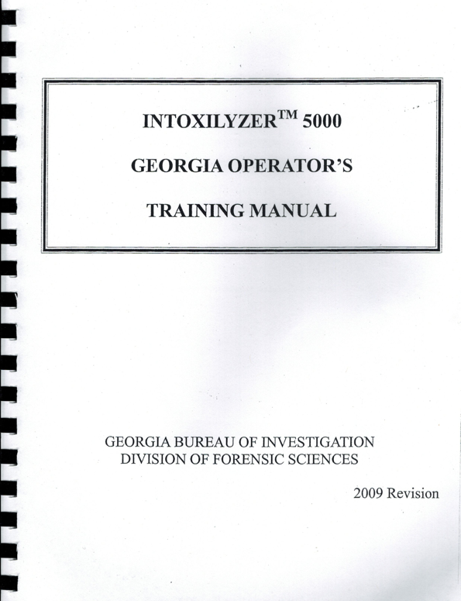
The Mouth Alcohol Defense starts with the Intoxilyzer Operator’s Manual.
Notes:
Great thing about the mouth alcohol defense: it’s based on the training of the breath test operator. We can build upon it fairly simply, but if you needed to try the case without an expert and the state did not call their expert to testify, you could win this case simply using the manual.
If the State calls their expert, as we’ll talk about shortly, there are some very good things you can do to improve your case.

Slide 7
The possibility of mouth alcohol is dangerous stuff when the State relies upon a breath test to prove a “per se” charge.
2012 Refresher Manual, p. 9
** This quote is not present in prior Operator Manuals

Slide 8
3 Safeguards Against Mouth Alcohol From the Manual
20-minute “wait” (OBSERVATION) period
.02 agreement of the samples (the consecutive samples vary by more than .02)
the slope detector in the machine (Invalid Sample)
2009 Manual, p. 26 | 2007 Manual, p. 27 | 2003 Manual, p. 22
2002 Manual, p. 22 | 2012 Refresher Manual, p. 10
Notes:
Every manual that I have includes the statment, “By utilizing the 20 minute wait, the Intoxilyzer 5000’s built in slope or mouth alcohol detector, and the use of replicate samples, the operator can be assured that residual or mouth alcohol with not influence the printed alcohol concentration.”
It does not say that any of 2 of these 3 will assure us that mouth alcohol will not influence the result. The Division of Forensic Sciences of the GBI has determined that all 3 conditions are necessary to assure us that mouth alcohol did not affect the results.

Slide 9
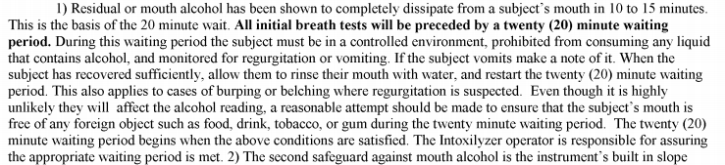
The Mouth Alcohol Problem:
The Intoxilyzer 5000 Operator’s Manual
2009 Manual, p. 25 | 2007 Manual, p. 26 | 2003 Manual, p. 21
2002 Manual, p. 21 | 2012 Refresher Manual, p. 9

Slide 10
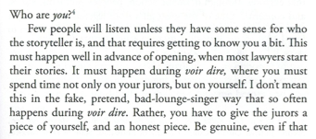
Jury Selection Ideas:
If you show them, they’ll show you
Carl Bettinger, Twelve Heroes, One Voice
Notes:
I used to think that I was a very dry, stick-to-the-facts kind of person in the way that I picked juries and tried cases. Well, it turned out that who I thought I was didn’t translate into wins in front a jury. There is nothing like losing a lot of cases to make you change your personality.
So, what I try to do in jury selection is show juries a little bit of who I am, and I try to show them something that I am not too proud of. For example, when a client sits down at an initial consultation and tells me that they blew a .12 and they don’t have any medical issues, all I think about is that # and, in my heart-of-hearts, I think they are screwed. I rush to judgment without knowing anything else about the case.

Slide 11
Jury Selection Ideas
Common Ground / Shared Values
Rule Followers – The Pros and The Cons

Slide 12
Opening Statement
I spoke with you about my fear of the number.
Ask that they reserve judgment on it until the conclusion.
Challenge the State to show compliance with the 20-minute observation requirement.
Let them know that they will not see compliance with the 20-minute observation requirement established by the

Slide 13
Goals in Cross-Examination of the Arresting Officer and Breath Test Operator
1. Lock them down with regard to the timeline
2. Lock them down with regard to their observation of your client
3. Their observation period consisted of times when they were not watching your client
4. Lock them into their training on the observation period

Slide 14
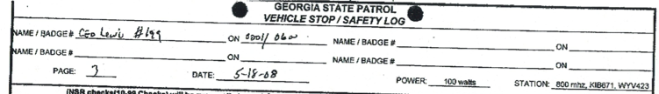

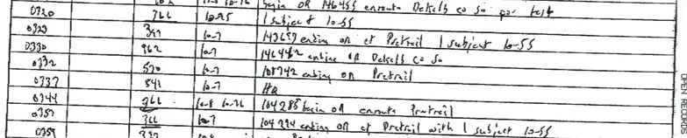
Cross-Examination of the Operator:
The Timeline of Observation Period
USE THE OPEN RECORDS ACT

Slide 15
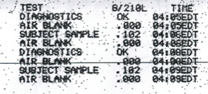
Cross-Examination of the Operator:
The Timeline of Observation Period
9 minutes passed from arrival at the jail to the 1st sample

Slide 16
Cross-Examination of the Operator:
Observation of My Client
1. Did not watch my client during the entirety of the 20-minute period
2. He was in the rear of your patrol car during part of the 20-minutes prior to the breath test
3. Possible he could have burped during the 20-minute period

Slide 17
Cross-Examination of the Operator:
Training on the 20-Minute Wait Period
1. 20-minute wait period is required before each test
2. During the 20-minute period, the suspect is to be:
(1) in a controlled environment,
(2) prohibited from consuming alcohol, and
(3)monitored for regurgitation or vomiting.
3. If vomit, allow them to rinse their mouth with water, and restart the 20-minute wait period.
4. This applies to cases of burping or belching where regurgitation is suspected.

Slide 18
Cross-Examination of the State’s Expert:
STAY FOCUSED ON YOUR GOALS
1. The mouth alcohol detector is not perfect.
2. The Intoxilyzer 5000 can produce results as high as .11 when a person has a true Blood-Alcohol Concentration of .000.
Additional Cross-Examination Areas:
3. You wrote the Intoxilyzer Operator’s Training Manual.
4. You established the Intoxilyzer Operator’s Training Curriculum.
5. In order to be assured that mouth alcohol will not influence the printed alcohol concentration, the 20-minute observation period must followed.

Slide 19
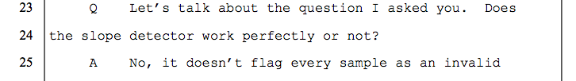
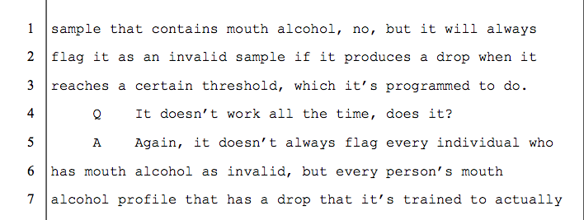
The Mouth Alcohol Detector (SLOPE DETECTOR) is not perfect.

Slide 20
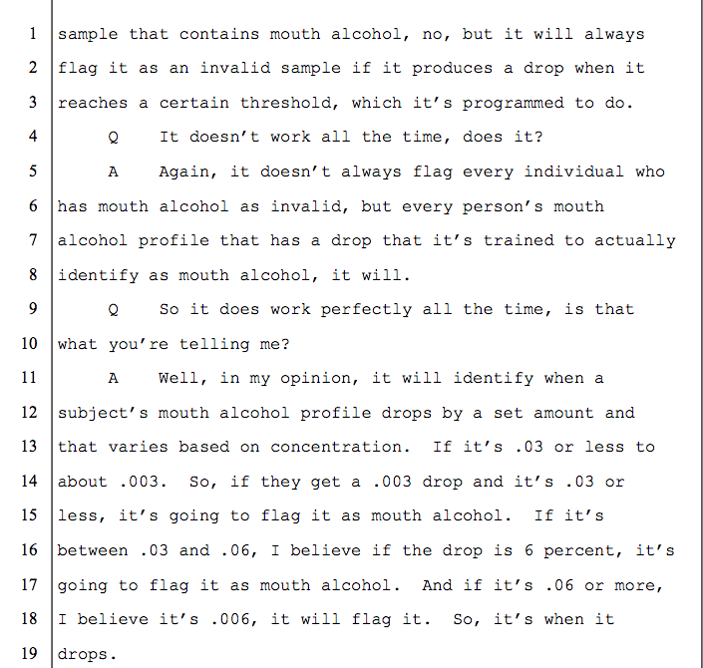
The Mouth Alcohol Detector (SLOPE DETECTOR) is not perfect.

Slide 21
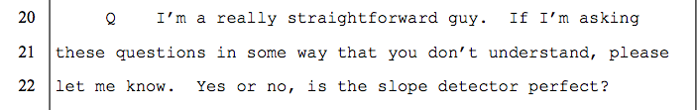
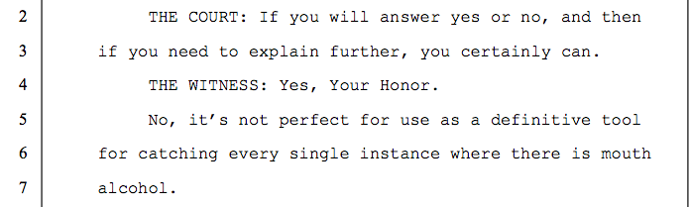
The Mouth Alcohol Detector (SLOPE DETECTOR) is not perfect.

Slide 22
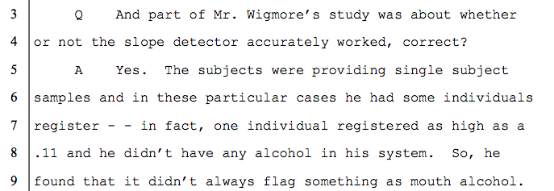
The Mouth Alcohol Detector (SLOPE DETECTOR) -
A .11 Result With a True BAC of .00?

Slide 23
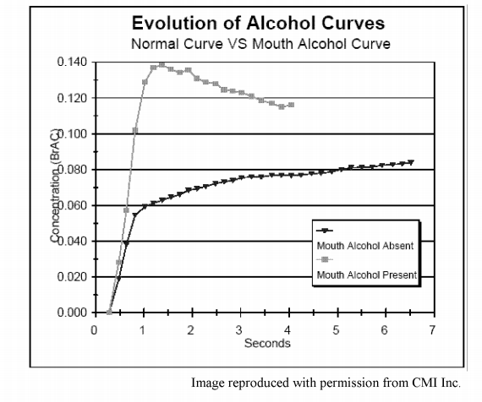
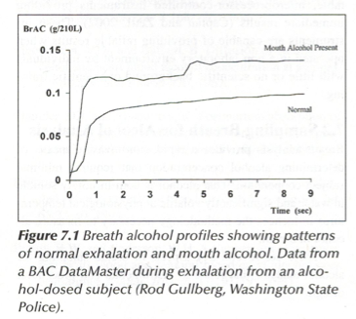
Comparison of Mouth Alcohol Curves
Operator’s Manual
Garriott’s Medical-Legal

Slide 24
Closing
We’re not here fighting over general reliability.
We’re here because we think it’s important that they follow THEIR rules in performing a test.
We asked at the beginning of the trial if the State would simply show us that the rules for performing a breath test were followed.
The evidence does not eliminate mouth alcohol as a problem.

Slide 26
Closing Argument –
Mouth Alcohol Defense
Presumptions:
Jurors will have to make a decision based on their values.
“I charge you that breath alcohol measuring equipment approved by the State Crime Lab is considered accurate if properly operated.”
Johnson v. State
“The presumption of innocence, the burden of proof, and the standard of proof are the fundamental doctrines of American criminal jurisprudence and the bedrock of determining guilt or innocence in a criminal case.”
Little v. State, 230 Ga.App. 803, 806(2), 498 S.E.2d 284 (1998).

